Slide 1
MegaSat Development Board

Slide 2
What is the MegaSat?
The MegaSat is a microprocessor developmental board designed to assist students in learning electronic instrumentation and programming using the Arduino Mega.
It was developed by the Louisiana Space Grant Consortium as a replacement for the BalloonSat developmental board.

Slide 3
Development Background
CanSat was a project conceived by Professor Bob Twiggs at Stanford University’s Space Science Development Laboratory in the late 1990s.
CanSat was designed to be accommodated within a soda can-sized satellite enclosure.
BalloonSat was developed in the early 2000s at LSU by S.B. Ellison and Jim Giammanco as an adaptation of the CanSat.
ACES needed a more convenient way to expand the payload with external devices and wanted the convenience of having on-board components not offered by CanSat. This led to the creation of BalloonSat.
After many years of service, the hardware on the BalloonSat became outdated. The MegaSat was designed to update the hardware.
Notes:
Add to whatever slide ends the history section: <More details about the history of CanSat and BalloonSat are available in the BalloonSat assembly manual.>

Slide 4
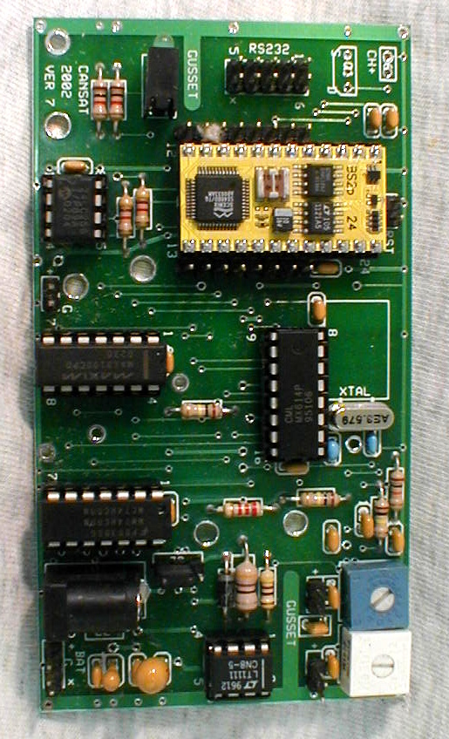
From CanSat to BalloonSat
CanSat featured a BASIC Stamp microcontroller, an additional memory chip for data storage and a modem for connecting to an external radio transmitter/receiver.
ACES payloads did not need the modem of CanSat so this was eliminated, but a number of enhancements were added to better accommodate payloads and allow for easier external expansion for students who wanted to go beyond the baseline features.
CanSat

Slide 5
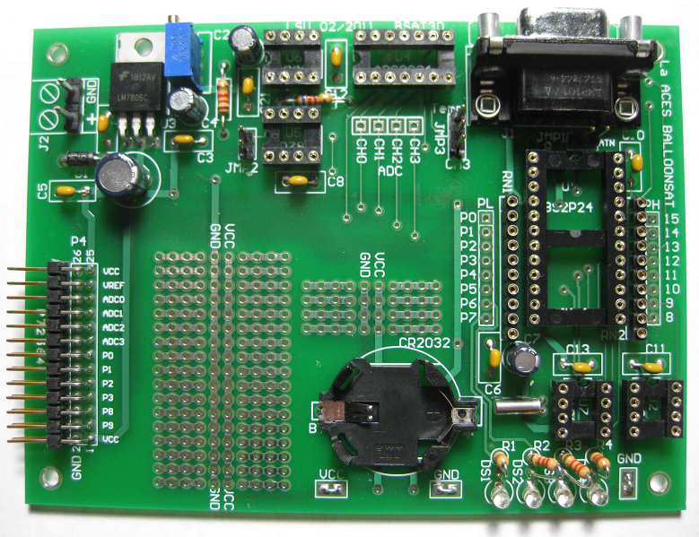
From BalloonSat to MegaSat
The BalloonSat featured a Basic Stamp microcontroller, an external EEPROM, a 4-channel analog-to-digital converter, a voltage reference, a temperature sensor, a real time clock with a battery backup, and 4 on-board LEDs for use as visual indicators
The BalloonSat was used by the ACES program for over ten years before the MegaSat was created to update the hardware.
BalloonSat

Slide 6
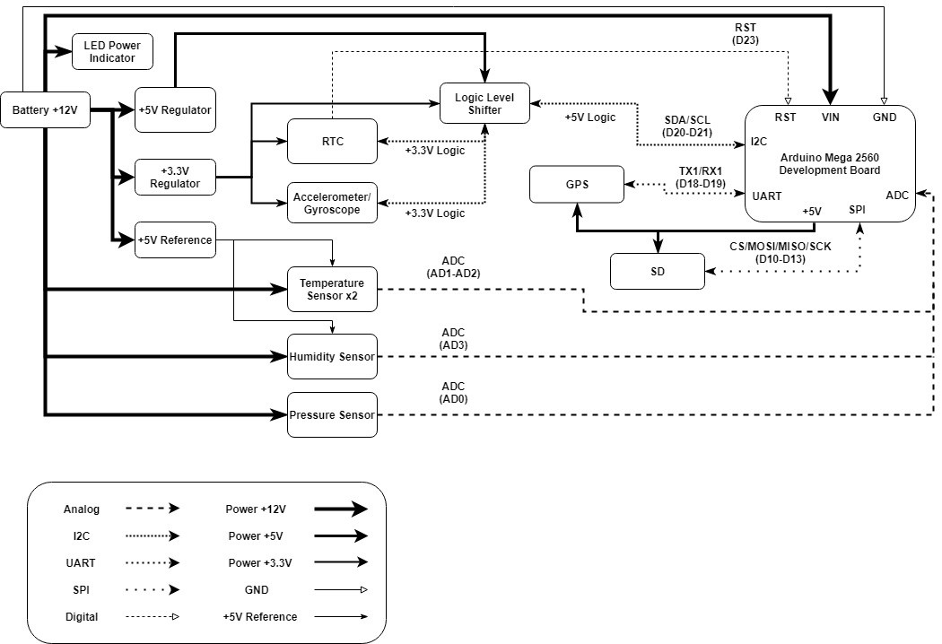
MegaSat System Diagram

Slide 7
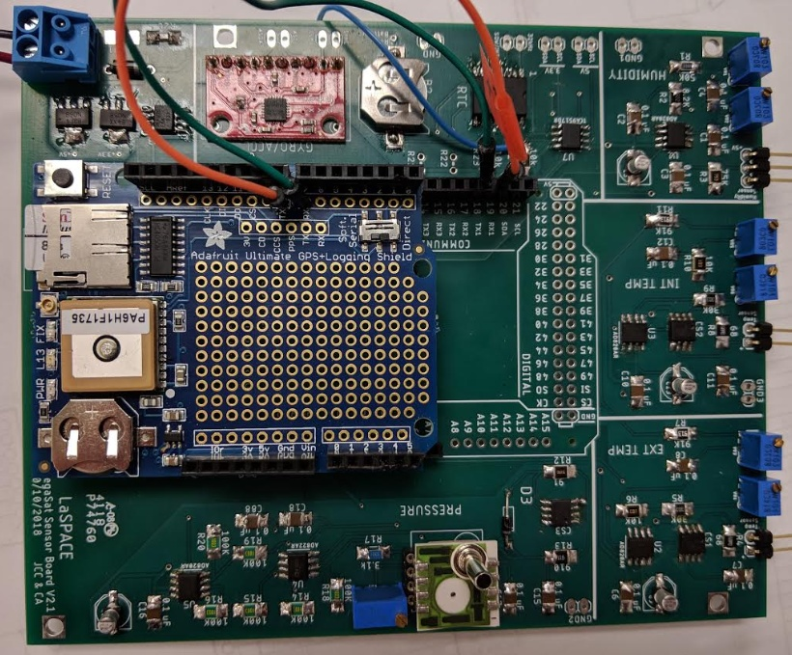
MegaSat Components
The MegaSat included several components for students to utilize:
Arduino Mega Interface
Real Time Clock
Gyroscope / Accelerometer
Analog Sensors
  Temperature x 2
  Pressure in gain ranges
  Humidity
Additionally, the MegaSat powers all components on the board from an a +12V supplied externally to the board

Slide 8
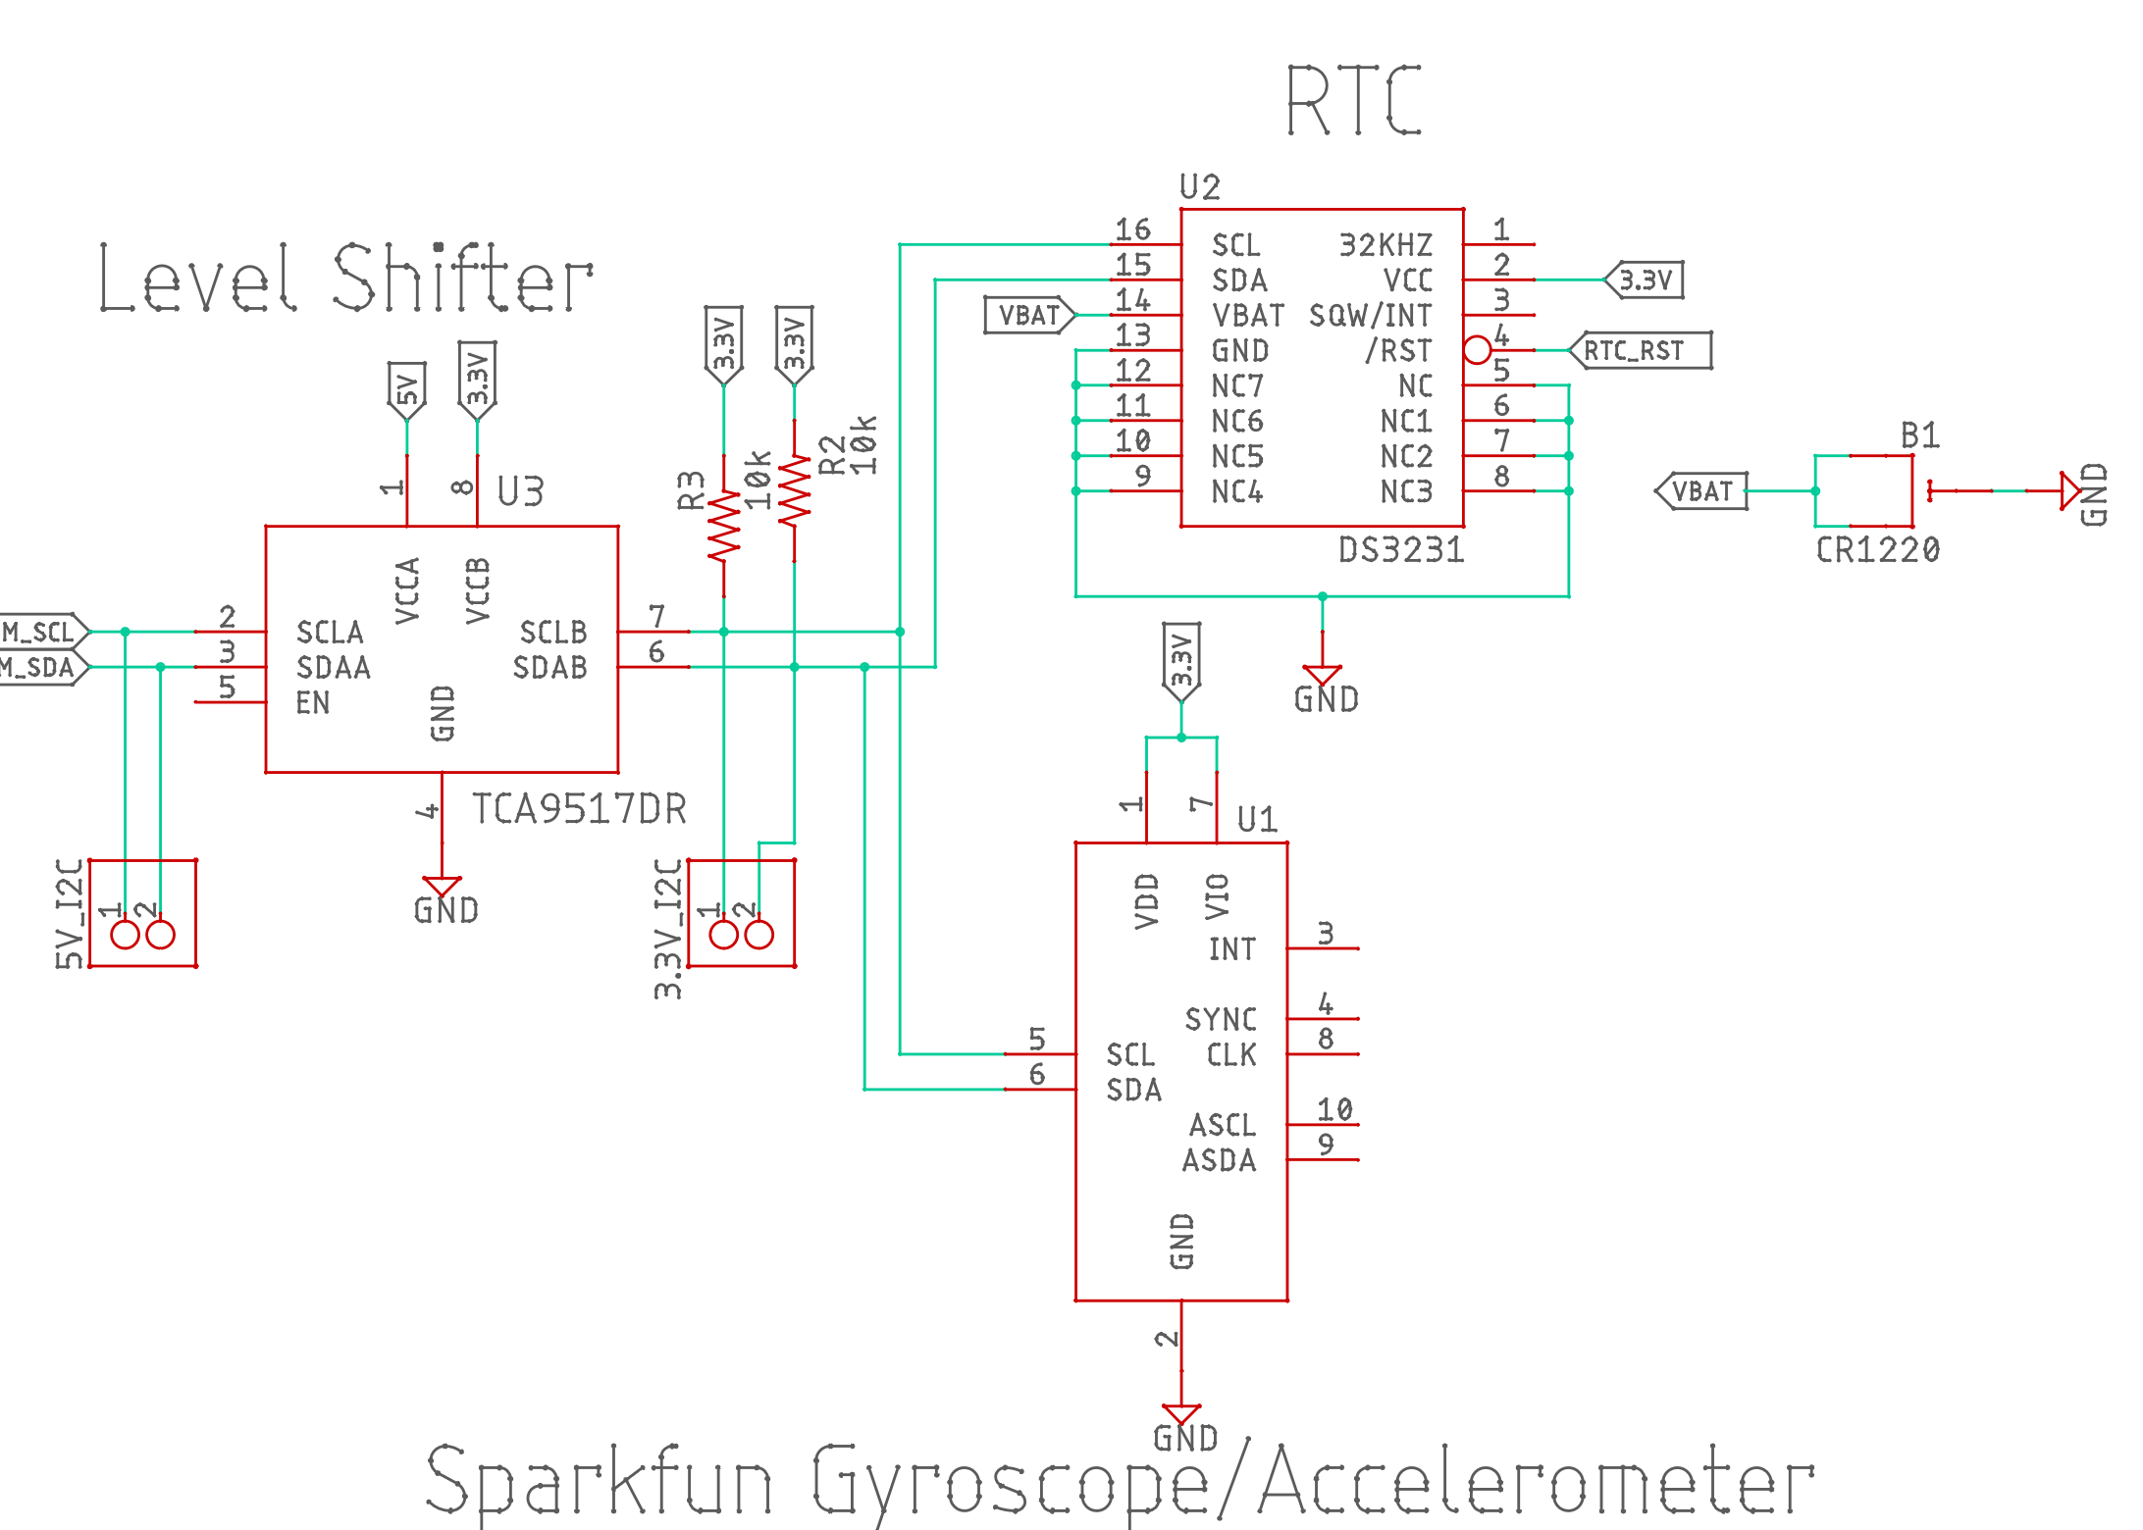
Real-Time Clock
Maxim Integrated DS3231 RTC
Fast (400kHz) serial I2C interface
Precision temperature-compensated voltage reference to enhance accuracy and a comparator circuit that monitors for power failure
Digital Temp Sensor Output: ±3°C Accuracy
Backup battery
Registers for year, month, day, hour, minute, second
Time must be set by writing the correct values to the registers (Just like setting a clock/watch)
Operating temperature from -40°C to +85°C
I2C Address (0x68 default)
Notes:
Year, month, day are not requirements. I only included that because it was included in the old presentation

Slide 9
Gyroscope/Accelerometer
InvenSense MPU-6050 gyroscope/accelerometer
I2C digital-output of axis values for acceleration and rotation (x, y, z)
Angular rate sensor (gyro) with a full-scale range of ±250, ±500, ±1000, and ±2000 degrees per second (dps)
Accelerometer with a full-scale range of ±2g, ±4g, ±8g and ±16g
I2C Address 0x68 or 0x69 set by external jumper, so must change the jumper on the breakout board to prevent RTC address conflict
Acclerometer/Gyro reading for each axis broken up into upper and lower byte each stored in a separate register
Notes:
InvenSense was the first company to deliver Motion Interface solutions with fully integrated sensors and robust MotionFusion™ firmware algorithms.

Slide 10
Logic-Level Shifter
RTC and IMU operate at 3.3V logic while Arduino operates at 5V
Texas Instrument TCA9517 Level-Shifting I2C Bus Repeater
Two-channel bidirectional buffer with level shifting capabilities for I2C
Shifts both serial data (SDA) and the serial clock (SCL) signals on the I2C bus
Bidirectional voltage-level translation between low and high voltages
Accommodates Standard Mode and Fast Mode I2C Devices
Notes:
I assume it’s best that the labels match where the component goes on the schematic. With that thought, should anything additional be added to that respect. Example M_SCL goes to pin 20 on the Mega and M_SDA goes to pin 21 on the Mega. Should that be identified here?
Do we want to include the manufacturer's name on these slides. Some of the BalloonSat slides include that information while others only include the part number.

Slide 11
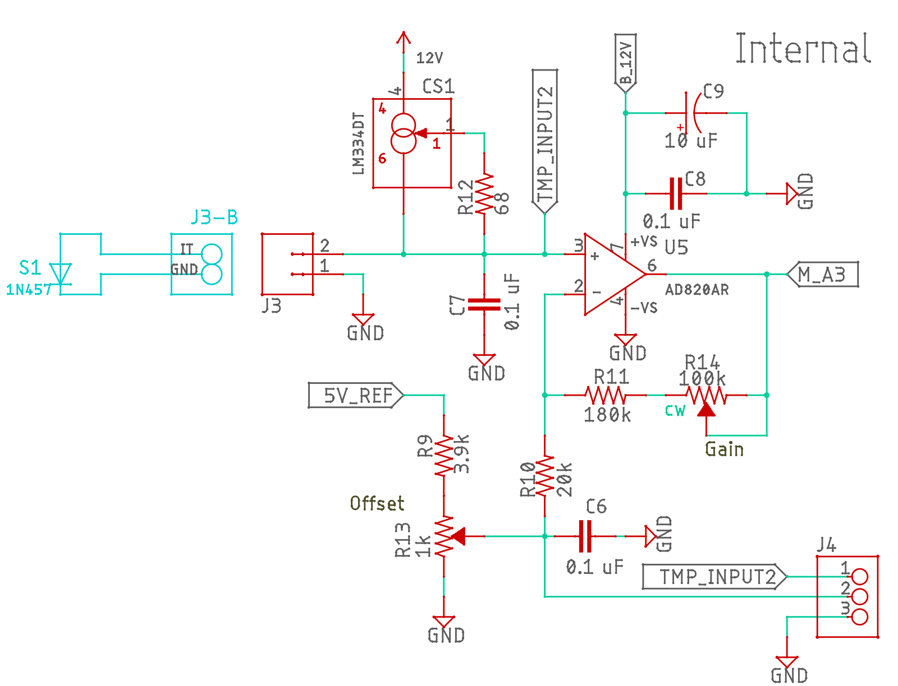
Temperature Sensors
1N457 diodes temperature acts as sensor
Two identical sensors with amplifying circuits
Idea is to set the gain and offset for differing expected ranges
  For example, internal circuit of -10 to 50C and external -50 to 50C
  Team should feel free to use their sensors as needed to meet requirements

Slide 12
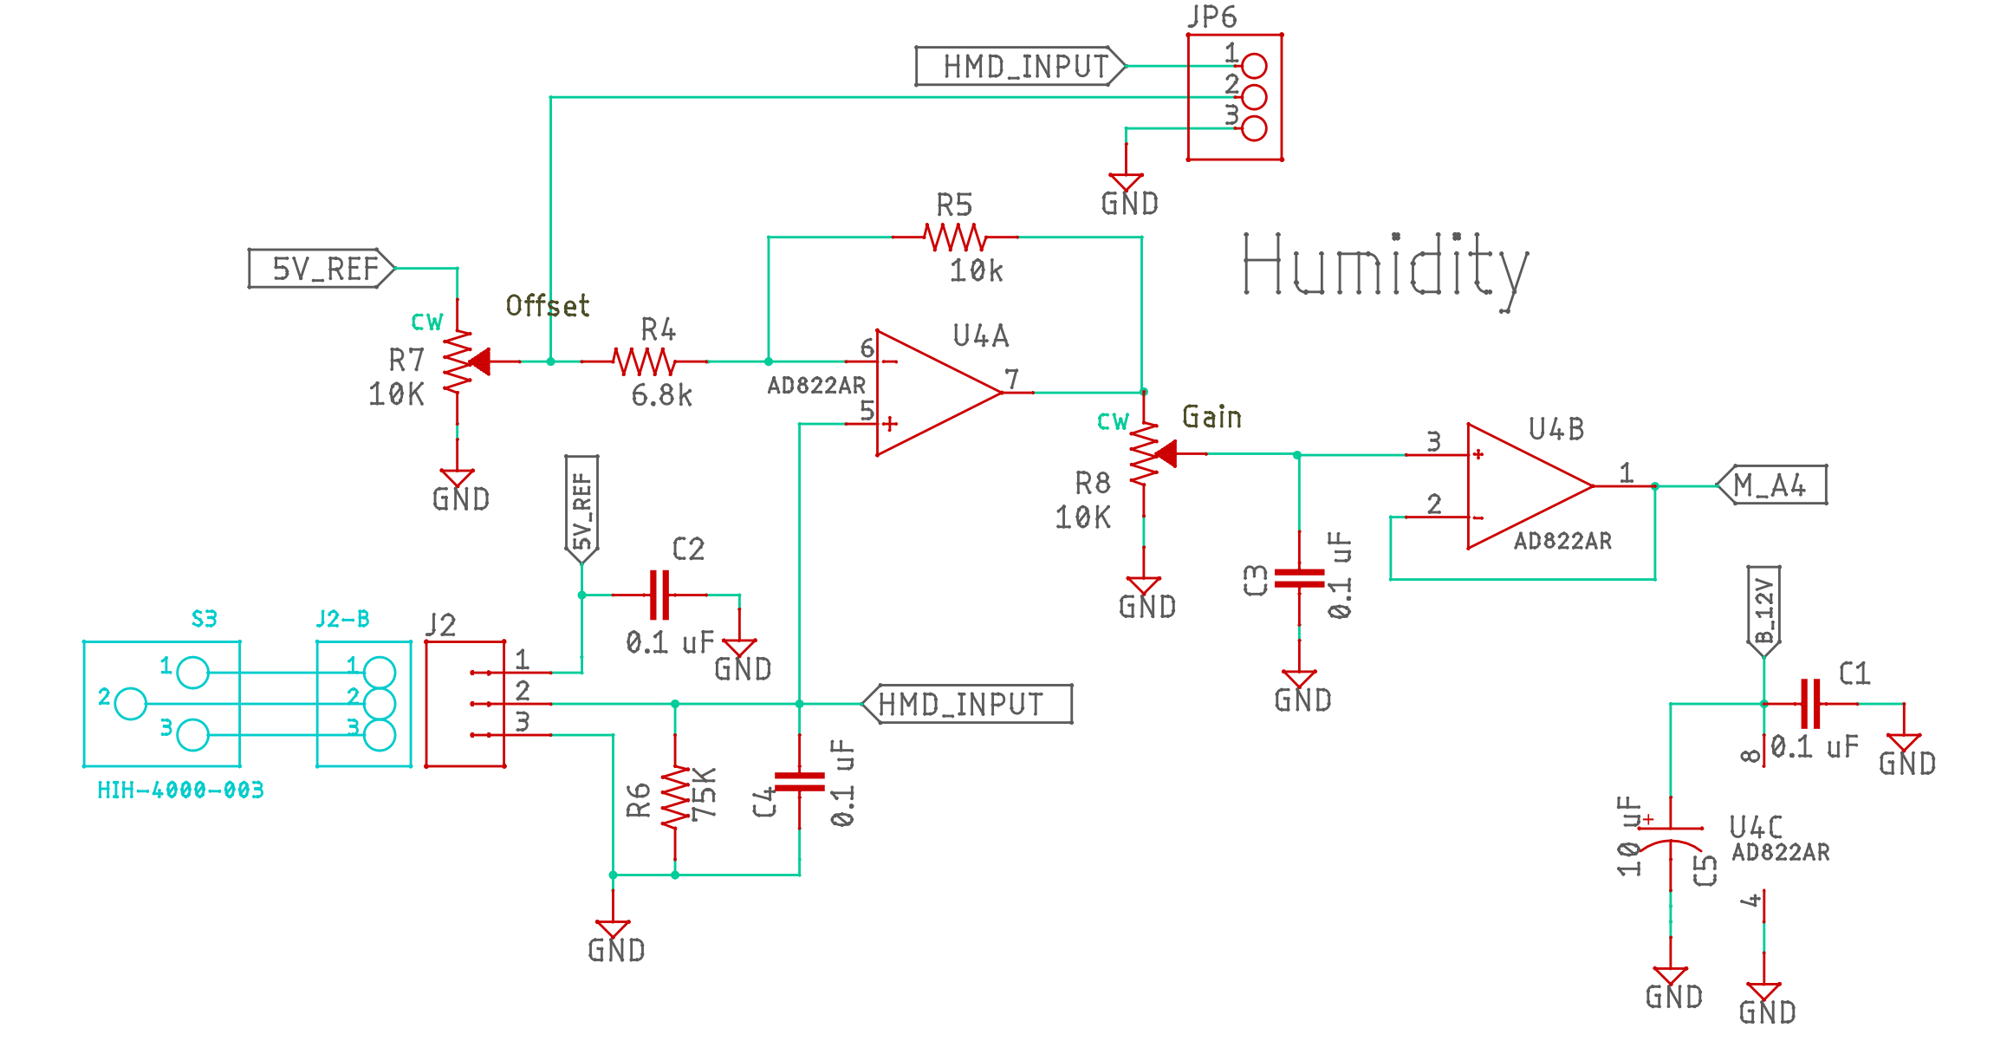
Humidity Sensor
Honeywell HIH-4000-003
Near linear voltage output vs percentage of relative humidity
Note each sensor should come with factory calibration data
Calibration data can be used if teams are unable to perform their own calibration

Slide 13
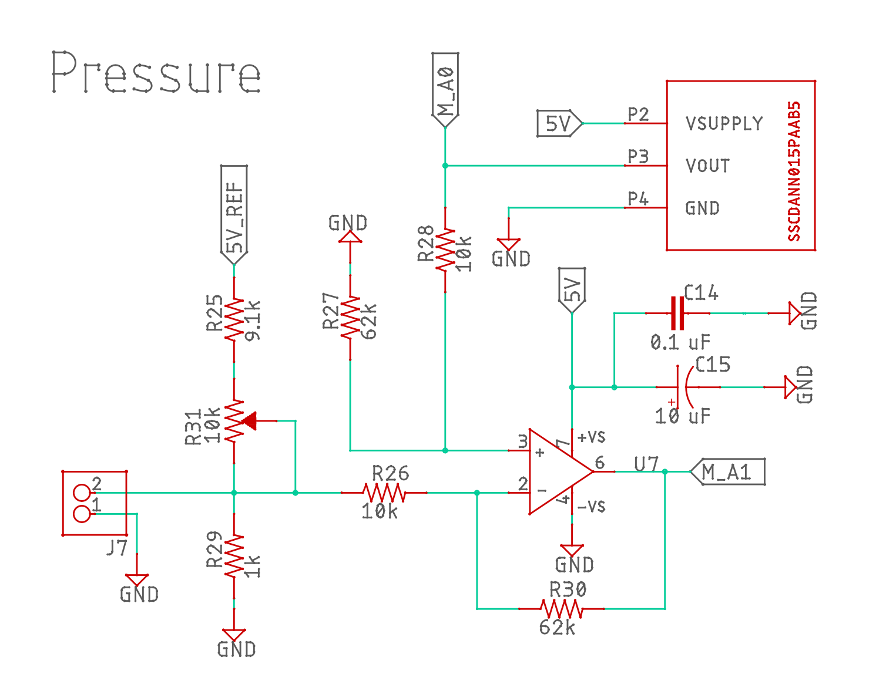
Pressure
Honeywell SSC series pressure sensor
0-15 psia range
0-5V output direct to analog pin (A0)
Amplified output to give increased sensitivity at low pressure (A1)

