Slide 1
Risk & Risk Management

Slide 2
Why manage risks?
It is a fact of life that chance events will occur and affect the outcome of your project
Murphy’s Laws codify this “knowledge”
If anything can go wrong, it will!
Of things that could go wrong, the one that causes the most damage will occur!
1982 Darwin Award Honorable Mention given to “Lawn Chair” Larry Walters. Cartoon by Jay Ziebarth, 2002
Project risks are defined as the undesirable event, the chance this event might occur and the consequences of all possible outcomes
Risk management attempts to identify such events, minimize their impact & provide a response if the event is detected
The essence of Project Management is Risk Management!

Slide 3
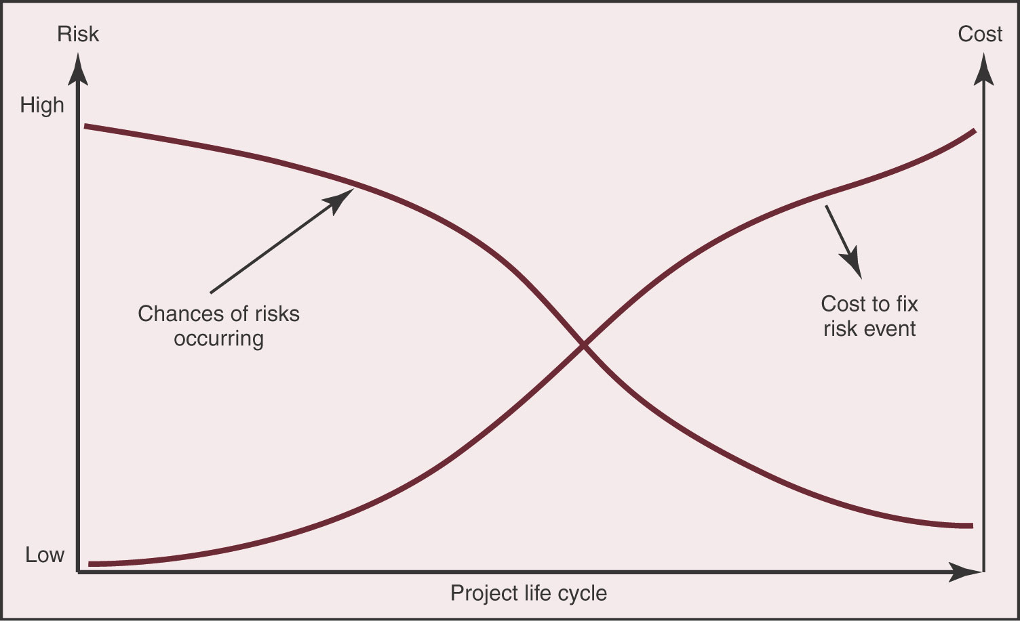
Risk during the project
Risk and the associated cost to address the risk, varies over the project life cycle
For initial phase there is high chance of risk events, but low cost impact
For final phase there is low chance of risk events, but cost impact is high
Identifying and managing risks will greatly affect project success
Figure from “Project Management” by Gray and Larson

Slide 4
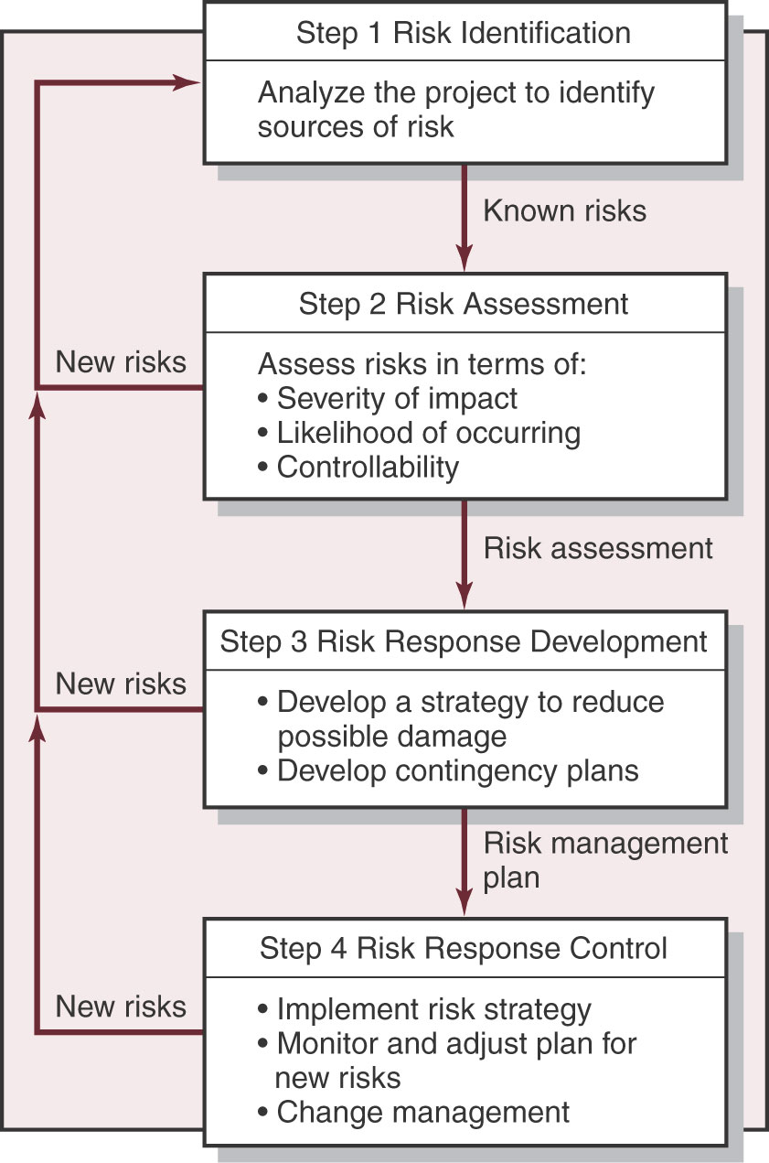
Risk Management Steps
There are four major steps to developing a risk management plan
Identify all the possible risk events that could affect the project
Assess each risk in terms of probability, impact severity and controllability
Develop a strategy and/or contingency for responding to each risk
Monitor and control risks dynamically
A Risk Management Plan should be developed during the initial project phase and immediately implemented
The plan should reviewed & revised as needed during each project phase
Figure from “Project Management” by Gray and Larson

Slide 5
Identify the project risks
Generate list of all possible risks by “brainstorming” among team members
Do not attempt to assess risk probability; that is for a later step
Focus on risk events, rather than risk consequences
For example, “instrument does not return correct data” is a consequence of events like poor circuit design, incorrect or failed components, poor software implementation
First focus on overall project risks, then identify specific risks
Use your WBS to help organize your risk identification process
Seek input from sources from outside your group
Emphasize critical thinking and remember Murphy’s Laws

Slide 6
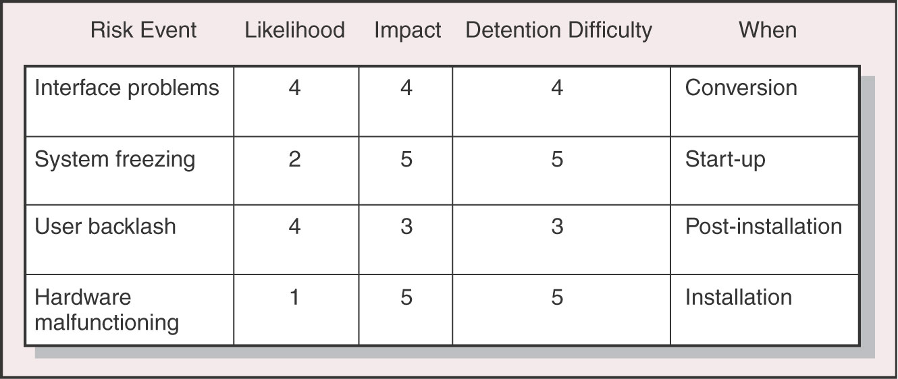
Assessing the risk impact
Not all risks need to be subject to monitoring and control
Use a Scenario Analysis to assess the risk event impact
Determine all consequences and their severity if the event happens
Identify when, during the project, will the event likely happen
Estimate the probability that the risk event will occur
Determine how difficult it will be to detect the event occurrence
Figure from “Project Management” by Gray and Larson

Slide 7
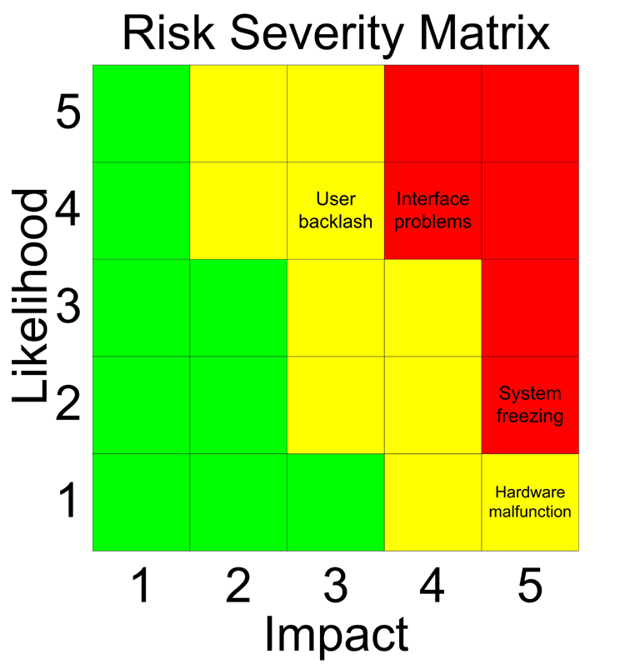
Ranking the risk importance
Rank risks from those that can be neglected to those that require elevated vigilance
A Risk Severity Matrix can be helpful in prioritizing risks
Plot of event probability versus impact
Red zone identifies the most important events
Yellow zone lists risks that are moderately important
Green zone events probably can be safely ignored
Based on figure from “Project Management” by Gray and Larson
Note that the zones are not symmetrical across the matrix
High impact low probability events much more important than likely low impact events

Slide 8
Risk response strategies
Mitigating risk
Actions are taken during the project to either A) reduce the likelihood of a risk, or B) reduce the impact of the risk
For example, testing electrical components after receipt would reduce the likelihood that “bad” parts would be used in a circuit
Retaining risk
Usually for events with low probability but high impact when no alternate strategy is feasible
Have a contingency plan ready in case event occurs
Sharing risk
Multiple units associated with the project assume some portion of the risk
Transferring risk
Risk is assumed and managed by a unit outside the immediate project
For example, risks associated with the balloon vehicle are transferred to the LA ACES Project management

Slide 9
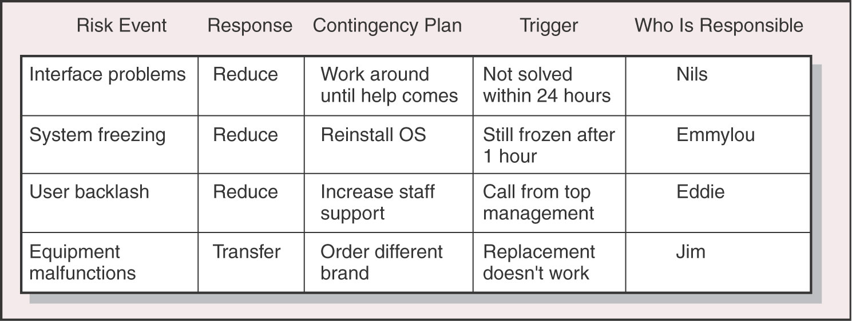
Develop a response for risks
A risk response plan identifies the primary components necessary for managing the risk
What response strategy will be used
How will the risk event be detected and the response triggered
What plan will be put in place in response to the event
Who will be responsible for monitoring and controlling the risk
Figure from “Project Management” by Gray and Larson

Slide 10
Contingency Planning
Risks associated with the technical aspects of a project can have the most sever outcomes
Can be mitigated by building and testing prototypes of critical components
Have available backup or alternate designs that have much lower risk
Risks associated with the schedule usually require a trade-off
Manage “slack” time to provide resources for delayed components
Bring in more people (increase costs) or reduce performance
Risks associated with costs usually result from estimate errors and omissions
Time & cost are related; trade-off schedule delays with lower cost
“Descope” options that remove components of the project, but still allow the primary mission to proceed
All “budgets” (mass, power, schedule, cost) should include a reserve percentage that can be expended as risk events occur

Slide 11
Risk response process control
The Risk Management Plan should specify the risks, risk responses, and mechanisms used to control the process
Need to continuously monitor for risk triggers
Potential risk events should be identified early in a project and monitoring for such events immediately commence
Each risk is assigned to a specific person
Has the expertise & authority to identify & response to an event
Need environment where problems are readily reported, embraced & solved
Changes in any aspect of the project need to be documented and communicated
Who will have the authority to approve a change
Use written form to track hardware, software & document changes
Who is notified of what changes when

