Slide 1
L24.02b ProjectLibre Example

Slide 2
Open Source Alternative to MS Project
MS Project is not part of the standard Office Suite
Free Alternatives are available but vary widely in quality and capabilities
One alternative that LaACES have discovered is the open-source software ProjectLibre
Installer available via the download link here https://www.projectlibre.com/
Will send you to a SourceForge page to download

Slide 3
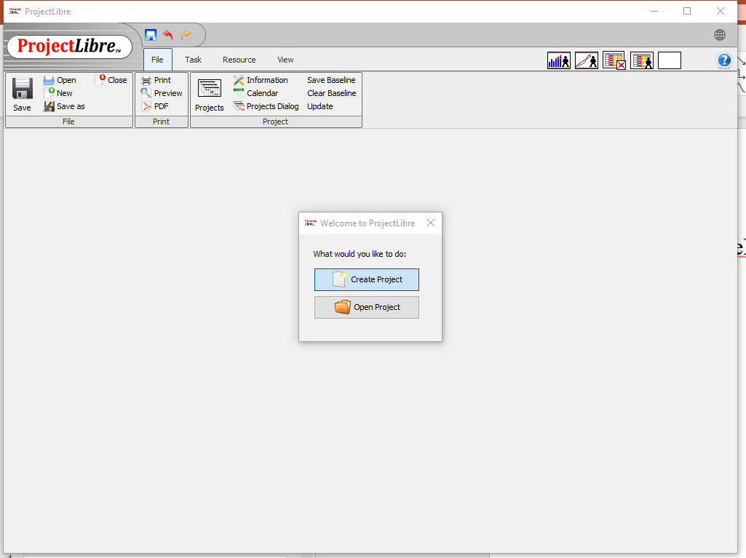
New Project
On starting LibreProject a dialog box asking we want to open an existing project or create a new project
Select create new project

Slide 4
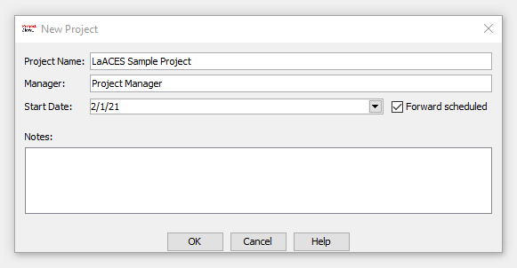
Basic Project Information
Next we will get a dialog box for basic project info like project name, who the project manager is, and the start date for the project
Note the forward scheduled box indicates we are scheduling forward from a start date, we could uncheck that to schedule backwards from a completion date

Slide 5
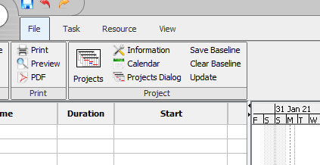
Setting the Working Hours
Before we schedule any tasks we want to change the working hours for the project
Otherwise, will assume assume everyone is able to work standard 8 hour days
We want to schedule tasks based on realistic working hours
Hit the calendar button inside the project box when the file tab is selected from the menu

Slide 6
Setting the Working Hours (2)
This will bring up a window allowing us to change the working time on calendar
While we could set specific times or days off for now we just want set the working time to a more realistic 20 hours (hours a day)
With the standard calendar selected from the drop down select MTWTF by shift clicking on all the days

Slide 7
Setting the Working Hours (3)
Next click the “Non-default working time” option to allow us to change the time
In the time field we could select specific working hours but all we really care about is having a 4 hour workday
So delete the afternoon 13:00 to 17:00 blocks, then click ok
Afterwards reopen the calendar and click on the days to be sure that change was applied
Now tasks will be scheduled assuming 4 hours of work is what can be accomplished in a day

Slide 8
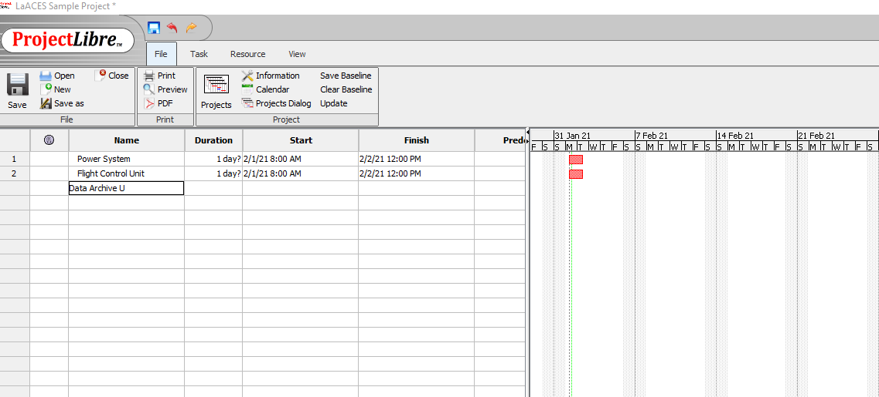
Enter the major tasks
Type in the major tasks (WBS level 1) in the “Name” box.
Each row is a separate task
Do not worry about the rest of the columns for now

Slide 9
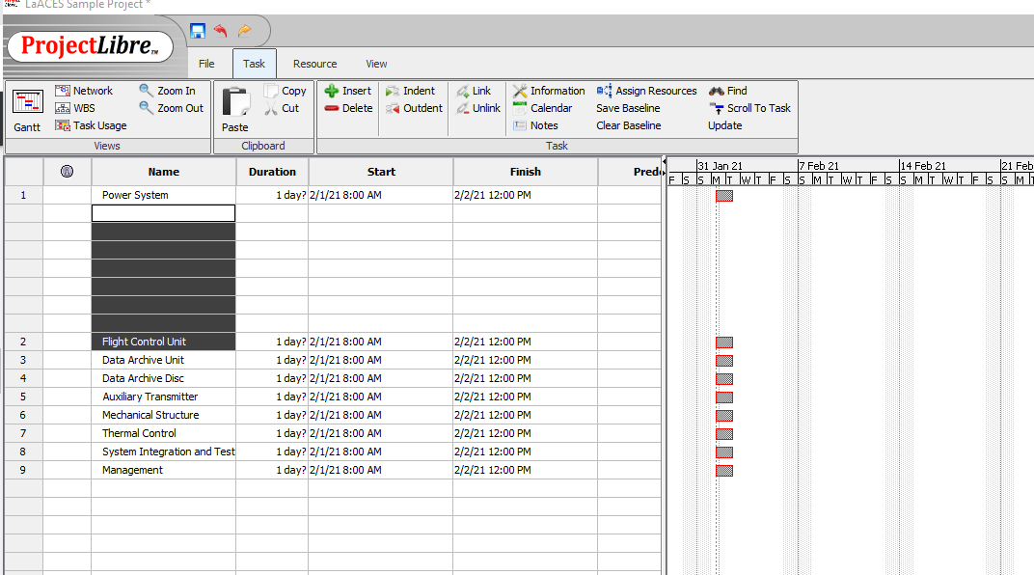
Insert Rows
Select the row above which you want to insert a subunit
Select “Insert” from the “Task” section of the Task menu tab
To delete a row, select the row and select “Delete” from the same menu section

Slide 10
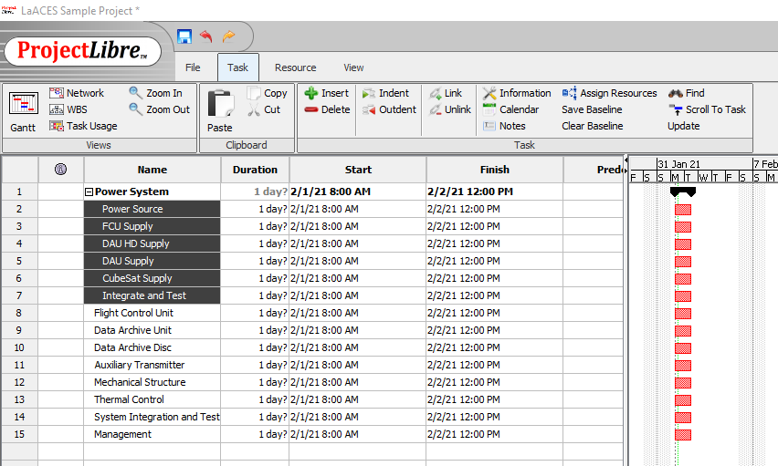
Enter the subunit task names
Type in the name of the subunit task in the “Task Name” field
Subunits are “indented” with the ident buttong with the right arrow next to the insert and delete buttons
When subunits are so “indented” the major unit will become bold and the Gantt chart bar will change shape

Slide 11
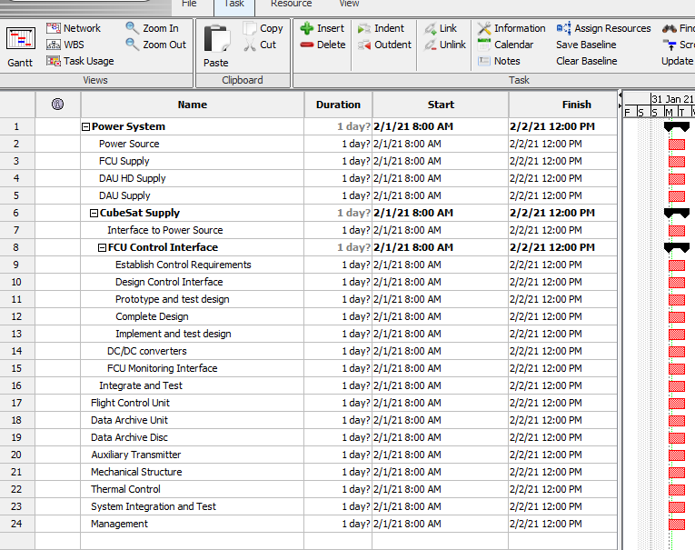
Complete entering WBS
Repeat the process of inserting rows, typing in the task name and indenting the subunit continues until all tasks in the WBS are entered

Slide 12
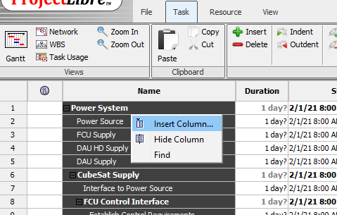
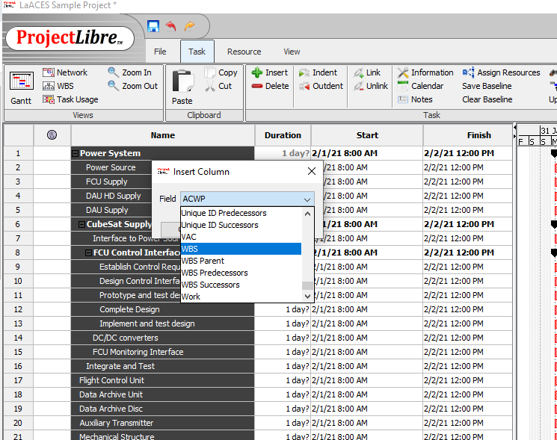
Display the WBS code
Right click on any of the column headers such as “Name”
Select “Insert Column”
Choose “WBS” from the “Field” dropdown and hit ok

Slide 13
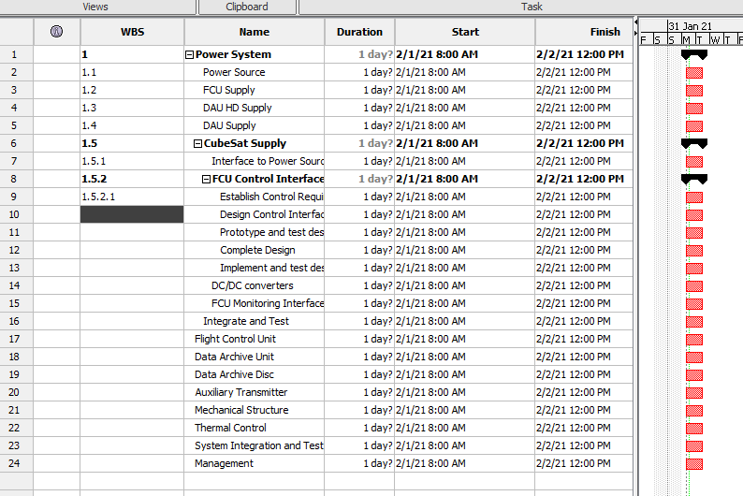
Entering the WBS code
Any empty WBS column should now be visible
You will have to manually enter the appropriate WBS code (1, 1.2, 1.2.1, etc.) for the tasks

Slide 14
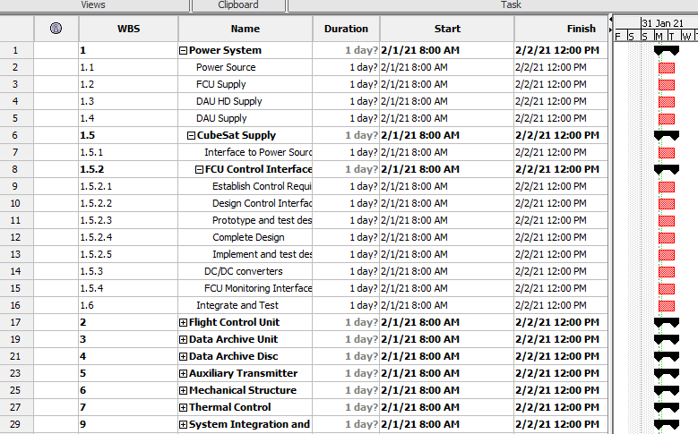
Task bars
With all subunits inserted the lowest level will be red rectangles and higher levels will be black bars with points on the ends.

Slide 15
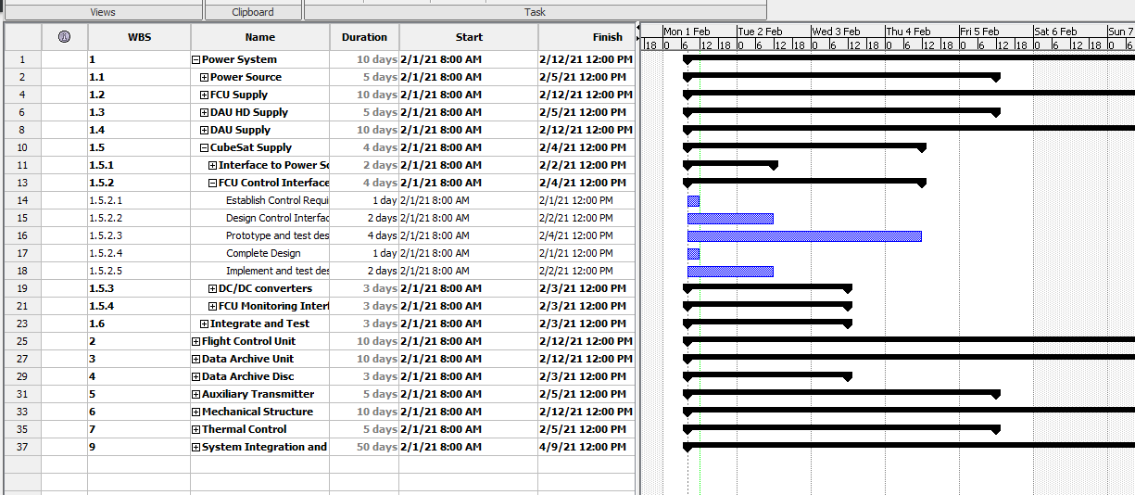
Set the task durations
Now enter the time associated with each task in the “Duration” field.
Set durations for the lowest level tasks and the total time will be summarized or rolled-up to the next highest level.

Slide 16
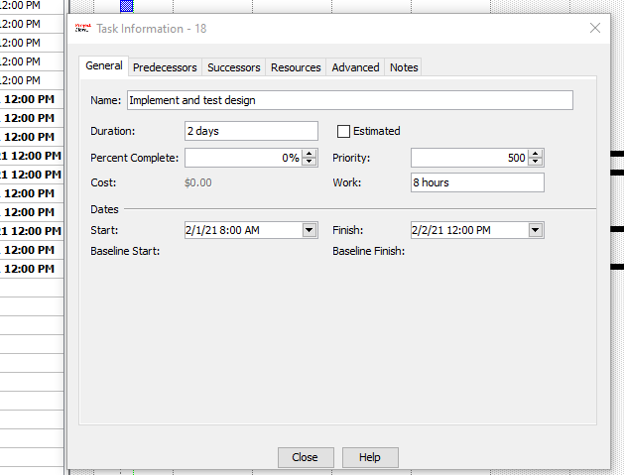
Set the task durations (2)
Smaller time units such as hours can be set but duration will always be displayed in decimal days
Durations can also be set by double clicking on a task and changing either the “duration” (displayed in days) or “work” (displayed in hours) under the general tab.
Note: Here we can se that our 8 hours of work will take 2 days, as per our 4 hour daily schedule

Slide 17
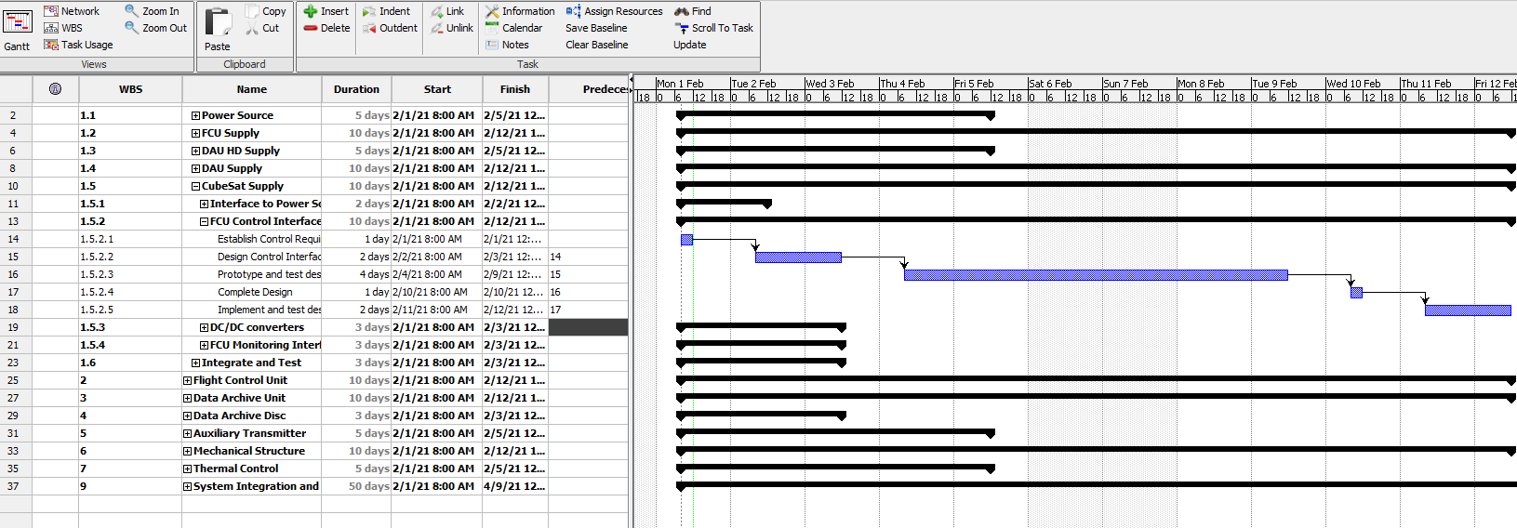
Set the task predecessors
Enter the task dependence (i.e. which tasks must be complete prior to starting the next task) in the “Predecessors” field.
You need to use the row number, not the WBS code.

Slide 18
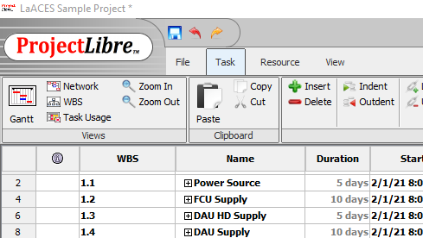
Set the timescale of the chart
Changing timescale of the chart is accomplished vua zooming in and out with the appropriate buttons

Slide 19
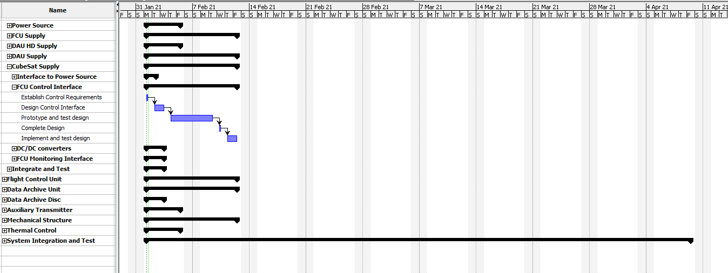
Make an image for documents
Unfortunately, ProjectLibre does not have export option
The best option seems to be adjust the Gantt chart and task list windows until they display what you want to show
Then either take a screenshot and crop and example is shown below

