Slide 1
MS Project Example

Slide 2
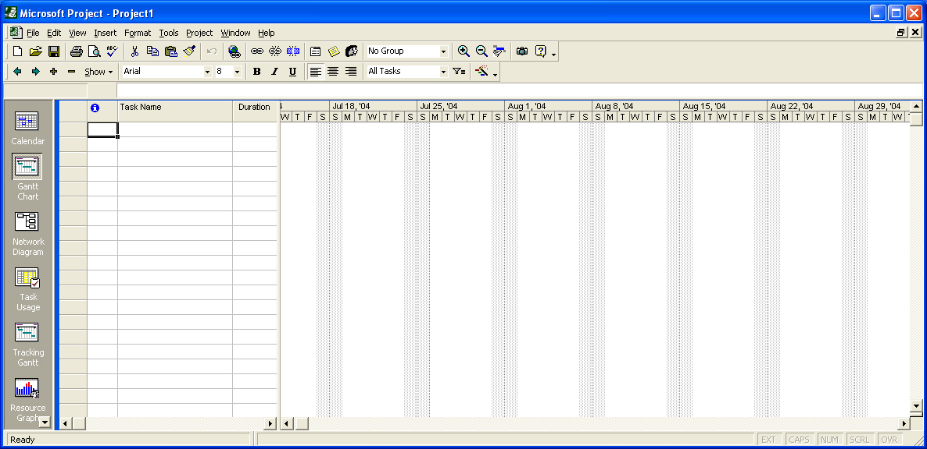
New Project Screen
On starting Project a blank template will appear.

Slide 3
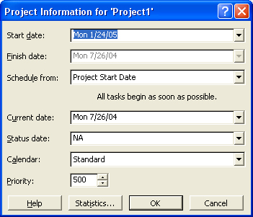
Basic Project Information
From the “Project” menu select “Project Information” and enter the anticipated project start date.

Slide 4
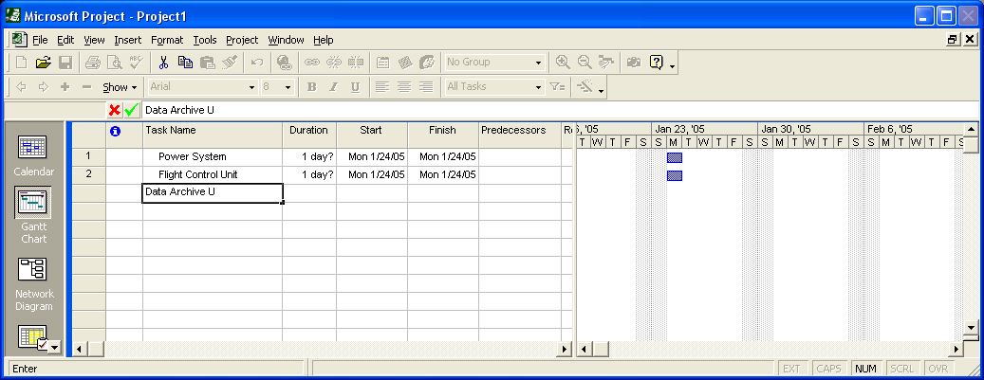
Enter the major tasks
Type in the major tasks (WBS level 1) in the “Task Name” box.
Each row is a separate task
Do not worry about the rest of the columns for now

Slide 5
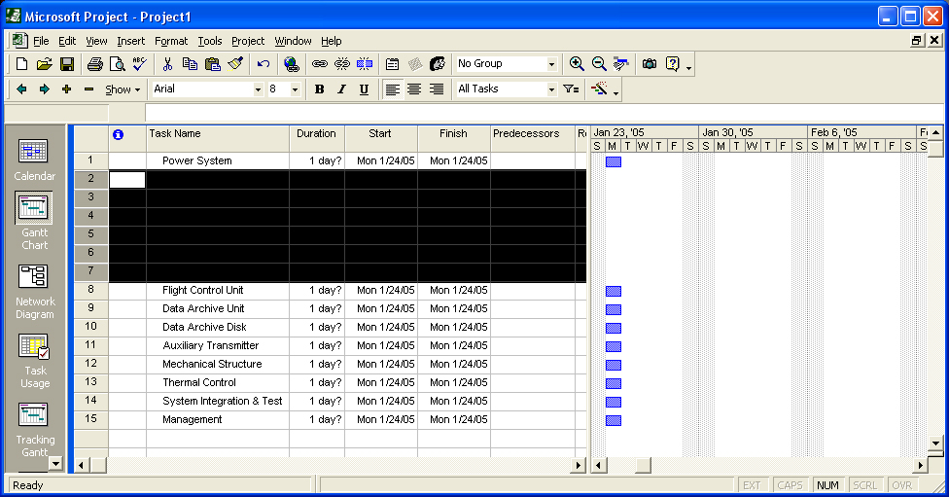
Insert Rows
Select the row above which you want to insert a subunit
Select “New Task” from the “Insert” menu
To delete a row, select the row and press the “Delete” key

Slide 6
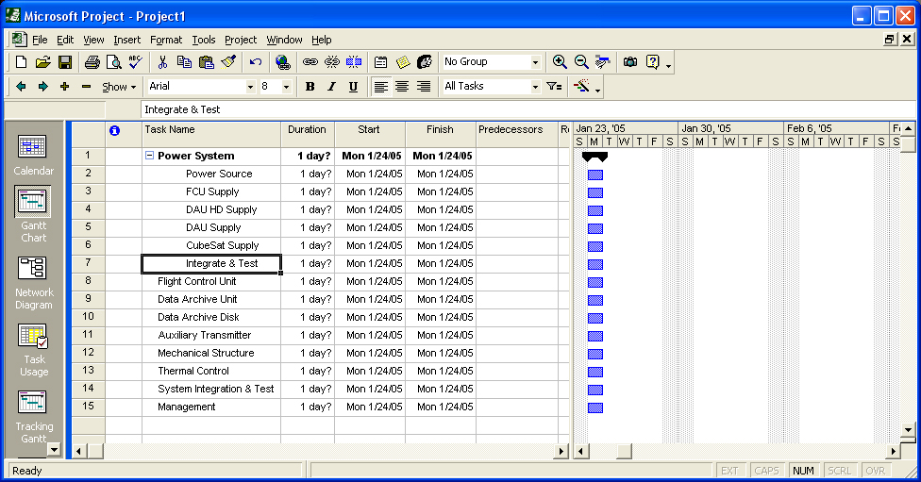
Enter the subunit task names
Type in the name of the subunit task in the “Task Name” field
Subunits are “indented” with the right arrow on the task bar
When subunits are so “indented” the major unit will become bold and the Gantt chart bar will change shape

Slide 7
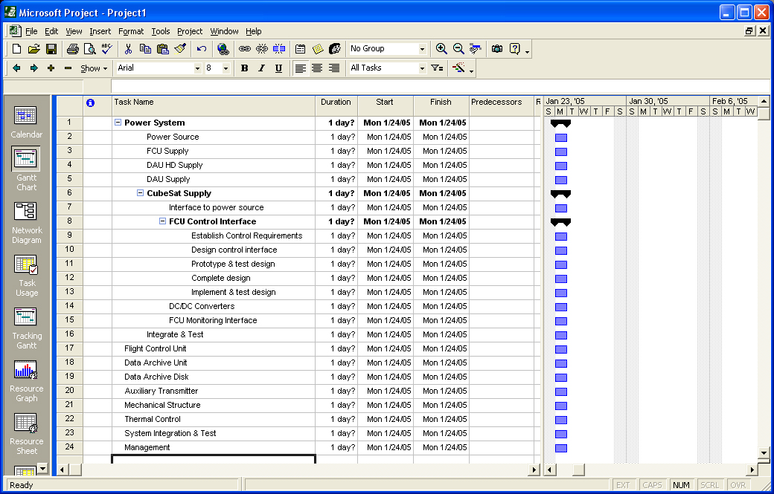
Complete entering WBS
Process of inserting rows, typing in the task name and indenting the subunit continues until all tasks in the WBS are entered

Slide 8
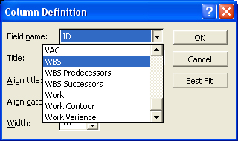
Display the WBS code
Select the “Information” column, right click and choose “Hide Column”.
Next select the “Task Name” column and from the “Insert” menu select “Column”. The following pop-up will appear.
Choose “WBS” as the “Field name”

Slide 9
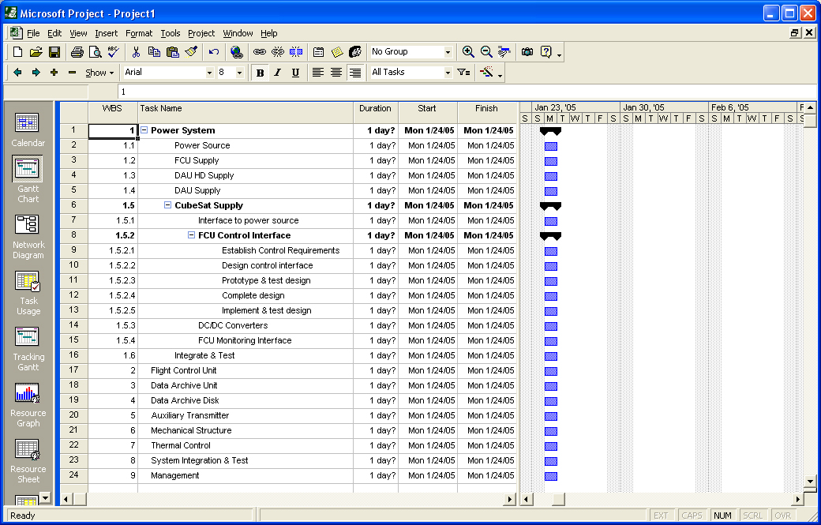
Showing the WBS code
The correct WBS code number will now be displayed for all tasks

Slide 10
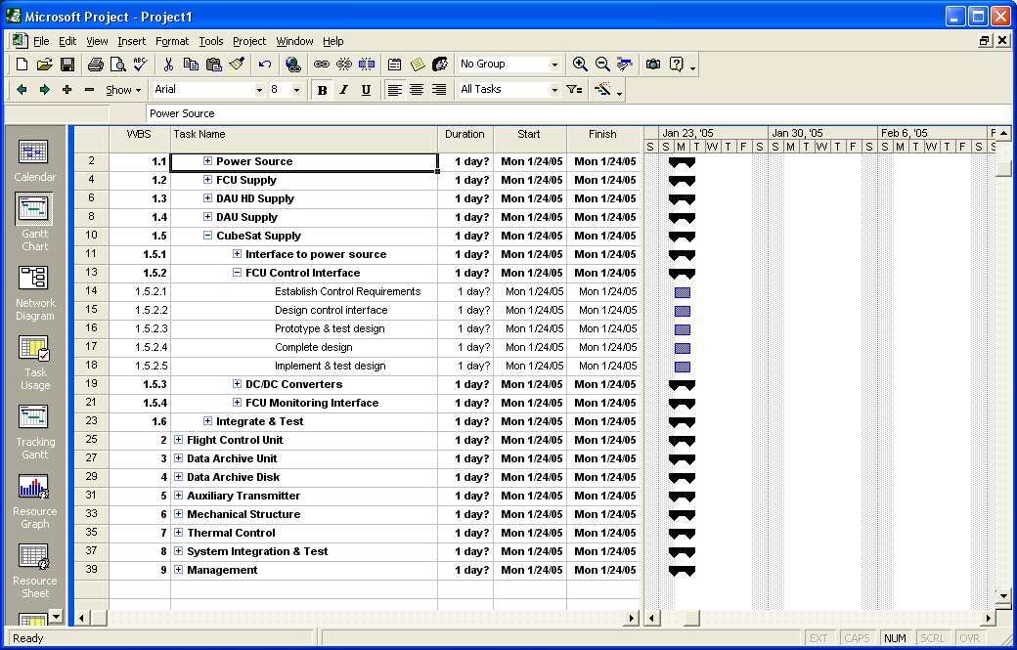
Task bars
With all subunits inserted the lowest level will be blue rectangles and higher levels will be black bars with points on the ends.

Slide 11
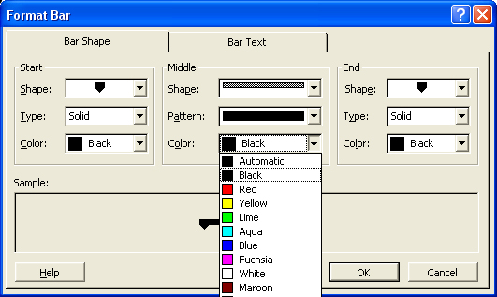
Distinguishing different levels
You can change the color of the task bar to distinguish between the different levels in your WBS
Select the task bar to change (in the Gantt chart area), right click and select “Format Bar”.
Change the color of the “Start”, “Middle” and “End”

Slide 12
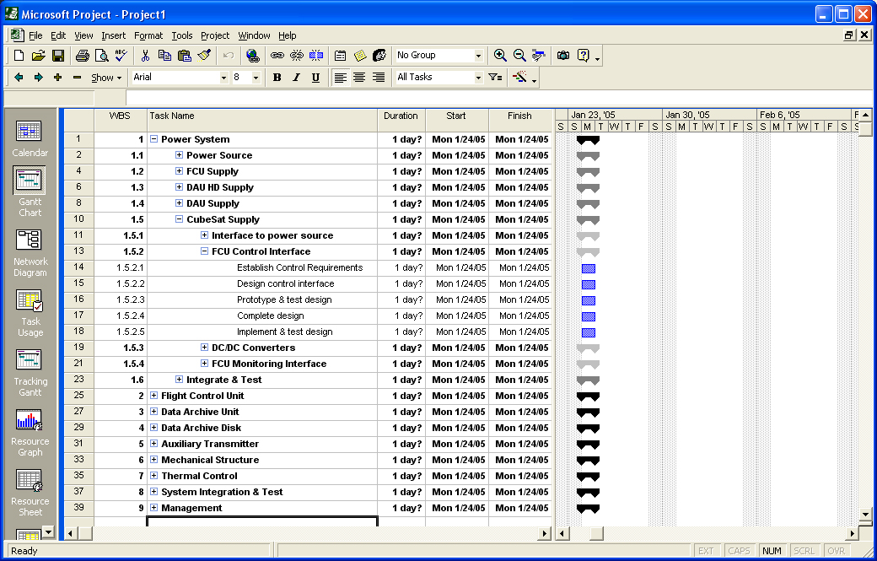
Results after task bar change
The results of changing the task bar color are shown below

Slide 13
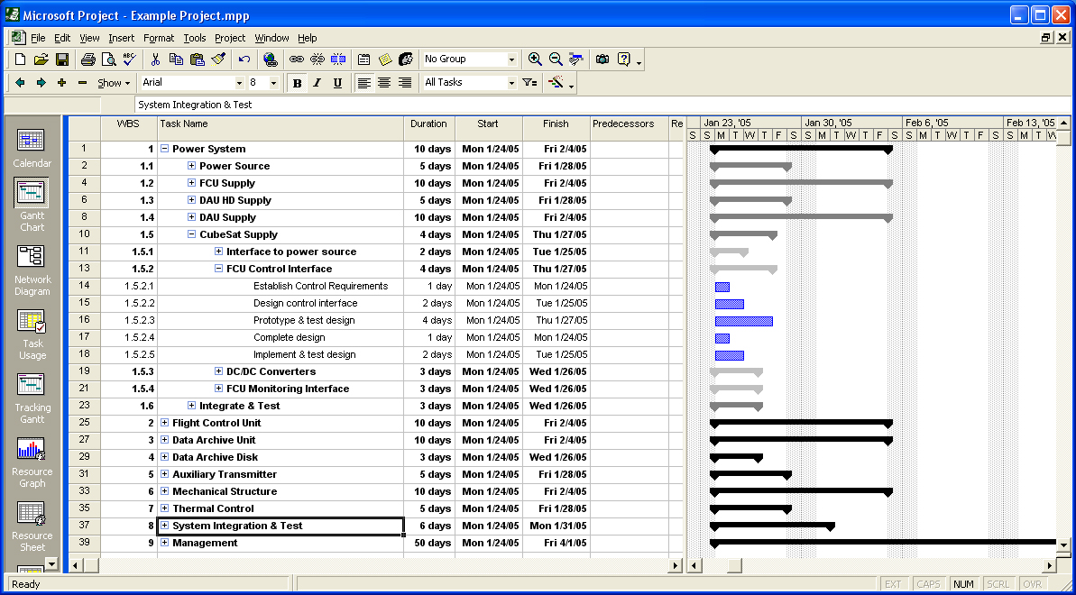
Set the task durations
Now enter the time associated with each task in the “Duration” field. See the MS Project Help for choices on units.
Set durations for the lowest level tasks and the total time will be summarized or rolled-up to the next highest level.

Slide 14
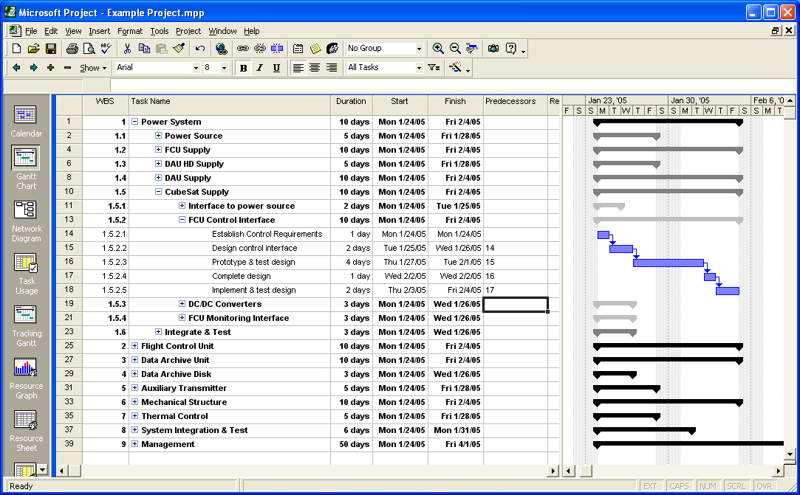
Set the task predecessors
Enter the task dependence (i.e. which tasks must be complete prior to starting the next task) in the “Predecessors” field.
You need to use the row number, not the WBS code.

Slide 15
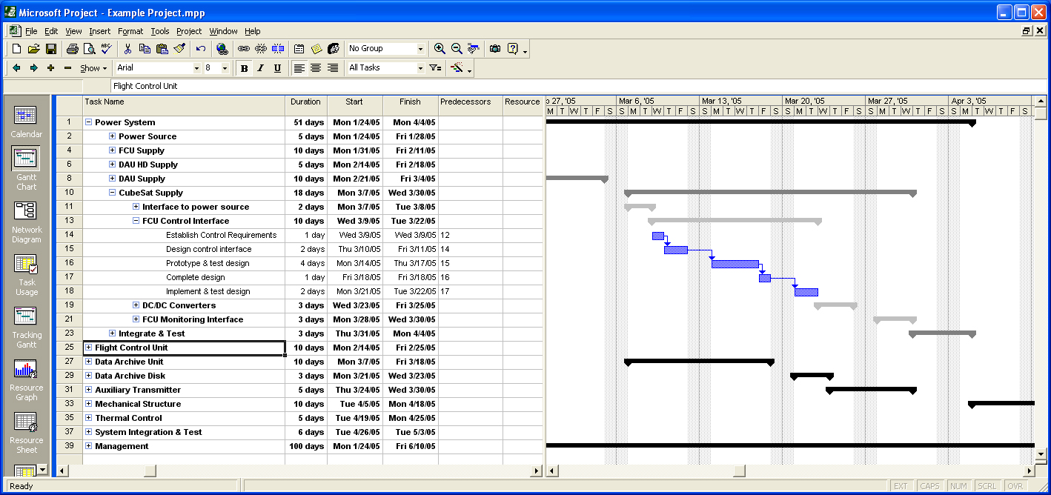
Enter all predecessors
Here all the task predecessors are determined and entered, but the Gantt chart now needs room to display fully

Slide 16
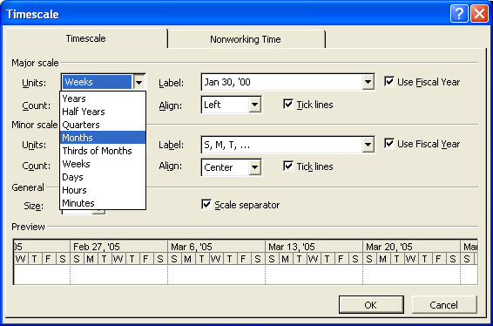
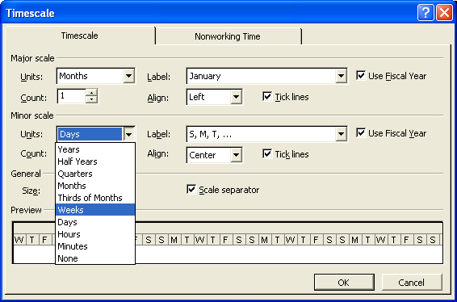
Set the timescale of the chart
From the “Format” menu select “Timescale”
Set the Major Scale to Months
Set the Minor Scale to Weeks

Slide 17
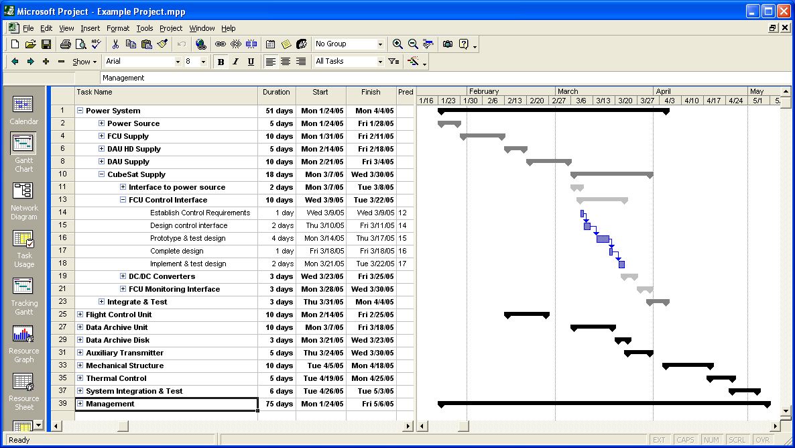
After timescale change
Now the full Gantt chart from project start to end can be displayed

Slide 18
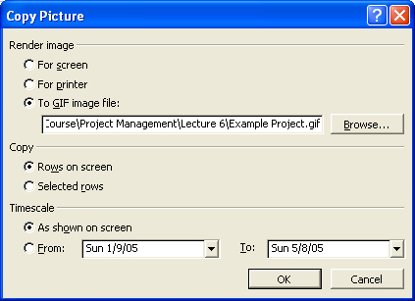
Make an image for documents
To make a GIF image that can be inserted into documents, first arrange the chart and task info boundaries to display just what you want.
From the “Edit” menu select “Copy Picture”
Select “To GIF image file:” and enter a filename for the image
Select what to copy: Rows on screen or Selected Rows
Select the timescale as either what is shown on the screen or for specific dates
Click OK and the image will be generated.

Slide 19
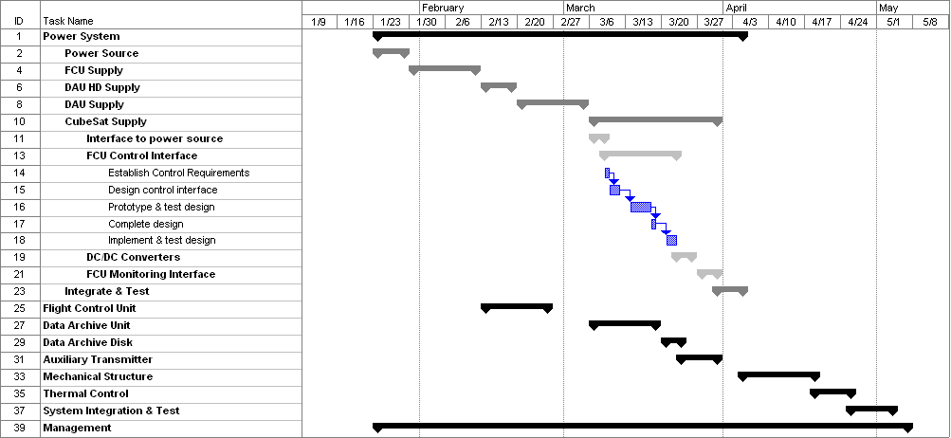
Final version of project
Below is the GIF image of the example project ready to be inserted in a document.

