Slide 1
Drawing System Diagrams
Lecture 23.02

Slide 2
Basic Steps
Identify all major components
Derived from your project goal, objectives and requirements
Identify all interfaces between components
These are either relationships or real connections between components
Produce your drawing
Components are labeled boxes
Interfaces are arrowed lines keyed to the interface function
Keep your layout as straight forward as possible

Slide 3
Identify Components
Components are based upon the project goal, objectives, requirements, and level of detail
For example, system level (High Level) diagram our components would be our subsystems:
Requirement: Measure Something -> Sensor Subsystem
Requirement: Store Data for analysis -> Data Archive Subsystem
For your payload to operate by itself during flight you need a Control Subsystem
Requirement: Provide Payload Power -> Power Subsystem
Requirement: Maintain payload integrity through flight -> Mechanical Support Subsystem
Requirement: Maintain components within operating temperature -> Thermal Control Subsystem
Requirement: Control system from the ground -> Ground Support Subsystem
Different kinds of subsystems may be required based on the goals and objectives of the project

Slide 4
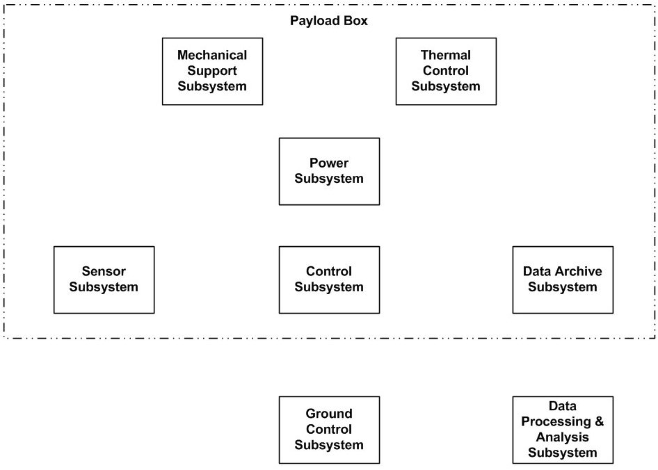
Example System Level Drawing
Each sub-system has its own box
Components are arranged in a way to show their connections to other components
Components do not need to be drawn in their physical arrangement

Slide 5
Determine the interfaces
Interfaces are the “connections” between the components
Could be a physical connection (e.g. wire, mechanical)
Could be an electrical signal (e.g. Serial, radio signal)
Could be a relationship / property (e.g. temperature, light)
We do not need to draw every wire (Could use a single line for an SPI interface [4 Wires])
Each type of interface should be represented by a different kind of line
Each interface should be labeled according to its specific characteristics
Arrows on the ends of the line indicate flow
For example: Electrical power is usually 1 way, communications are often bidirectional)

Slide 6
Sample Interface representations
Interfaces types
Power
Data
Control
Mechanical
Thermal
Interface flow
To component
From component
Bi-directional

Slide 7
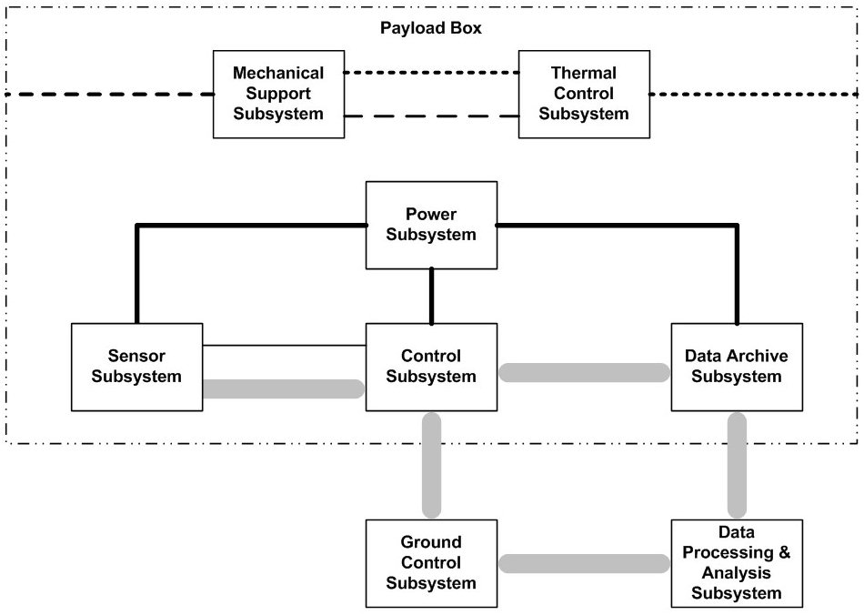
Add the interfaces

Slide 8
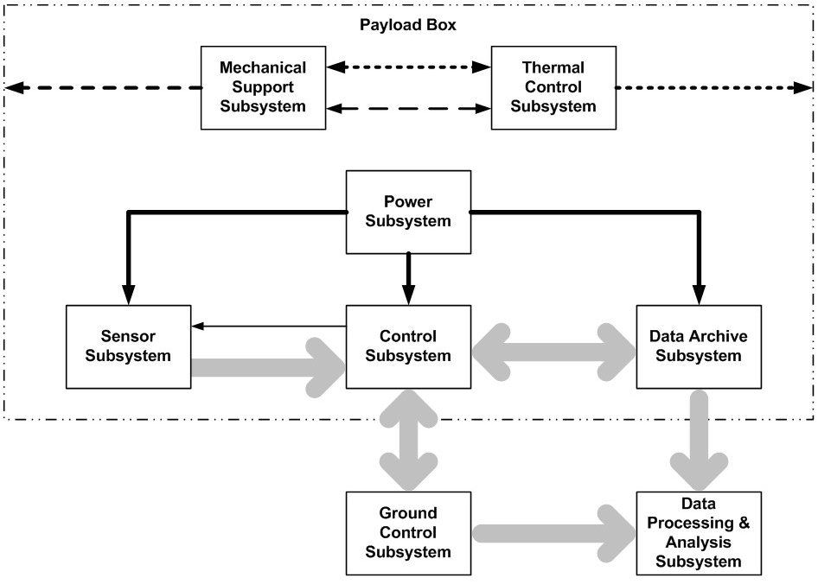
Indicate the interface flow

Slide 9
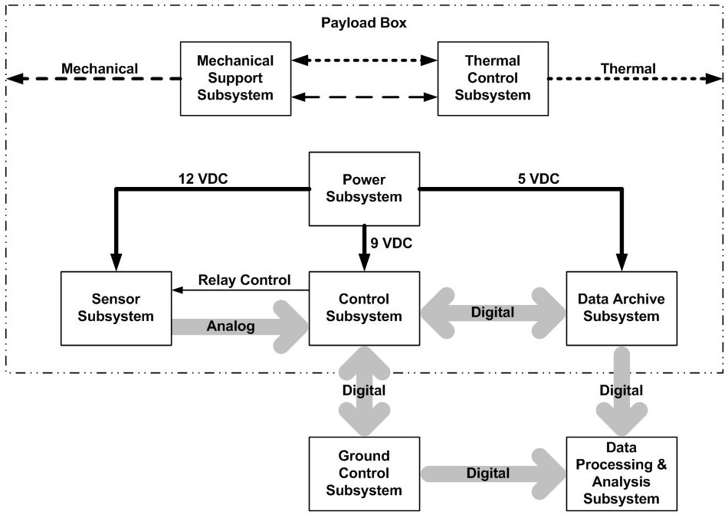
Add labels

Slide 10
Detailing Subsystems
Remember from System Design, we will have multiple levels of details for system drawings
Each of the previous subsystems would have more detailed drawings
As you develop your desin and requirements you should develop more detailed system drawings
System drawing help you identify the interfaces and may point out an interface you have missed
A good rule of thumb is 3 levels of system diagram in increasing detail
High Level System overview
Subsystem functional version
Refined Subsystem with detailed components and interfaces
More complex subsystem will may need additional detailed levels and simpler system may not need as many

Slide 11
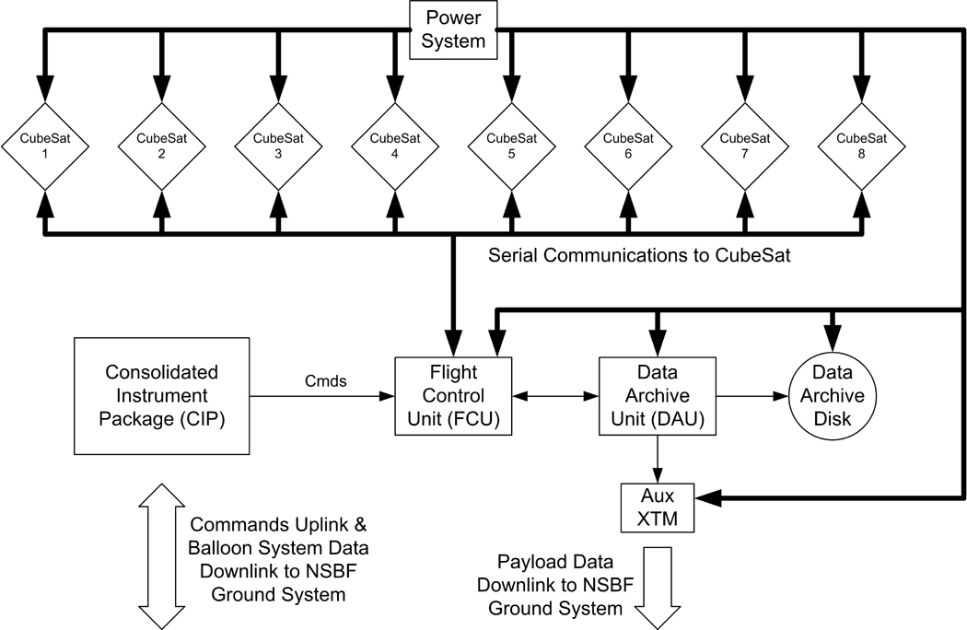
System Level Drawing Example

Slide 12
Subsystem Level Example

Slide 13
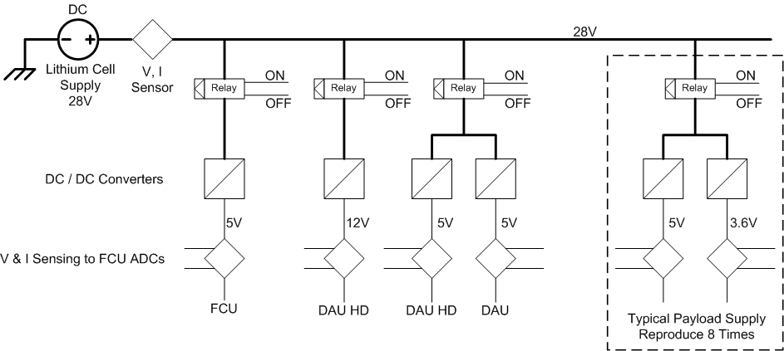
Refined Subsystem Example

Slide 14
Drawing Readibility
Do not try to squeeze too much information into a single drawing
Give subsystems individual drawings
Can spread interfaces across multiple drawings
Could have multiple versions of the system level diagram for different sets of interfaces
Show connections to outside systems
A control signal coming in a sensor subsystem
Do not need to draw the entire control system on the sensor drawing, but would shown in detail where it connected inside the sensor
Try to vary line style as well as color and include a legend

Slide 15
Drawing Software
Microsoft Office Suite: Visio works well
Google Drawings
Draw.io
Choose something with predefined blocks and arrow connectors rather than image editing software.

