Slide 1

Requirements Module:
Configuration & Change Management
Space Systems Engineering, version 1.0
Notes:
Version 1.0
SOURCE INFORMATION:
The material contained in this lecture was developed by Lisa Guerra of NASA’s Exploration Systems Mission Directorate while on assignment in the Department of Aerospace Engineering at the University of Texas at Austin. As part of a course entitled, Space Systems Engineering, the lecture was piloted at UT-Austin in Spring 2008.
The content that follows was also reviewed and edited by Dr. Paul Graf, Adjunct Professor at the University of Colorado at Boulder.

Slide 2
Module Purpose: Configuration and Change Management
Define system baselines and when they are updated.
Describe why system baselines are useful.
Define requirements and configuration management and why they are necessary.
Discuss the fact that changes are inevitable.
Describe a typical management process for considering and assessing the impact of requirements and configuration changes.

Slide 3
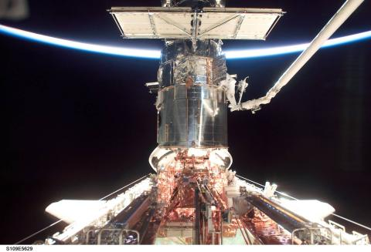
Baselines Periodically Capture the Complete System Representation
A system baseline is a complete system description including the latest requirements, designs, constraints, assumptions, interfaces, resource allocations and team responsibilities at the time the baseline is created.

Slide 4
Baselines Help Ensure
Everyone is on the Same Page
With large teams working on many different parts of a project simultaneously, it is important to make sure there is a common understanding of what is to be done and that no necessary task is ignored.
Baselines are established at milestone reviews (SDR, PDR, CDR, ORR) and are the common departure point for subsequent design and product maturation.
Baselines also ensure that the entire project matures at an approximately uniform rate.
  If one subsystem design is advanced much beyond its peers and it is later discovered that the allocations or interfaces are inappropriate, more rework will have to be done than if the subsystems had advanced at the same rate.
Notes:
Definitions as discussed in project life cycle module
SDR- System Design Review
PDR-Preliminary Design Review
CDR-Critical Design Review
ORR-Operational Readiness Review

Slide 5
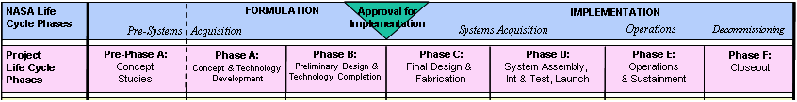
System Maturity Advances
Over the Project Life Cycle
Feasible
Concepts
Allocated
Baseline
As-Built
Baseline
Functional
Baseline
Product
Baseline
Operational
Baseline

Slide 6
Technical Baseline Definitions
Functional Baseline (Phase A)
  The functional baseline is the approved documentation describing a system’s functional, performance, and interface requirements and the verifications required to demonstrate achievement of those specified characteristics.
  Established at the System Definition Review (SDR).
Allocated Baseline aka the ‘Design-to’ Baseline (Phase B)
  The allocated baseline extends the top-level performance requirements of the functional baseline to sufficient detail for initiating manufacturing or coding.
  Established at the Preliminary Design Review (PDR).
Product Baseline aka the ‘Build-to’ Baseline (Phase C)
  The product baseline describes detailed form, fit, and function characteristics; the selected functional characteristics designated for production acceptance testing; the production acceptance test requirements.
  Established at the Critical Design Review (CDR).
‘As-Built’ Baseline (Phase D)
  The as-built baseline describes the detailed form, fit, and function of the system as it was built.
  Established at the Flight Readiness Review (FRR).
Operational Baseline aka ‘As-Deployed’ Baseline (Phase E)
  The as-deployed baseline occurs at the Operational Readiness Review (ORR) . At this point, the design is considered to be functional and ready for flight. All changes will have been incorporated into the final documentation.

Slide 7
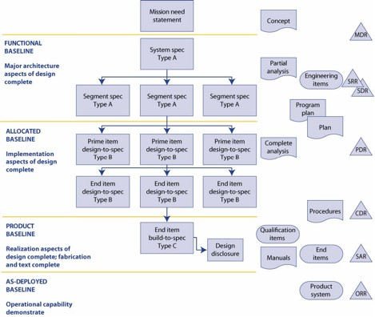
Evolution of the Technical Baseline
Notes:
Source: 2007 NASA Systems Engineering Handbook, page 153
Or the NASA Systems Engineering Process for Programs and Projects; JSC 49040; page 4-7; 10/94
A-Specs, B-Specs etc are from Mil-Std 490A; Specification Practices; 10/30/68

Slide 8
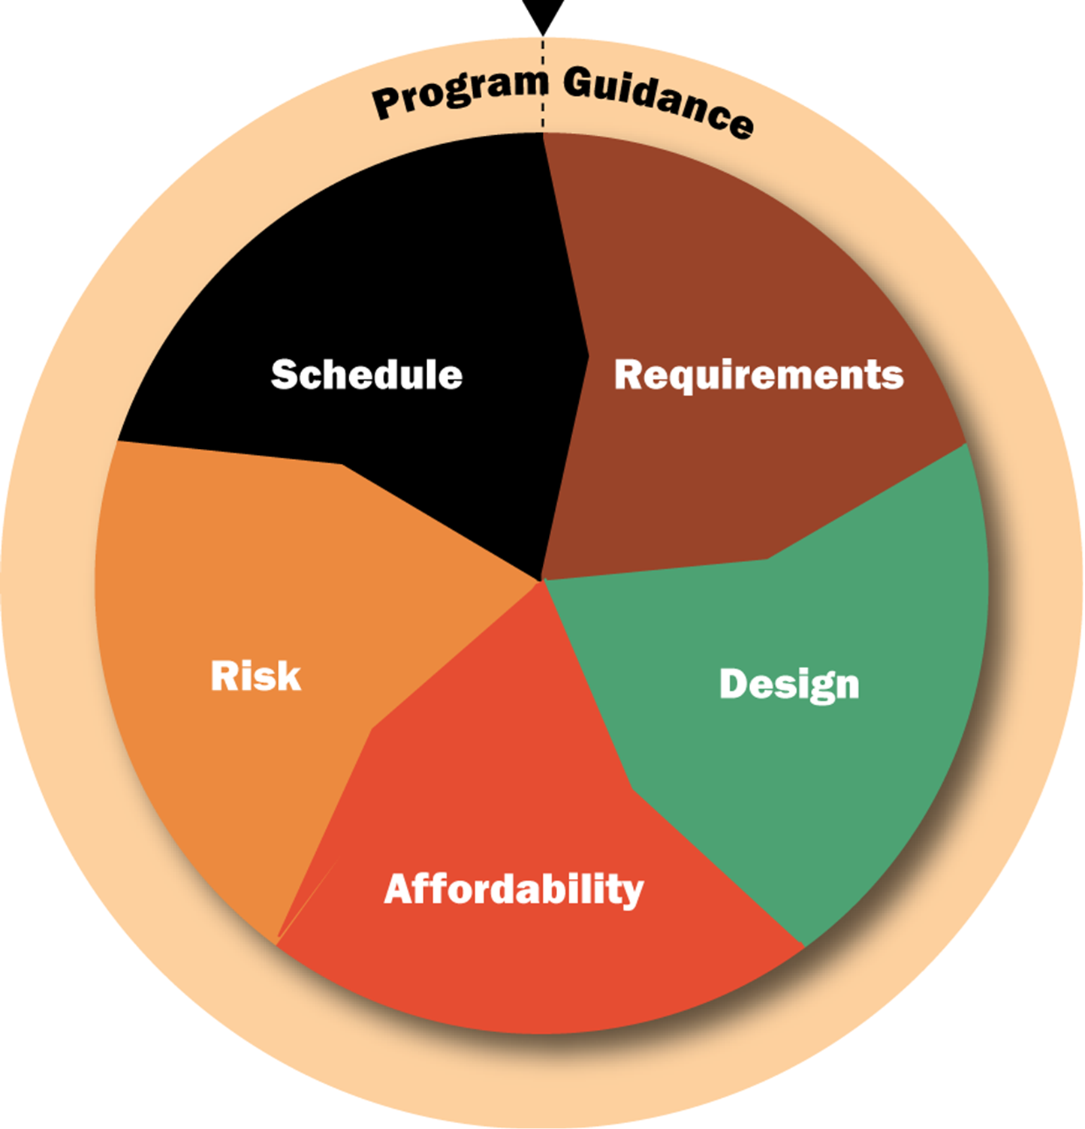
Baselines Are More Than
Just Requirements and Designs
Technical baseline deals with requirements and design.
New focus: Integrated program management synchronizes these baselines:
  Requirements
  Design
  Affordability ($$$)
  Schedule
  Risk
All 5 baselines need to be linked and tracked over the project life cycle.
Use of tools and processes to ensure that the linkages and their impacts are captured and updated in all major project documents.
This practice enables informed decision making for the future.
Integrated Program Management
Notes:
Source: Constellation Program Office Management Requirements Document (# CxP 70071)

Slide 9
Managing Requirements and the System Configuration is a Necessity
Capturing all the requirements and their traceability can be a mess!
  Parent requirements beget child requirements
  Problem-space requirements beget solution-space requirements
  Functional and performance requirements have lots and lots of peers
  Traceability, linkages and rationale must be documented and maintained
  So baselined requirements are required for each control gate
Management of it all.
  Configuration management keeps track of all of the requirements, and once hardware is built or software coded, keeps track of what has been built and coded.
  This is a huge, complex and extremely important bookkeeping job – made easier today by database tools (e.g.,CRADLE or DOORS).

Slide 10

Change - The One Constant
Concept
Studies
Concept & Technology
Development
Preliminary Design & Tech Completion
Final Design & Fabrication
System Assembly , Int & Test, Launch
Operations & Sustainment
Organizations
&
People
Changes
Changes
Changes
Changes
Changes
Artifacts
Problems
User
CONOPS
Concept
Form, Fit,
& Function
As-built
As-
deployed
Concepts
System
Reqmts.
Verificat’n
Plan
Build-to
Specs
As-verified
As-
operated
Expecta-
tions
Validation
Plan
Design-to
Specs
Verificat’n
Procedures
Anomalies
Notes:
9903
10

Slide 11
Where Do Changes Come From?
Requirements change when:
  They are reallocated as the system design matures, since initial allocations are typically suboptimal.
  New requirements are added to the system, since initial requirements may not have been complete.
  A stakeholder decides that new functions or performance is needed.
  Measured performance does not meet requirements. Reallocation or redesign are possible responses to non-compliance in test.
Configurations change when:
  What is built is not identical to what is designed. Configuration descriptions strive to be the most accurate possible description of the current system.
  Something breaks in test. Reallocation or redesign are possible responses to test failures.

Slide 12

Pause and Learn Opportunity
The Cosmic Background Explorer (COBE) satellite was slated to launch on the Space Shuttle in 1989, but the loss of the Challenger on January 28, 1986 changed everything. The COBE team was forced back to the drawing board: it had to find a new way to get COBE into orbit.
Using the COBE case study (COBE_case study.pdf) discuss the impact to a system design based on a single baseline change — a new launch vehicle.

Slide 13
Requirements Change Control
Capturing the complete set of requirements and assessing the impacts of considered changes are systems engineering responsibilities.
Top level requirements are captured first, then lower levels as the system design matures.
  Top level requirements are typically placed under change control just after the System Requirements Review (SRR).
  Lower level requirements are placed under change control after the corresponding subsystem Preliminary Design Review (PDR).
Engineering Change Requests (ECRs) are the means for making changes to requirements, with assessment and review.
Change Control Boards (CCBs) are established to review and assess the impacts of ECRs.

Slide 14
Typical Requirement and
Configuration Control Flowchart
Changes
Enhance-
ments
Problems
Evaluate Engineering Change Proposal
Analyze and Assess Impact
Project Design Review Board
Approve?
Incorporate Change
Yes
No
Archive Change
Engineering Change Proposal Preparation
Project Configuration
Control Board
Verify Change
Supply Feedback to Originator
Applicable to all baselined artifacts
Disseminate Change
End
Notes:
9903
14
Notes:
The point is not that a project needs this exact process; the point is that there needs to be a process for approval based on solid impact assessment.
Many projects have an initial administrative person or group that preprocesses changes to ensure that they are ready for the process.
A best practice is to run all potential changes through the process, including problems, suggested enhancements, and identified changes.
Part of the approval process involves determining effectivity – when the change will be implemented.

Slide 15
The Later a Change is Proposed the More Costly it is to Implement
For every hour spent in writing requirements- hundreds of hours will be spent in reading requirements- plus
  Endless meetings
  Countless debates
  Continual rewrites
  Continual rework
=> $$$$$$
System
Requirement
Verification
Plans & Procedures
Segment
Segment
Requirement
Requirement
Test
Plans
Requirement
Element
Requirement
Test
Proce-
dures
Ops
Proce-
dures
Test
Results

Slide 16
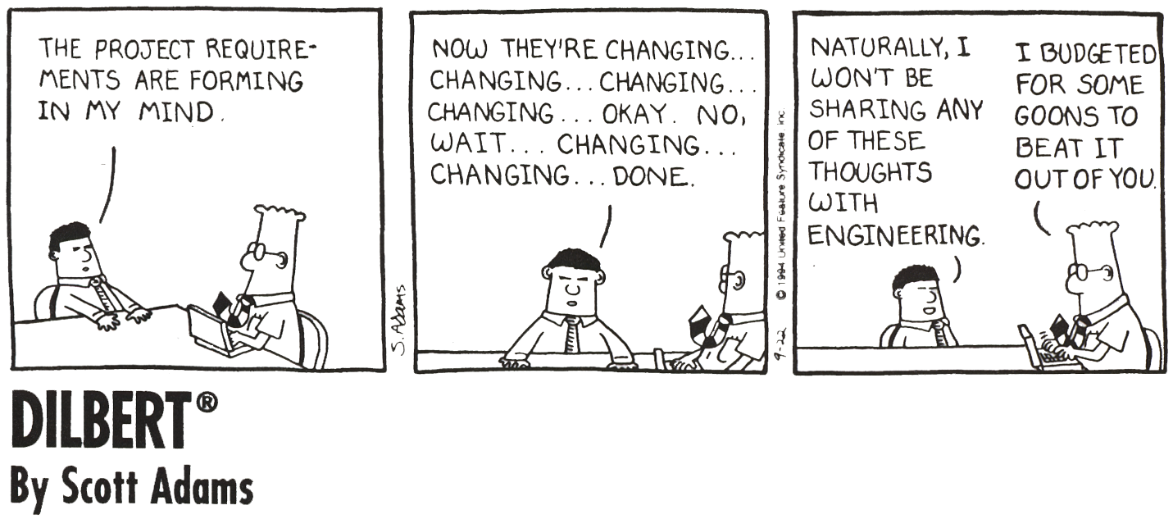
Mission Analysis, Like We Usually Have to Do It
Notes:
Is use approval needed from United Feature Syndicate, Inc?

Slide 17
Module Summary: Configuration and Change Management
System baselines capture the complete, current system description.
System baselines are updated periodically at five major milestone reviews - SDR, PDR, CDR, FRR and ORR.
Requirements and configuration changes are inevitable, so a formal process of considering the implications of these changes is used.
It is important to have managed baselines, requirements and configurations so that the entire team is working with the same assumptions of what the current system is and what it must do.
Systems engineering is responsible for creating and updating the system baseline, assessing the implications of considered changes and disseminating the news of any accepted changes.

Slide 18
Backup Slides for Requirements — Configuration &CM Module

Slide 19
Pause and Learn Opportunity
Discuss James Webb Space Telescope (JWST) Requirements Examples using the following document:
JWST Mission Requirements Document (.pdf)
Section 4.1 Descriptions of types of verification
Section 4.2 Verification Matrix
See Notes to this slide for more detail.
Notes:
Notes for reviewing the JWST Mission Requirements Document
There is a traceability matrix in appendix B with the parent-child relationships identified.
There is a verification table with the primary methods of verification - test, demonstration, analysis and inspection and the integrated product team (IPT) responsible for verification is identified.
There are a small number of TBDs and TBRs with assignments and resolution plans.
BUT, there are no rationale statements.
There are no performance allocation trees or error budgets for the performance requirements.
There are some implementation specific requirements.

Slide 20
Change Control Boards Ensure
Coordination of Changes
Level -1 CCB controls the following:
  Interface
  Level-1, 2, or 3 requirements
  Master Schedule
  Cost
  Safety
  Mission Risk
  Interchangeability
Level -2 CCB controls the following:
  Changes not shown above
  Outside controlled baseline
  In-scope cost
  Prior to formal release (freeze)
Level -3 CCB controls the following:
  Changes not shown above
  Changes not affecting another design team
  In-scope cost
  Prototype drawings
Level -1 CCB players:
  Project manager
  Project scientist
  Project System Engineer
  Mission Assurance Mgr
  Config. Mgmnt. Engineer
Level -2 CCB players:
  Design teams and their associated
    Project SE
    Mission Assurance Mgr
    Config. Mgmnt. Engineer
Level -3 CCB players:
  Cognizant engineers
  Config. Mgmnt. Engineer

Slide 21
Blue text indicates changes from last update

Slide 22
Prioritization
  List items that are mandatory.
  Group them as “musts.”
  All other items are “wants” that can be prioritized.
  Important “wants” are given a high weighted value.
  When candidate concepts are evaluated, if they do not satisfy all the “musts,” they are eliminated.
Be careful about overstating the “musts.” Otherwise, promising candidates may be prematurely eliminated.
Notes:
9903
22
Be careful to communicate clearly here. 7123.1A defines requirements as absolute musts. Using this definition “wants” are not requirements, they are “wants”.

Slide 23
Prioritizing Wants
Several methods:
  High, Medium, Low
    Select highs and lows and all else falls into medium
  One, Two, Three
    Same as high, medium, and low
  Relative to a base of ten
    Relative importance assigned a number against a scale (0-10), with ten being the highest.
  Pair-wise comparison
    Each “want” is compared to each other and a decision is made as to which one is more important. When all comparisons have been made a priority stacking results.
  Categorize “satisfaction” and “dissatisfaction”
    “How pleased will you be when this capability is provided?”
    “How upset will you be if we cannot provide this capability?”
Get the users involved to establish and baseline the priorities.
Notes:
9903
23

