Slide 1
System Design
L23.01

Slide 2
What is system design?
High level design identifying the system processes, functional components and their interfaces
Derived from system requirements
Provides an overview of the project
Define the components that are needed
Establish how components “communicate” with other components
Determine how to modularize the project into discrete work packages
Identify critical interfaces that must be well defined
Used to provide initial cost, schedule & resource estimates
Usually little or few implementation details
As system design is refined, and lower level subsystems are included, implementation issues may need to be addressed

Slide 3
System design steps
Define project goal and objectives
Develop the project system requirements
Identify the major system components that satisfy the system requirements
Identify the major system interfaces
Refine the system design
Define subsystems making up each component
Specify interfaces between subsystems
Establish management controls for the system interfaces

Slide 4
Project goal and objectives
The goal specifies the overall purpose of the project
Defines what one wishes to accomplish as a result of the project
Objectives are discrete intended accomplishments during and resulting from the project
Science objectives describe the specific scientific results expected from the project
Technical objectives describe the specific technical accomplishments expected during the project
Together the project goal and objectives define and constrain the project scope
Leads to defining the system requirements

Slide 5
System requirements
A document listing the constraints imposed upon and the results necessary from the project
The project goal as well as the scientific and technical objectives should be reflected in the system requirements
Time spent on detailing the system requirements is worthwhile
A greater understanding of what is required facilitates design and implementation and improves the chances of success
Initially focus on developing the high level scientific and technical requirements
Based upon current science knowledge, what is to be measured with what resolution and accuracy?
What constraints impose what technical limitations on your design?

Slide 6
Initial System Design
Development of the initial system design can, at times, go hand-in-hand with refinement of the system requirements
Functions needed to satisfy the science requirements define the initial system
For example, to perform any science measurement
You will need a sensor (detector system)
You will need to power the sensor (power system)
You will need to read data from the sensor (data acquisition system)
You will need to store the data (data archive system)
You will need to control the sensor, readout, storage (control system)
You will need to analyze the data (ground data system)
These functions will also need to have a set of requirements specified
For example, the power system will need to supply volts & milliamps to the sensor, data acquisition, archive and control systems

Slide 7
Traceability Matrix
Shows the relationship between requirements and the components that satisfy these requirements
Commonly used in software engineering, but has application to hardware as well
Used to assure that the system design properly addresses the project needs and does not incorporate any unnecessary components
Format of the matrix can vary widely but generally includes the following for each requirement
Identification number
Description of the requirement
Description of the component that satisfies the requirement
Description of test that verifies the components meets the requirement

Slide 8
Major System Interfaces
An interface describes the linkage between two functions or processes
Neglecting how your systems fit together can lead to disaster
NASA Mars Climate Orbiter failed in 1999 because ground systems used “English” units while the flight systems used “Metric” units!
There are multiple types of interfaces
Mechanical: How systems physically fit together
Power: What voltage and current flows between the systems
Electronic: The characteristics of electrical signals between systems
Data: Format and content of information transferred between systems
Thermal: How does heat flow between systems
Software: How modules communicate with other modules or hardware
The type and characteristics of all interfaces need to be identified and defined

Slide 9
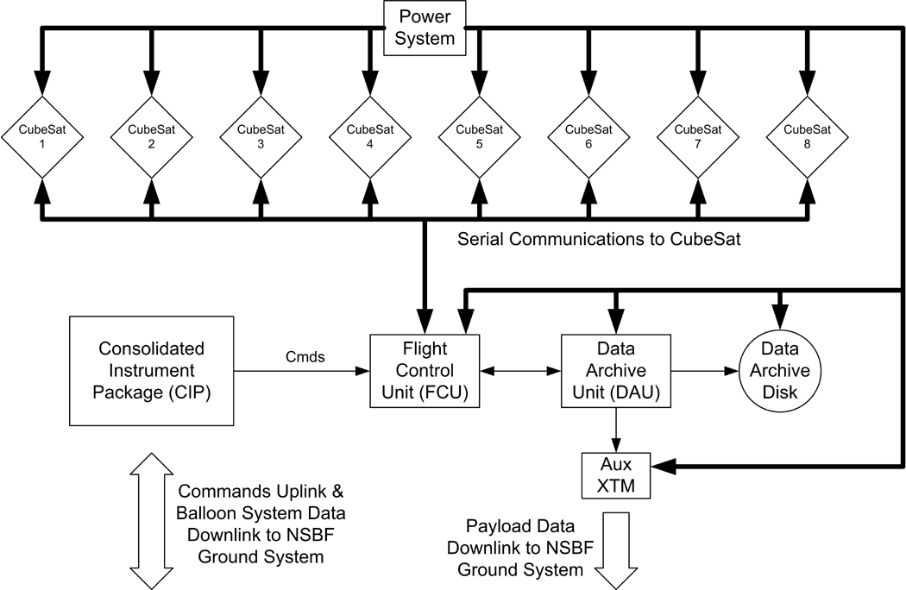
System Level Drawing Example
High level overview of a balloon platform that could carry eight student built payloads
Primary subsystems are identified
Directionality and content of major interfaces are identified

Slide 10
Refining the System Design
After the major systems and interfaces are identified the subsystems are described
Each major function is composed of multiple activities, processes or modules each with a specific function of its own
For example, the Power System in the previous slide has the following subsystems
Power source that supplies the energy for the entire platform
Separate supplies to convert the source power to the proper volts and amps required by the FCU, DAU, DAU Disk, Aux XTM and Cubesats
Each of the subsystems has interfaces that need specification
How many of what kind of interface do the subsystems have?
Is the interface to another subsystem or another system?
What is the content of the interface?
Traceability matrix should include these new subsystems

Slide 11
Subsystem Level Example
Subsystem design provides additional details
Major functional components are identified and expressed
Shows that system requirements are satisfied
Most important interface details are revealed
Still little hardware or implementation dependence

Slide 12
Moving to Design Specifics
The system design refinement process continues by specifying the subsystems of the subsystems
For example, the FCU supply in the power system might include the following sub- subsystems
A relay to turn the supply on / off by computer control
A DC / DC converter to provide the required voltage from the source power
An inline sensor so that volts and amps can be monitored in real-time by the computer
With enough iterations the system design can evolve into an actual implementation
Actual components to use in the design start becoming apparent
Interfaces become very specific and well defined

Slide 13
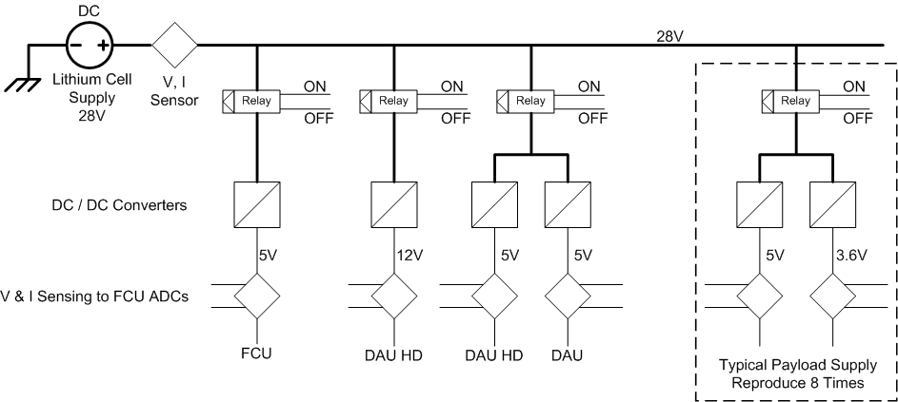
Refined Subsystem Example
Implementation and hardware details are starting to appear
Interfaces are close to being fully defined
Next step would be full hardware and interface specification

Slide 14
Controlling Interfaces
Critical interfaces need to closely monitored by use of an Interface Control Document (ICD)
Written description of the interface that is modified only under specific, previously defined conditions and is used by team personnel for implementation
Not all interfaces need to be controlled, but an ICD can be helpful during system design
Written specification of the interface
Obtain agreement between stakeholders on the interface characteristics
Controlled ICDs should be used to help manage potential risks
When an interface error or mismatch could result in project failure
When stakeholders implementing the interface ends are separated in either geographic distance or time

