Slide 1
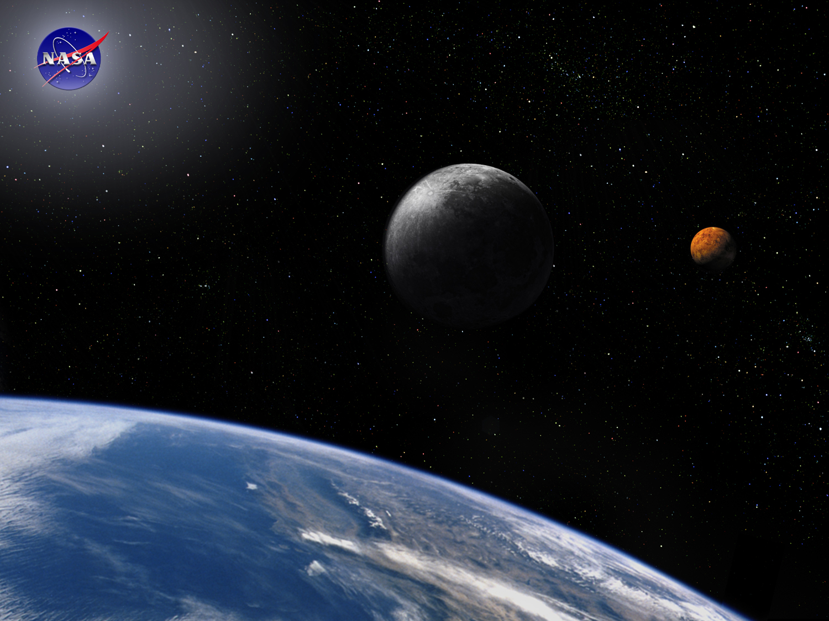
Requirements Module:
Writing Requirements
Space Systems Engineering, version 1.0
Notes:
Version 1.0
SOURCE INFORMATION:
The material contained in this lecture was developed by Lisa Guerra of NASA’s Exploration Systems Mission Directorate while on assignment in the Department of Aerospace Engineering at the University of Texas at Austin. As part of a course entitled, Space Systems Engineering, the lecture was piloted at UT-Austin in Spring 2008.
The content that follows was also reviewed and edited by Dr. Paul Graf, Adjunct Professor at the University of Colorado at Boulder.

Slide 2
Module Purpose: Writing Requirements
Define and understand the characteristics of and rules for writing good requirements.
Understand the value of providing the rationale and the preliminary verification technique with each requirement.
Define and establish the difference between requirements verification and requirements validation.
Establish the importance of resolving undefined (To Be Defined — TBD) and estimated (To Be Resolved — TBR) requirements early.
Related Readings:
Writing Good Requirements, INCOSE 1993, Ivy Hooks.
NASA Systems Engineering Handbook 2007, Appendix C, How to Write a Good Requirement

Slide 3
Good Requirements Are SMART
  Specific -
    It must address only one aspect of the system design or performance
    It must be expressed in terms of the need (what and how well), not the solution (how).
  Measurable -
    Performance is expressed objectively and quantitatively
    E.g., an exact pointing requirement (in degrees) can be tested thus verified prior to launch.
  Achievable -
    It must be technically achievable at costs considered affordable
    E.g., JWST early designs specified an aperture requirement eventually descoped due to technical issues with deployment.
  Relevant -
    It must be appropriate for the level being specified
    E.g., requirement on the solar cells should not be designated at the spacecraft level.
  Traceable -
    Lower level requirements (children) must clearly flow from and support higher level requirements (parents).
    Requirements without a parent are referred to as orphans, and need to be assessed for necessity of inclusion.
Notes:
SMART Requirements; Mike Mannion, Barry Keepence; ACM SIGSOFT, SE Notes Vol 20, No. 2, April 1995

Slide 4
Rules for Writing Good Requirements
Requirements have mandatory characteristics:
  Needed
  Verifiable
  Attainable: technically, cost, schedule
Each requirement should
  Express one thought
  Be concise and simple
  Be stated positively
  Be grammatically correct; free of typos and misspellings
  Be understood only one way; they are unambiguous
  Use consistent terminology to refer to the system/product and its lower level entities
  Comply with the project’s template and style rules

Slide 5
More Rules for Writing Good Requirements
What a requirement must state:
  WHO is responsible
  WHAT shall be done
  Or HOW WELL something shall be done
  Or under what CONSTRAINTS something shall be done
Requirement format: “WHO shall WHAT”
  Uses active not passive voice
Example product requirements:
  The system shall operate at a power level of…
  The software shall acquire data from the…
  The structure shall withstand loads of…
  The hardware shall have a mass of…
Use the correct terms:
  Requirements are binding - Shall
  Facts or Declaration of purpose - Will
  Goals are non-mandatory provisions - Should
  Do NOT use “Must”

Slide 6
Goodness Checklist: Is this Requirement…
Free of ambiguous terms?
  Examples: as appropriate, etc., and/or, support, but not limited to, be able to, be capable of
Free of indefinite pronouns?
  Examples: this, these
Free of unverifiable terms?
  Examples: flexible, user-friendly, robust, light-weight, maximize, adequate, small, portable, easily - other “ly” words and other “ize” words
Free of implementation?
  Requirement should state WHAT is needed, NOT HOW to provide it, i.e., state the problem not the solution.
Necessary?
  Ask “Why do you need the requirement?”; the answer may lead you to the real requirement.
Free of descriptions of operations?
  To distinguish between operations and requirements, ask “Does the developer have control over this?” “Is this a need the product must satisfy or an activity involving the product?”
Free of TBDs (To Be Determined)?
  Use a best estimate and a TBR (To Be Resolved) with rationale when possible.
Notes:
Compliance Automation or Ivy Hooks?
Supplementary reading suggestion: PRODUCT REQUIREMENTS DEVELOPMENT AND MANAGEMENT PROCEDURE; Langley LMS-Pilot Procedure PRDM; Revision: R3 V1; 11/16/04

Slide 7
Example Requirements: Good or Bad?
The aircraft shall have three engines (initial DC-3 requirement).
  The aircraft shall meet the operation requirements with a single engine out.
The lunar lander shall include an airlock.
  The lunar lander shall provide the capability for crew to ingress/egress while maintaining pressurization.
The crew shall have the capability to perform extra-vehicular activities (EVAs).
  The vehicle shall allow extra-vehicular activities during operations.
The spacecraft shall maximize lifetime.
  The spacecraft shall have a lifetime of at least three years.
The software shall display data in a user-friendly fashion.
  The software shall display data as described in ICD 2345 Table 3.1.
Notes:
The aircraft shall meet the operation requirements with a single engine out.
The system shall allow a change of thread selection during operations.
The system shall have a lifetime of at least three years.
The software shall display data as described in ICD 2345 Table 3.1.

Slide 8
Rationale Captures the Motivation and
Assumptions of a Requirement
The rationale of each requirement defines
  Why a requirement is needed
  What assumptions were made
  What design effort drove the requirement
  Other data that will be needed to maintain the requirement over time
Example
Requirement: “The truck shall have a height of no more than 14 feet.”
Rationale: 99% of all US interstate highway overpasses have a 14 foot or greater clearance. (Assumptions: The truck will be used primarily on US interstate highways for long-haul freight in the US.)

Slide 9
Space Example Requirement & Rationale
Requirement: “The Constellation Architecture shall provide communication and tracking services prior to launch, during all mission phases, through recovery.”
Rationale: Communication and tracking services must be provided to elements during all mission phases. Ground based assets can provide this capability to elements when in direct line-of-sight with Earth. The Space Network can support launch, operations in LEO, re-entry and landing. Earth-based comm. and tracking services cannot, however, support the lunar landing, lunar ascent, or lunar surface operations if they are at polar locations or on the far side of the Moon. Another infrastructure element, such as a lunar relay, must be provided to support communications and tracking to elements during operations on the lunar far side or at the poles.
  This requirement does not imply continuous coverage.
  Lower level requirements will specify continuity and type of coverage.

Slide 10
Early Consideration of Requirement
Verification Helps Avoid Costly Problems
The systems engineer should create a preliminary verification plan as each requirement is written. Typically this plan is no more than establishing the technique (test, demonstration, analysis or inspection) that will be used for verifying a requirement.
This early consideration of requirement verification helps:
  Confirm the requirement is indeed verifiable
  Define the system verification plan
  Identify needed facilities for subsystem and system test

Slide 11
Preliminary Verification Plans Help Eliminate Impossible or Impractical Situations
The Magellan synthetic aperture radar had dozens of command variables each with hundreds of possible values and 8 redundant, cross-strapped subsystems. The number of hardware and command options made it impossible to test every valid radar command with every configuration.
The solution was to test 4 different hardware configurations with a small subset of stressing command variables at the extreme operating temperatures.
This helped establish confidence that the radar system would work with any valid command and hardware configuration while in orbit around Venus.
Magellan met or exceeded all of its mission requirements and mapped Venus from 1989 until its termination in 1994.
Notes:
For more about the Magellan Venus radar mapping mission see the The Magellan Venus Explorer's Guide at:
http://www2.jpl.nasa.gov/magellan/guide.html
Redundant, cross-strapped units are identical subsystems that are connected to the rest of the system in such a way that either unit can be commanded for use for the full system to operate. In the event of a unit failure or degraded performance the redundant unit is available.

Slide 12
Templates Help Capture Verification Technique, Rationale, Significance and Traceability
Notes:
9903
12
Verification can be by test, demonstration, inspection, or analysis
Note that requirements definition card template suggests that the only verification technique is test, which is not true.

Slide 13
Requirements Validation
Requirements validation asks three questions:
  Do we have the correct problem?
  Do our requirements capture this problem?
  Are our requirements SMART?
Performed to assure the system requirements set is complete, consistent, and each requirement is achievable and verifiable.
Performed by subject matter experts, the system performing organization and the system authorized customer.
Does the requirement set completely address and accomplish the mission?
Are the requirements consistent with the established system boundaries and constraints?
When does requirement validation take place?
  Usually before the System Requirements Review (SRR)
Notes:
Definition of SRR
System Requirements Review (SRR) - A validation of the realism of the functional and performance requirements and their congruence with the system configurations selected to conduct the mission.

Slide 14
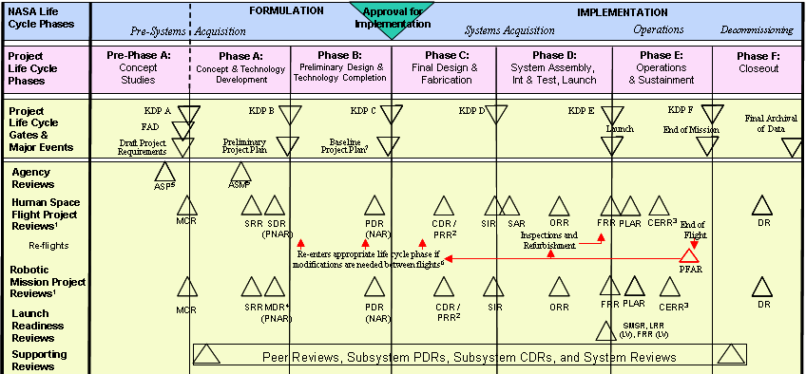
Resolve TBDs and TBRs Early in the Project Life Cycle
TBDs and TBRs can cause rework
TBDs and TBRs identify missing or uncertain information.
When resolved they may cause rework of items previously completed.
Assign responsibility for all TBDs and TBRs.
Resolve as soon as possible.
Notes:
This chart shows the standard NASA Life Cycle chart from the NASA SE Handbook 2007.
The point is that turning TBD and TBR requirements into real requirements needs to occur early in the life cycle, preferably before the Systems Requirements Review.
9903
14

Slide 15
Overall Constellation Program
System Requirements Review (SRR) Schedule
You are Here!
2007
March
April
May
PBS
5/23
Issue ID, Form Entry
3/26
5/10
3/29
Provide Issue list w/ Resolution Plan & Impacts
Rev. Issue Table, POC, & Sched.
Provide Status on Issue Resolution
(every Mon. @ Cx SE&I 8:30 telecon)
4/6
4/9
4/16
4/23
4/30
Develop PBS Presentation
5/14
CLV SRR
(send updates to Cx SE&I COB every other day in May)
Issue ID, Form Entry
3/26
5/10
Provide Issue list w/ Resolution Plan & Impacts
Rev. Issue Table, POC, & Sched.
4/6
Provide Status on Issue Resolution
(every Mon. @ Cx SE&I 8:30 telecon)
4/9
4/16
4/23
4/30
Develop PBS Presentation
5/14
CEV SRR
(send updates to Cx SE&I COB every other day in May)
Issue ID, Form Entry
4/9
5/10
Provide Issue list w/ Resolution Plan & Impacts
Rev. Issue Table, POC, & Sched.
4/13
Provide Status on Issue Resolution
(every Mon. @ Cx SE&I 8:30 telecon)
4/16
4/23
4/30
Develop PBS Presentation
5/14
MO SRR
(send updates to Cx SE&I COB every other day in May)
5/10
Provide Issue list w/ Resolution Plan & Impacts
Issue ID, Form Entry
5/4
Rev. Issue Table, POC, & Sched.
5/5
5/14
GO SRR
Develop PBS Presentation
Provide Status on Issue Resolution
(send updates to Cx SE&I COB every other day in May)
5/10
Provide Issue list w/ Resolution Plan & Impacts
Issue ID, Form Entry
5/8
Rev. Issue Table, POC, & Sched.
5/9
EVA SRR
5/14
Develop PBS Presentation
Provide Status on Issue Resolution
(send updates to Cx SE&I COB every other day in May)
Notes:
This chart shows the schedule in 2007 for NASA’s Constellation Program Office to manage the System Requirements Reviews for the following systems:
Crew Launch Vehicle (CLV), Crew Exploration Vehicle (CEV), Mission Operations (MO), Ground Operations (GO), and Extra-Vehicular Activity (EVA).
Note that the various system SRRs occur in a series and culminate into the Program level SRR, here referred to as PBS (5/23/07).

Slide 16
Constellation Program Status (spring ‘07)
(Closure of SRR)
RIDS
Total RID Count: 6,283
6,225 Closed
58 Open
  Majority closed prior to PBS
  All RIDs should be closed prior to CxP SDR
Board AI
Total AI Count: 48 Total
9 Closed
39 Open
  30 are “Past Due”
  9 are in work, “Not Due Yet”
TBD/TBR
Total Count: 2,532
  Received plans for 2,064 TBRs/TBDs in 72 of 95 documents (76% of docs.)
  Need burn-down plans for 196 TBRs/TBDs in 16 documents (17% of docs.)
  7 documents (274 TBRs/TBDs) will not be updated/baselined until post CxP PBS. These TBRs/TBDs will not be closed prior to CxP PBS
Notes:
This chart is an actual status chart from the Constellation Program Office in Spring 2007.
AI - Action item
RIDS - Review Item Disposition System
TBD - To Be Determined (no requirement yet)
TBR - To Be Reviewed (best estimate is provided)
CxP - Constellation Program
PBS - Product Breakdown Structure
SDR - System Definition Review

Slide 17
User Participation and
Communication are Key
Suddenly, a heated exchange took place between the
King and the moat contractor.
Notes:
9903
17
Contact information for permission to use a Far Side cartoon
Marianne Sugawara
Creators Syndicate
5777 W. Century Blvd., Suite 700
Los Angeles, CA 90045
Tel : (310) 337-7003
Fax: (310) 337-7625
E-mail: FarSide@creators.com
Web: http://www.creators.com

Slide 18
Pause and Learn Opportunity
Discuss James Webb Space Telescope (JWST) Requirements Examples
JWST Science Requirements Document (.pdf)
Chapter 4 Table 4.1 Verification Matrix
Chapter 7.0 Rationale Chapter
Chapter 8.0 Actual Science Requirements Chapter
Appendix B Traceability Matrix

Slide 19
Module Summary: Writing Requirements
Good requirements Are SMART: Specific, Measurable, Achievable, Relevant and Traceable
It is good practice to capture the rationale and preliminary technique for verification when writing requirements.
Requirement validation is a process of ensuring that: the set of requirements is correct, complete, and consistent.
Since the cost of reconciling undefined requirements grows as the project matures, undefined (TBD) and estimated (TBR) requirements should be resolved as early as possible.

Slide 20
Backup Slides for Requirements — Writing Module

Slide 21
Work With the Customer to Distinguish Between ‘Desirements’ and Requirements
Desirement – something that would be nice to have but is not mandatory to accomplish the mission
Requirement - something that must be done for the mission to be successful
Customers and stakeholders often blur the distinction between what is necessary and what would be nice to have
Develop the problem statement independently of the solution
Customers, stakeholders, design engineers and even systems engineers often have solution biases – Desirement space
Be Careful - Customers or stakeholders may have a good idea, but early implementation solutions may prove impossible, impractical or sub-optimal when looked at in detail - capture what is necessary for mission success and then develop solutions to meet those needs.

Slide 22
Requirements Validation
Requirement Validation is the process of confirming the completeness, compatibility and correctness of the requirements.
Requirement Validation answers the questions: “ Are the system design requirements correctly defined and mean what we intended? “Is the set of requirements, or the specification, self-consistent?”
When does requirement validation take place?
  Before design and during detailed design, i.e., mostly in Phase B and tapering down in Phase C
  Ideally, completed prior to System Requirements Review (SRR)
What is importance of getting requirements validation right early in the project life cycle?
  So when it comes time to verify the system, you are verifying to the right requirements.
Notes:
Additional thoughts on requirements validation.
Source: Goddard Procedures and Guidelines on Systems Engineering; GPG 7120.5; page 16
During the design phases performance predictions, trade studies, analyses are used to validate that the chosen design meets the requirements, when utilized according to the Operations Concept.
Validation also establishes requirements tracing to ensure that the higher level requirements flow to a lower level or child requirement. Requirements validation also makes sure that the lower level requirements have a parent requirement. Orphan requirements, ones without a higher level parent, are evaluated to determine if they are needed.
a. Requirements shall be validated to assure that the system will meet the Mission Objectives, be capable of performing the Measurement Concept, accommodate the Instrument Concept, and operates as defined in the Operations Concept.
b. Each project shall decide on the mechanism for tracking the requirements and who is responsible for the requirements flow and verification.

Slide 23
Automated Tools
  There are tools that provide requirements management capabilities and also offer executable models
  Tools such as CORE, DOORS, CRADLE, SLATE, Popkin, etc., provide feature rich interactive analysis
  The INCOSE web site www.INCOSE.org gives access to an INCOSE Tool Survey
    Fifteen requirements management and ten systems architecture tools are listed
Notes:
23

Slide 24
Requirements Verification and Requirements Validation
Requirement verification is establishing confidence that the requirement has been met.
  Requirements are verified by test, demonstration, analysis or inspection.
  Test is the most common method of verification and the technique that provides the most confidence that the system will indeed work as intended in its anticipated environment.
Requirement validation is a process of ensuring that :
  the set of requirements is correct, complete, and consistent,
  a model can be created that satisfies the requirements, and
  a real-world solution can be built and tested to prove that it satisfies the requirements.
If a systems engineer discovers that the customer has required a perpetual-motion machine, the project should be stopped.
Notes:
Requirements validation definition from: Requirements Development, Verification and Validation Exhibited in Famous Failures; Bahill and Henderson; Systems Engineering, 8(1):1-14, 2005.

