Slide 1
Second Semester of the 2021-2022 LaACES Program

Slide 2
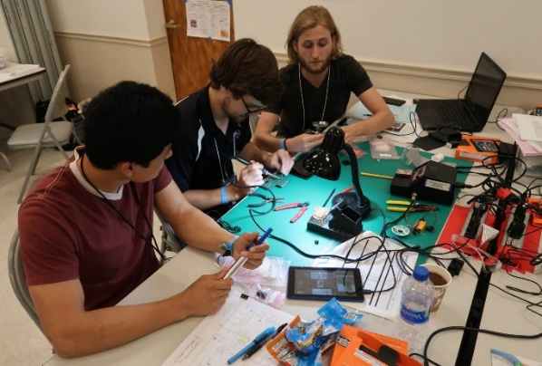
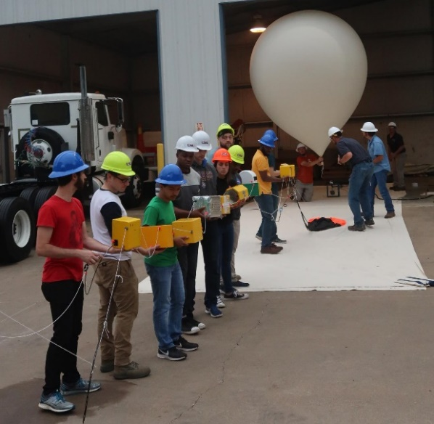
Objectives for 2nd Semester
Goal:
“To inspire students to continue towards STEM related careers”
Objectives:
Provide students with an authentic flight project experience not normally available through the classroom
Develop student skills in electronics, real-time programming, communication, and project management
Guide students to work in teams and to use acquired knowledge to create a science payload for balloon flight
Students communicate their progress through required documents and presentations on a milestone schedule
Conduct annual flight operations where approved student team payloads are flown on a latex sounding balloon to an altitude of ~100,000 feet or the very “edge of space”

Slide 3
Outline of 2nd Semester Tasks
Guide students toward a realistic payload based upon the MegaSat stack
Provide choice of different options
Fabrication and use of the MegaSat
Students must be working in a team during payload development
Discuss and guide development of the “Team Contract”
Project Management Unit:
Introduction, Requirements, System Design, Tasks and Scheduling, Flowcharts, Risk Management
Payload Design Unit:
Mechanical Drawings, Fabrication, Materials, Power Systems
Payload Design, Development, Fabrication, Calibration, System Testing
Preliminary Design Review and Critical Design Review milestones and deliverables
Thermal Vacuum System Testing at LSU
Flight Readiness Review milestone and deliverable

Slide 4
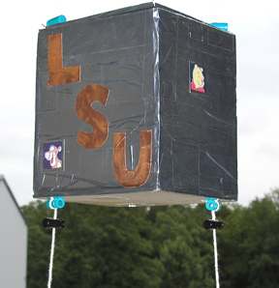
Balloon Payload Requirements
Limited to about 500 grams weight
Roughly a polygonal prism with 15 cm to 20 cm long sides
Mechanical structure constructed from ¾” polystyrene foam
Vehicle interface is a pair of strings, separated by ~17 cm, that pass through the payload unbroken and secured with spring clips.
Needs to conduct science or technology experiment
Designed, built, tested and shown to be fully “space worthy” by May 2022.
Need to successfully complete three major design reviews and T/V system test.
48 hours after flight the team will need to have calibrated science results from the flight and present results to an audience of professional scientists and engineers.
Payload mechanical interface

Slide 5
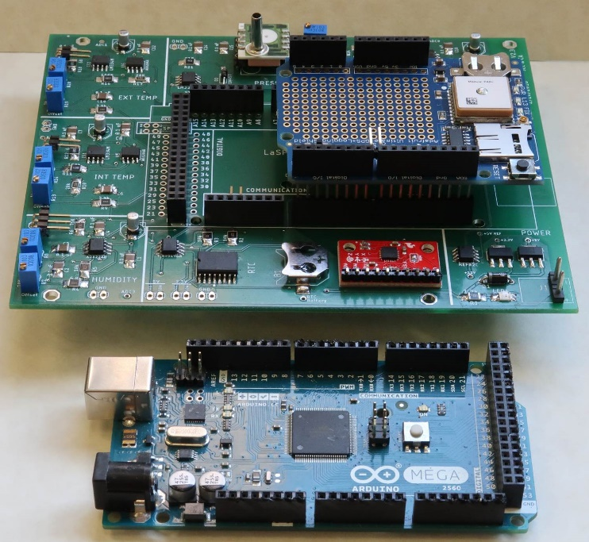
LaACES MegaSat Core
The core of the payload will be the LaACES MegaSat that includes
Two temperature sensors, one humidity sensor, one pressure sensor, 3-axis accelerometer, 3-axis gyroscope, and a real-time clock with backup battery
Payload controller will be the Arduino Mega.
Will have the Adafruit Ultimate GPS Logger shield for GPS data throughout the flight and recording NMEA data on a SD card.
The prototype area on the Adafruit GPS shield or a separate proto-shield board can be used to interface with other sensors.
Construction of MegaSat shield is done in parallel with other required activities
The team will need to include in planning
The components that will be part of the payload
Time needed to construct the MegaSat shield
How to interface additional sensors to the Mega
LaACES MegaSat payload stack

Slide 6
Suggested possible science topics
Radiation Intensity as a function of altitude
Measure intensity of UV bands as function of altitude to deduce properties of ozone layer
Directly measure concentration of O3, NOx, COx gases as a function of altitude using solid state sensors
Develop a system to measure air flow (e.g. hot wire anemometer) at high altitudes (i.e. very low pressure).
Investigate methods to optimize atmospheric temperature measurements
Investigate thermal flow and conductivity of boundary layer around payload
Develop an inertial sensing system which will provide sub-minute of arc orientation knowledge
Additional details for suggested ideas can be found in L18.01

Slide 7
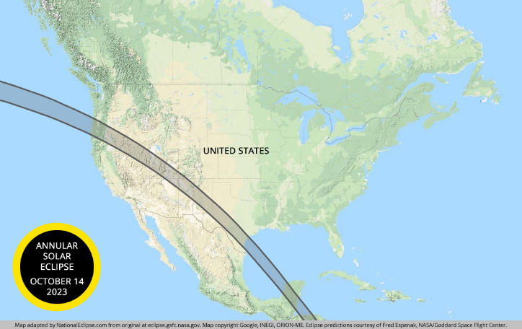
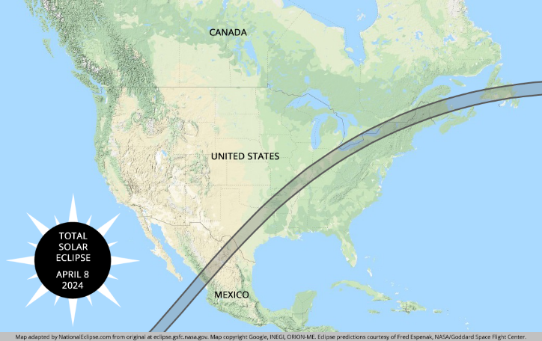
Upcoming Solar Eclipse Ballooning Opportunities
As we did for the 2017 solar eclipse, we will also hold a competition during LaACES 2022-2023 for “solar eclipse” student payloads
Payload science objective determined by the individual science team
Selected teams will be awarded a seat on LASPACE Balloon flights during the Solar Eclipses
October 14, 2023 annular solar eclipse launch
April 8, 2024 Total solar eclipse launch
Details for the upcoming solar eclipse competition will be released at a later date
LaSPACE selected as an Engineering POD lead for select teams for the National Eclipse Ballooning Project - https://eclipse.montana.edu/
Applications are scheduled to be released in late 2022.
2 science track for NEBP balloons
Atmospheric Science track
Engineering Science track

Slide 8
Payload Development Requires Team Cohesion
The activity for the Project Management unit is to have each team produce their own “Team Contract”
Students need to identify and write down their “rules of engagement” for how they will operate as a project team
The Team Contract should include items such as meeting schedule, document management, roles, task management, as well as joining and leaving a team
The institution faculty advisor will lead this effort
These Team Contracts are not a LaACES deliverable
However, teams that do not spend sufficient time determining, and writing down, how to operate as a group tend to have a high probability of failure

Slide 9
Payload Development Requires Management
Project Management lectures and materials are in Part II, Units 21 through 26
https://laspace.lsu.edu/laaces/student-balloon-course/
These lectures and materials include the following:
Lecture 21.01: Management, Life Cycle, Documentation
Lecture 22.01: Requirements Module - The Basics
Lecture 22.02: Requirements Module - Writing Requirements
Lecture 22.03: Requirements Module – Change Management
Lecture 23.01: System Design
Lecture 23.02: Producing a System Design Drawing
Lecture 24.01: Defining the Project Tasks, Costs & Schedule
Lecture 24.03: The Project Schedule
Lecture 24.02: Working with MS Project
Lecture 25.01: Basics of Flowcharts
Lecture 26.01: Risk and Risk Management

Slide 10
Payload Structure and Design
Payload design lectures are in Part II, Units 27 through 30
https://laspace.lsu.edu/laaces/student-balloon-course/
Units 27 and 28 are concerned with fabrication, testing, and use of the MegaSat
Other payload lectures and materials available for reference (These will not be covered in a formal session)
Lecture 29.01: LaACES Balloon Vehicle and Flight Profile
Lecture 29.02: Mechanical Design Guidelines
Lecture 29.03: Payload Construction Consideration & Techniques
Lecture 29.04: Constructing an ACES cube payload
Lecture 29.05: Constructing an ACES octagon payload
Activity 29.01: Constructing a Structure with XPS foam
Lecture 30.01: Simple Power Systems
Lecture 30.02: Batteries and Battery Packs
Activity 30.01: Power Systems and Budgets

Slide 11
The Project Reviews
There are at least three major reviews during a project
Preliminary Design Review (PDR)
Critical Design Review (CDR)
Flight Readiness Review (FRR)
You should also include a Pre-PDR and Pre-CDR review at your institution to divide the reviews into more manageable sections
Each review has a somewhat different objective and emphasis and provides a check on project progress for all stakeholders
Templates are provided for all review documents. Read all instructions contained within the template carefully!
Required deliverables to LaACES Management are written documents for the PDR, CDR, and FRR
These documents must be fully vetted by the institution faculty advisor(s)
The required documents will be rated as Pass / Fail. A “Fail” on any document means the team will very likely not fly

Slide 12
The Project Reviews Document Templates
The templates provide a sequence of payload documentation from the initial organization and justification to the final defense of the payload flight worthiness
Each template ADDs to the previous template so it is important for a student team to fully complete one document before moving on to the next.
Pre-Preliminary Design Review (Pre-PDR) template
Preliminary Design Review template (PDR)
Pre-Critical Design Review (Pre-CDR) template
Critical Design Review (CDR) template
Flight Readiness Review (FRR) template
These templates can be found on the LaACES Document Center at https://laspace.lsu.edu/laaces/laaces-document-center/
Will talk about these reviews and expectations in the Project Management overview lecture.

Slide 13
Milestone Schedule for LaACES 2021-2022
Recommended Deadline LaSPACE Deadline
PDR February 11, 2022 February 18, 2022
CDR April 1, 2022 April 8, 2022
Thermal / Vacuum Test (at LSU) April 22, 2022
FRR April 29, 2022 May 6, 2022
LaACES Launch Trip May 15, 2022 – May 20, 2022
FRR Defense Presentation (at CSBF) May 16, 2022

