Slide 1
Student Payload Ideas

Slide 2
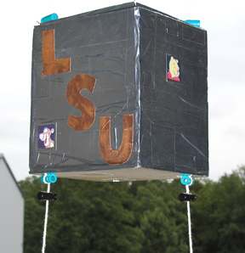
Balloon Payload Requirements
Limited to about 500 grams weight
Roughly a polygonal prism with 15 cm to 20 cm long sides
Mechanical structure constructed from ¾” polystyrene foam
Vehicle interface is a pair of strings, separated by ~17 cm, that pass through the payload unbroken and secured with spring clips.
Need to conduct some kind of science or technology experiment
Designed, built, tested and shown to be fully “space worthy” by May 2020.
You will need to successfully complete three major reviews of your progress.
48 hours after launch you will need to have calibrated science results from your flight and present your results to an audience of professional scientists and engineers.
Payload mechanical interface

Slide 3
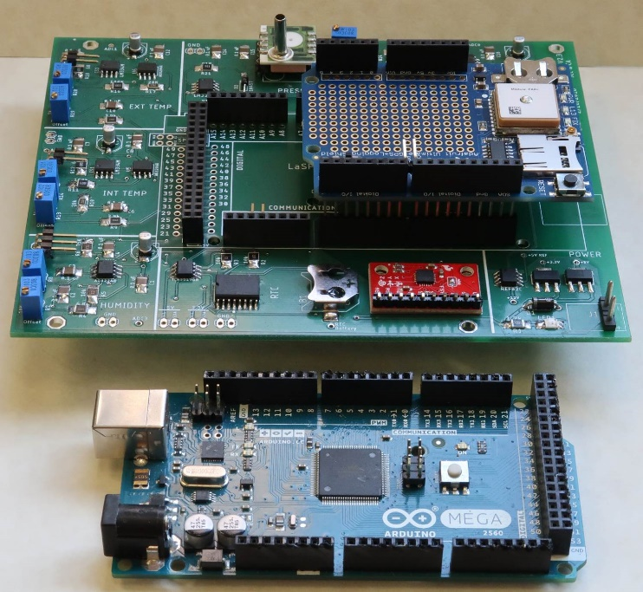
LaACES MegaSat Core
The core of your payload will be the LaACES MegaSat that includes
Two temperature sensors, one humidity sensor, one pressure sensor, 3-axis accelerometer, 3-axis gyroscope, and a real-time clock with backup battery
Payload controller will be the Arduino Mega.
Will have the Adafruit Ultimate GPS Logger shield for GPS data throughout the flight and recording your data on a SD card.
You can use the prototype area on the Adafruit GPS shield or a separate board to interface with other sensors.
You will begin construction of your MegaSat shield in a few weeks
Need to include in your planning
The components that will be part of your payload
Time needed to construct the MegaSat shield
How you will interface your sensors to the Mega
LaACES MegaSat payload stack

Slide 4
Need to begin thinking now!
Given the constraints, you need to think about and address issues throughout the academic year
Here we discuss some example payloads
Either previously developed and flown or
Should be feasible to develop and fly within the limitations of this program
Your team needs to choose one of these examples!
Your team will have two weeks to develop your Pre-PDR
Research and write the scientific background for your payload
Determine your mission goal, objectives, and requirements
Establish a general schedule for payload development
You will write a complete a defense (i.e. the FRR) of your payload proposal by the end of this semester.

Slide 5
Some possibilities
Radiation Intensity as a function of altitude
Measure intensity of UV bands as function of altitude to deduce properties of ozone layer
Directly measure concentration of O₃, NO_{x}, CO_{x} gases as a function of altitude using solid state sensors
Develop a system to measure air flow (e.g. hot wire anemometer) at high altitudes (i.e. very low pressure).
Investigate methods to optimize atmospheric temperature measurements
Investigate thermal flow and conductivity of boundary layer around payload
Develop an inertial sensing system which will provide sub-minute of arc orientation knowledge

Slide 6
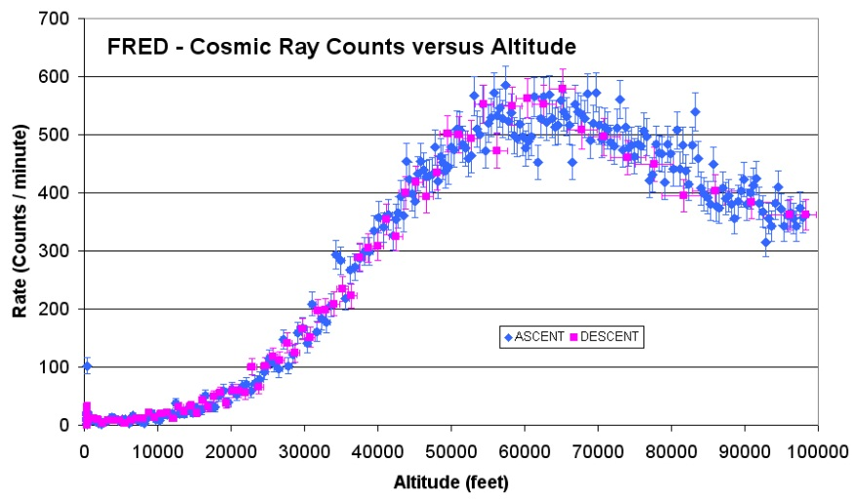
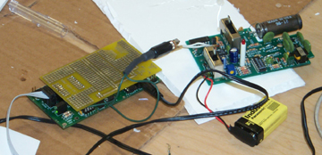
Radiation Intensity vs Altitude
Cosmic rays are high energy nuclei that originate outside our solar system.
CR interact in Earth’s atmosphere producing a shower of particles
The intensity of this radiation varies with altitude
This payload would determine the radiation flux as a function of altitude on ascent and descent
Two sensors to implement and compare 1) Geiger-Muller tube, 2) Scintillator and solid state PM
Determine a rough energy spectrum by comparing count rates with different thresholds.

Slide 7
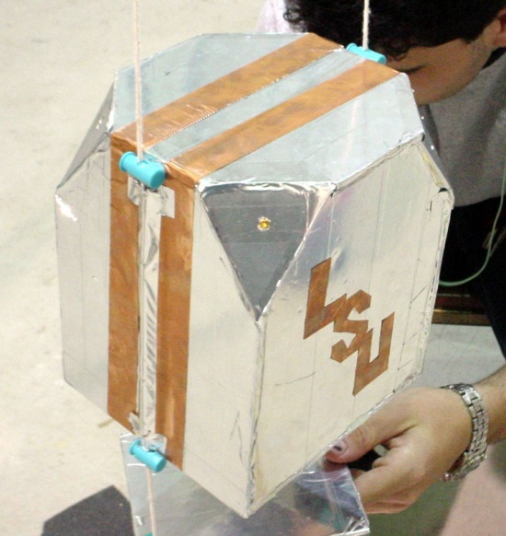
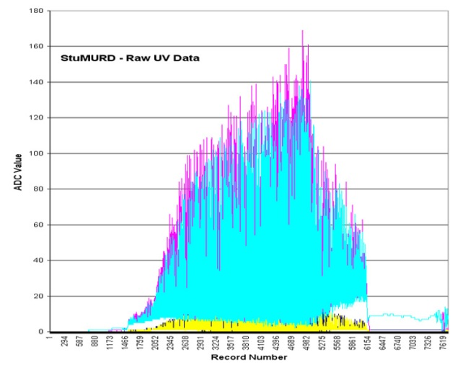
Intensity of UV versus Altitude
UV is absorbed by ozone in the upper atmosphere
Surprisingly there are few (none?) published measurements of UV intensity in the stratosphere.
This effort has the potential of generating a journal publication with the team as authors!
Payload would measure the UV intensity as a function of altitude and infer the vertical distribution of ozone
One or more sensors (or the appropriate wavelength sensitivity) would monitor UV from the Sun.
The signal from the sensor would need to be conditioned and converted to a digital number by an ADC
You will need to take into account rotation of the balloon craft
Calibrations of sensor and ADC will be needed to determine flux

Slide 8
Measure Atmospheric Components
The gas composition of the atmosphere changes as a function of altitude
The increase in temperature above the Tropopause is related to the ozone layer
This payload would measure trace gases using solid state sensors
Correlate stratospheric temperature with ozone concentration
The aerosol particle density also changes as a function of altitude
Determine how to measure aerosol characteristics (density, size distribution) as a function of altitude
NO₂
Altitude (km)
NO
CO₂
N₂O
O₃
H₂O
Generalic, Eni. "Troposphere." Croatian-English Chemistry Dictionary & Glossary. 20 Oct. 2018. KTF-Split. 9 Jan. 2020. <https://glossary.periodni.com>.

Slide 9
Air Flow Sensing
Payload would measure the air flow or ‘wind speed’ as a function of altitude using a hot-wire anemometer
Investigate various techniques used to build hot-wire anemometers
Investigate methods to calibrate a hot-wire anemometer sensitive enough to measure small ‘wind speeds’
Determine the wind speed and the air pressure and use them to calculate the air mass flow rate
Payload can use the upward movement of the payload to generate the wind across the anemometer

Slide 10
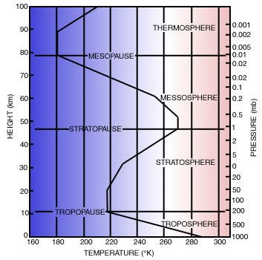
Accurate Atmosphere Temperature
The temperature and pressure of the atmosphere varies as a function of altitude.
Temperature initially decreases with increasing altitude, then increases as UV is absorbed in the atmosphere.
Pressure decreases in an exponential manner
Many factors influence the accuracy of atmospheric temperature including the sensor color, air flow around the sensor, where the sensor is placed.
This payload would need to investigate and quantify the different influences, develop a method for accurately measuring the atmospheric temperature, and quantify the measurement uncertainty.
Measurements should be compared with NOAA soundings.

Slide 11
Thermal Investigations
Investigate thermal flow & conductivity of boundary layer around payload
Temperature sensors on box interior, interior surface, exterior surface, 5 cm boom and 10 cm boom
Determine heat flow and the payload effect on measuring the temperature of the atmosphere.
Optimizing thermal shields for temperature sensors
Temperature sensors on 10 cm booms with white, black, checkered and silver shields
Measure and model the “atmospheric temperature” measured by the four sensors

Slide 12
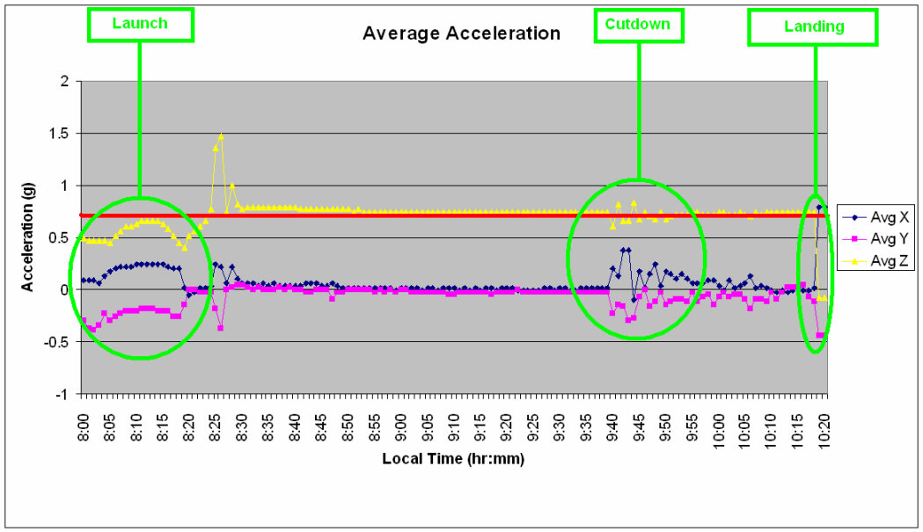
Minute of Arc Inertial System
Develop an inertial attitude sensing system that would be accurate to less than one minute of arc
Use to investigate the rotation and turbulence of the payload during flight
Use some combination of magnetometer compass, tilt sensors, fiber-optic gyroscopes, accelerometers and a sun sensor
Develop system that would determine payload attitude to about one arc-minute
Correlate observed turbulence with atmosphere layers

