Slide 1
Memory and Data Storage Devices

Slide 2
Memory Devices
Memory devices are electronic devices that store information for immediate use in electronic hardware. Memory devices utilize digital logic to perform their operations.
Examples:
EEPROM
RAM
Flash Memory

Slide 3
Building Blocks of Memory
Memory devices are often constructed on a hardware level with logic gates and simple memory circuits such as latches and flip-flops.
Types of Logic Gates:
AND, OR, NOT, NAND, NOR
Types of Latches
SR NOR, SR NAND, SR AND-OR
Types of Flip-Flops
D Flip-Flop, T Flip-Flop, JK Flip-Flop

Slide 4
Memory Types
There are two main types of memory devices: volatile and non-volatile
Volatile Memory is memory that requires power to maintain stored information (Ex. RAM)
By contrast, Non-Volatile Memory is computer memory that stores information even after power has been cycled. (Ex. Flash memory)

Slide 5
ROM
Read-Only Memory (ROM) is a type of non-volatile memory used to store programs and data
Traditional ROM cannot be changed after it has been written
EEPROM and EPROM are types of ROM that can be changed after the initial programming. The write time for such devices is often relatively slow
EEPROMs have a finite amount of times it be erased and rewritten
Often used to store software or data that is rarely changed (ex. firmware, lookup tables)

Slide 6
Flash Memory
Flash memory is a type of non-volatile computer memory that can be erased and reprogrammed
Flash memory is based on EEPROM with larger memory block sizes
  Technically Flash is a type of EEPROM
  Usually “EEPROM” use NOR and “Flash” use NAND
  “EEPROM” small, “Flash” large
Flash memory is often used for large solid-state digital storage
Solid-state hard drives are often made using flash memory

Slide 7
RAM
Random Access Memory (RAM) is a type of volatile computer memory where memory cells can be accessed in any order
Since programs do not need to look up addresses for memory, RAM is significantly faster than other memory devices
RAM is often used for programs or software that are actively being used

Slide 8
Magnetic Hard Disk Drive
Hard disk drives are non-volatile memory devices used for storing large amount of data
Data is stored in individual blocks of memory that can be stored or retrieved in any order
Data is saved by magnetizing ferromagnetic material on a disk using a magnetic lever. The encoding allows for data to be stored even when power is lost
Primarily used as secondary storage devices for computers.
Notes:
Magnetic hard disk drives do not function in space environments

Slide 9

SD Cards
Secure Digital (SD) cards are a type of non-volatile memory devices used for portable devices
SD cards utilize flash memory to store large quantities of data in a small physical size
SD Cards are available in multiple storages size ranging from 512 MB to 1 TB
SD, SDHC, SDXC, SDUC are simply standards of increasing size and write speed and generally not important for Arduino usage

Slide 10
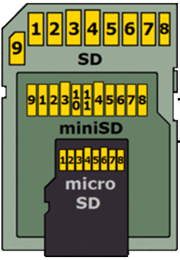
SD Cards Physical Details
SD cards are available in three physical sizes: standard, miniSD, and microSD
Standard: 32 mm x 24 mm x2.1 mm
Mini: 32 x 20 mm x 1.4 mm
Micro: 15 mm x 11mm x1.0 mm
The pinout for each size varies

Slide 11
SD Cards File Systems
An SD card (or any storage device) uses a particular format to store/arrange its flies.
The file system places maximum limits on the total storage size and on single file size
For SD cards you are likely to encounter one of the versions of the File Allocation Table (FAT)
  Under 2GB have FAT16
  2- 32 GB FAT32
  >32 GB exFAT
One detail to keep in mind is that a libraries that are compatible with larger file systems will require larger amounts of the Arduinos RAM
File System | Max Volume Size | Maximum Single File Size
FAT16 | 2 GB | 2 GB
FAT32 | 32 GB | 4 GB
ExFAT | 128 PetaB | 2 ExaB

Slide 12
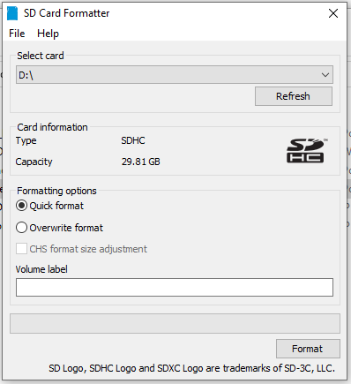
Using the SD Formatting Utility
It is useful to be able to completely erase the SD using the formatting utility Utility from the SD card Association
Download the correct version for you operating system
Formatting the card will erase all the data on the card
When the SD card is inserted into the computer the Card should appear under the select card drop down and the Card Information should update

Slide 13
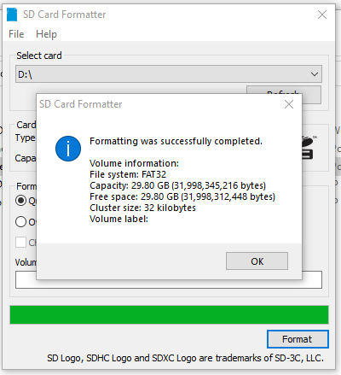
Formatting FAT32
The utility will automatically select the appropriate file system for the size card.
You can see here that the 32GB SD card was formatted in FAT32

Slide 14
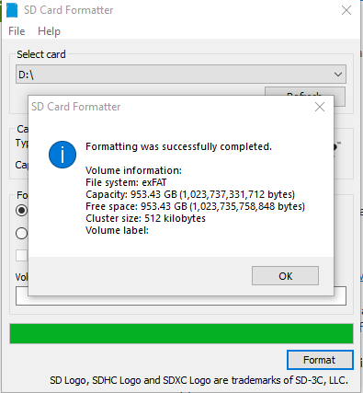
Formatting ExFAT
And here a 1 TB SD card was formatted to exFAT
It is important to know which file system was selected because not all file systems are supported by all libraries
Also, note there are 2 format options
  Quick – just marks the space as available to overwrite
  Overwrite – Actually erases the data by overwriting it

Slide 15
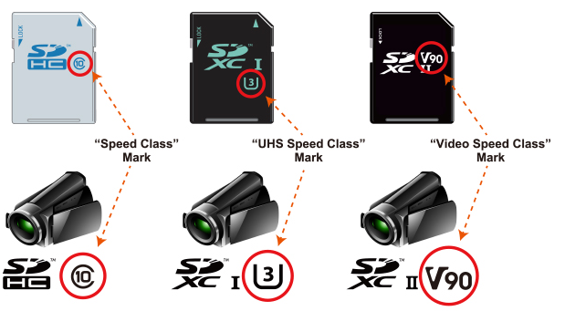
Write Speed Standards
You may see references to the “Class” or markings like those shown to the right
These refer to write speed standard the card must achieve
These speeds are far higher than the Arduino will be able to achieve so not a specification we need to be concerned about

