Slide 1
The Ultimate GPS Logger Shield - SD
LaACES Student Ballooning Course

Slide 2
SD Card
The GPS shield has a microSD card slot. Use this to save the GPS and flight data
Communication between the Mega and SD card uses SPI
The microSD can be any capacity, but be aware of the limitations of the SD library being used
When inserting the microSD, ensure that it latches. If it does not latch, no data will be logged
Data saved in files on SD card
The Adafruit Ultimate GPS Logger Shield’s microSD socket. It is next to the Reset button. When inserting a microSD card, it will latch once fully inserted. To eject simply push the card in again

Slide 3
SD Card Communications
SPI communication requires 4 lines: MISO, MOSI, Clock, and Chip Select
On the Adafruit Shield pins 10, 11, 12, 13 are CS, MISO (DO), MOSI (DI) and CLK, these are the UNO SPI pins
On the Mega2560 MISO, MOSI, and SCK are digital pins 50, 51, and 52
Because of this we either need a library that will do Software SPI or to solder jumpers between the pins
CS pin is selectable in most libraries

Slide 4
SD Library: Installation
Because of this for the activites, an older SD library will be used. It can be found at: https://github.com/adafruit/SD
We will need to manually install the library
Download the zip file. Extract it into the libraries folder.
The folder will be named “SD-master.” Rename it as “SD”.
Default windows location: Documents >> Arduino >> libraries
This library was chosen because it allows you to easily implement software defined SPI pins.
This must be done before launching the IDE to load the library

Slide 5
SD Library: Limitations and Characteristics
Card must be FAT32 or FAT16
ExFAT cards will not be recognized
Only ~2 GB storage of the SD card will be recognized/ accessible
File names must follow 8.3 format
Software SPI will lead to slower write speeds
It is important to note while this library installed it will override the default Arduino SD library

Slide 6
Filenames
File names must follow 8.3 format – FILENAME.EXT
Filenames can be shorter than 8 characters but cannot be longer and include a 3 character extension
Common extension types are .txt and .csv
If possible, use filenames that convey information
Ex: Use a timestamp for the filename
Approved characters in Adafruit SD library filenames
Letters, numbers, _, - (not all inclusive)
Characters not allowed in filename by Adafruit library
Spaces, periods (not all inclusive)

Slide 7
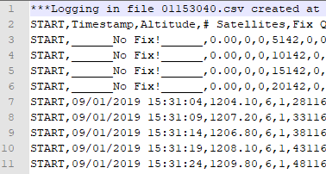
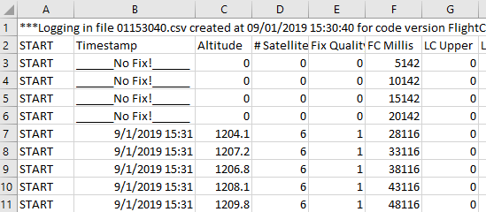
Extension Types
Some common extension types are .txt and .csv
CSV is a comma-separated values file
Figure 2 shows an example of what this data could look like
Excel automatically separates each row by the delimiter (,)
TXT file can have the same data format, but user must manually tell Excel what the delimiter is
Figure 2: This is an example of a .csv file. Left – opened in a text editor. Right – opened in Excel, the commas are used to separate the columns.

Slide 8
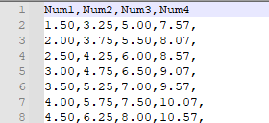
Designing a Data Packet
For this program we recommend you record your data in plain text in CSV files
CSV format easily opened excel and other software
Plain text allow easily viewing the data and can determine if an error occurred during writing
SD Library uses same format as Serial libraries to write text to a file
Comma delimiters separate the data into discrete spots
If a particular piece of data is missing can easily see the rest of data
Use a header as the first line of the file as a label

Slide 9
Other Data File Recommendations
How do you need to format the numbers you are recording
Number decimal places, positive or negative signs
Its easiest to have a data format rather than multiple types of formats, even if data will be recorded at different rates
Have a column for each possible type of data if not recorded in that record can just not write a number
NUMBER,TYPE,TIME,TEMP1,TEMP2,ALT,
1,A,3,34.0,12.0,,
2,A,8,33.0,12.0,,
3,B,10,,,500.2,
Make sure you can easily identify each data pack uniquely and include sort of type identifier if you have multiple sorts of data records to allow sorting after recording

Slide 10
Process of Writing Data to SD Card
SD card communication initialized in setup()
SD.begin(CS, MOSI, MISO, CLK);
Open/create SD file
myFile = SD.open(filename, FILE_WRITE);
Write to SD card – same as printing to Serial Monitor
myFile.println(“This sentence will be written to my SD file”);
Flush the data
myFile.flush();
When finished, close the file
myFile.close();

Slide 11
SdFat
If you get comfortable with the SD card library used here recommend moving to SDFAT library
SdFat removes the size and filename limitations
Can install jumpers to SPI connections :
MISO, MOSI, and SCK (50, 51, and 52) must be hardwired to pins (12, 11, and 13)
Since SPI is synchronous match all pin jumper lengths and keep lead as short as reasonable
Also has Software SPI implementation but requires editing of the library files
The SdFat library can be found at https://github.com/greiman/SdFat

