Slide 1
Using the Adafruit GPS Library
LaACES Student Ballooning Course

Slide 2
Installing the Library
Easiest way to install is using the Arduino Library Manager
Select Tools->Manage Libraries
We can also manually install by downloading the .zip file and unpacking the library into the sketchbook libraries folder
https://github.com/adafruit/Adafruit_GPS
Remember we set the Sketchbook in the preferences
As of October 2021 most recent version is 1.5.4

Slide 3
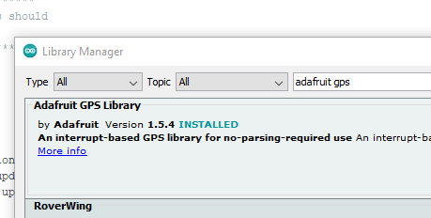
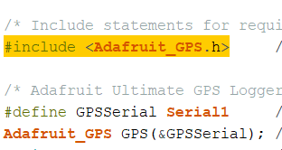
After installation
After installation should show up as installed in the library manager and library should be listed under the File-> Examples and Sketch -> Include Library menu options
We need to have the line #include <Adafruit_GPS.h> at the top of our sketch to use the library
Adafruit_GPS.h should be orange if the library was installed correctly

Slide 4
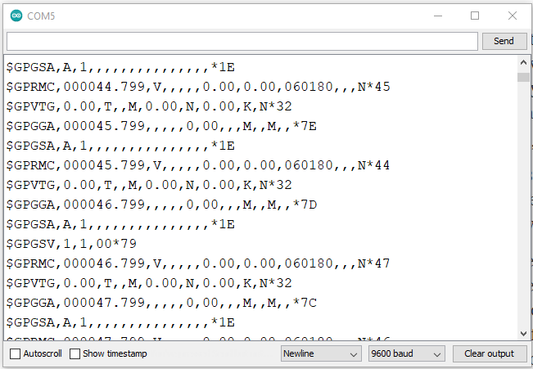
Communicating with the GPS
We send and receive data from the GPS using plain text strings
These strings are are sent and received as ASCII characters over UART at 9600 baud via the TX and RX pins of the shield
Baud rate can be changed, but default is 9600
Remember was can switch which Arduino pins using the Direct/Soft-Serial Switch

Slide 5
Data Streams
Data received from the GPS shield will be NMEA sentences.
Figure 10 shows what raw GPS data will look like in the Serial Monitor
$GPRMC,212628.068,V,,,,,0.00,0.00,150819,,,N*4A
This is an example of a NMEA sentence pulled from Figure 10
From this data stream, we can see it was taken on August 15, 2019 at 21:26:28 UTC. A fix was not achieved.
Figure 10: Shown is an example of the raw output of the Adafruit Ultimate GPS Logger Shield on the serial monitor when the Shield is switched to Direct Connect. The GPS did not have a fix, so most data fields are blank

Slide 6
Input/Output Strings
Output
Input
NMEA Sentences
All selected sentences
Default GGA,GSA, RMC, VTG sentences on
Automatically at set rate
Default every 1 second
Will also send response string to any commands send
Commands take the form of preformatted text strings similar to NMEA
Commands are called PMTK
MediaTek Protocol named after the GPS manufacturer
Full Command list reference
https://laspace.lsu.edu/laaces/wp-content/uploads/2021/10/PMTK_Packet_User_Manual.pdf

Slide 7
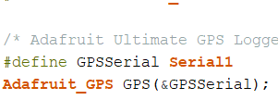
GPS Object
We use the GPS in programming by declaring a variable of the Adafruit_GPS type and we need to tell it which serial port the GPS is connected to
Here GPS is the name of our variable
The line above tells the compiler that we want Serial1 every place that put GPSSerial
The & just tells that we want to send the location in memory of the Serial object instead of the actual Serial object
The way the GPS library is written we send the Serial this way

Slide 8
GPS Functions
Once we have created the GPS object we call functions of it to do operations
GPS.sendCommand() – sends the string inside the parenthesis to the GPS
GPS.read() – reads a character off of the GPS serial, returns it and copies it to the current NMEA sentence being built
GPS.lastNMEA() – returns the last complete NMEA received
GPS.newNMEAreceived() – returns true or false if a new (since last time lastNMEA() was used) complete NMEA is available
GPS.parse() – breaks apart the NMEA we give it inside the parenthesis and updates all of the individual GPS variables

Slide 9
GPS Data Flow
GPS outputs a characters to the Arduino Serial, all sentences are output with no pause (only time required to send by the baudrate)
Since we are connected to a Hardware Serial, Arduino Automatically copies the characters into the buffer for that serial port
This has space for 64 characters. If more are sent before they are read old characters will be overwritten
We call GPS.read(), this returns the next character out of the buffer and add it to the end “current NMEA” being built, if the character read is a newline (indicating the end of a sentence) 3 things happen:
Copies “current NMEA into lastNMEA (overwriting the old one)
Sets newNMEAreceived to be true
Starts a new “current NMEA”

Slide 10
Reading the GPS
GPS send data to a Serial buffer. This buffer needs to be read manually. There are two ways – polling and interrupts. Interrupts are the proper way.
Polling
Whenever we get to certain point in the program we check to see if there are characters to read
If program gets busy can miss characters
Interrupt
When a specific signal is received, the Arduino pauses what it is current doing and goes and reads the serial buffer. Otherwise, it keeps on doing other things.
Signal could be a timer, a signal on a pin, etc.

Slide 11
Interrupt Example
Figure 9 is the code used to interrupt and read the GPS serial buffer
Timer0 is an internal timer used for millis()
This interrupt checks the serial buffer every millisecond regardless of what else the Arduino is doing
This ensure we don’t miss a character
Figure 9: The top function simply reads a character from the GPS serial buffer. The second function uses Timer0 (an internal timer on the Mega), which is used to increment the millis() call. This function says to interrupt between the millis() increments (so as not to interfere with it). This will result in the Mega reading a character from the GPS serial buffer once a millisecond.

Slide 12
PMTK Comands
Command Structure: String of characters similar to NMEA sentences
$PMTK###,<Command Data>*CS<CR><LF>
$ - Indicates Start of Command String
‘PMTK’ – Character string indicating MediaTek Packet
‘###’ – 3 Digit character string of numbers indicating what the command is
<Command Data> - the actual command usually comma separated series of numbers
*CS – Character representation in hexidecimal of the checksum
<CR><LF> - Carriage return and line feed

Slide 13
Sending Commands
Using GPS.sendCommand() we can send a string of characters that the GPS will treat as command
We could send the entire string manually:
GPS.sendCommand(“$PMTK314,1,0,0,0,0,0,0,0,0,0,0,0,0,0,0,0,0,0,0*29”); This will send turn off all NMEA sentences except GLL
The Library defines constants for most of the useful command strings so we do not have to figure out the entire string:
GPS.sendCommand(PMTK_SET_NMEA_OUTPUT_GLLONLY); This will accomplish the same thing as above
After sending a command the GPS will respond with an acknowledge, this will be between the automatic NMEA sentences

Slide 14
Setting Balloon Mode
Some GPS shields have had their altitude lockup at ~10km.
This might be due to some units being set a navigation mode that limits the altitude to 10km
To set the unit to “Balloon Mode” be sure to include the following line in your setup:
GPS.sendCommand(“$PMTK886,3*2B”);
The Adafruit documentation does not discuss this but we think this may be the cause
We found a more recent version of the PMTK command list that includes this
Remember that the GPS will return to default on power loss

Slide 15
Parsing
By calling GPS.Parse() the GPS library will break down the NMEA sentence into the individual data pieces and update internal variables that we can then read the values of
We do need to pass the NMEA to the Parse() function for example like -> GPS.Parse(GPS.LastNMEA());
For example, after we a sentence that contained an altitude reading 300.2 meters we can call GPS.altitude and we will get 300.2
It is important to remember that these values only get updated when we call Parse on a NMEA sentence that has those variables.
For example, if we have only called Parse on GGA sentences (which do not include the year) and we call GPS.year we will get the default year value
We also need a fix to get an accurate value

Slide 16
GPS Command - Type | Returns
GPS.latitude – float | Latitude (Degrees and Minutes DDMM.MMMM)
GPS.longitude – float | Latitude (Degrees and Minutes DDMM.MMMM)
GPS.latitudeDegrees – float | Latitude (Decimal Degrees)
GPS.longitudeDegrees – float | Longitude (Decimal Degrees)
GPS.speed – float | Speed over Ground in Knots
GPS.altitude – float | Height in meters above MSL
GPS.year – int | Year
GPS.month – int | Month
GPS.day – int | Day of the Month
GPS.hour – int | Hour
GPS.minute – int | Minute
GPS.seconds - int | Second
GPS.satellites – int | Number of Satellites Locked
GPS.fix – bool | Have a fix T/F

