Slide 1
Expanding the Arduino Mega Useful Peripherals

Slide 2
Expanding the Arduino Mega
You can enhance your project by adding additional boards to the microcontroller
Arduino has a standard pin footprint and boards designed to match this are called “Shields”
Commercial shields are available to perform specific tasks
They can be used for prototyping before adding a more permanent component to your PCB
Custom shields can be designed, like the MegaSat

Slide 3
Commercial Shields
Using a shield can simplify a project because there is less assembly required and discrete components are already soldered on
More information is available online to help with troubleshooting because many others have purchased and used the same shield(s)
There is existing documentation on the device
Because the design is complete, you will not be able to easily make changes

Slide 4
Adafruit Ultimate GPS Logger Shield
This shield is a datalogger, and it incorporates GPS with an SD card for storage
Footprint designed for Arduino Uno but useable with other boards (Like Mega)

Slide 5
Proto-Shields
Proto-shields are blank boards that connect to the pins on the microcontroller
They contain holes for soldering in components and may have traces connecting those holes pattern similar to the bread board
Can be used to test your circuit before making it permanent on your PCB
You are limited on space and the wiring can get messy

Slide 6
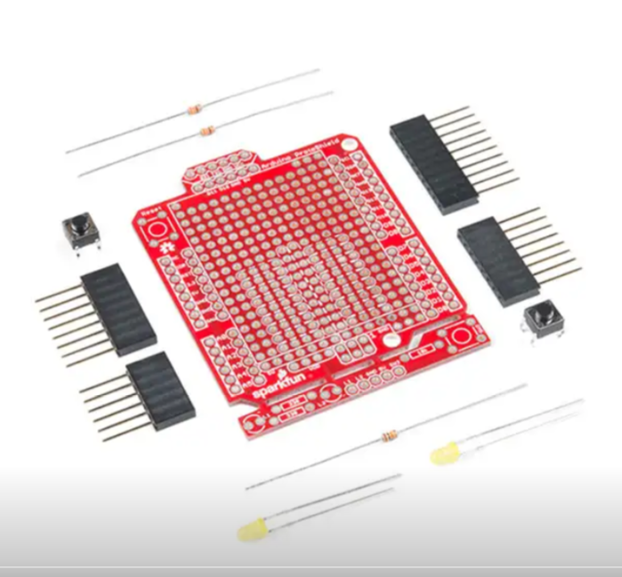
Arduino Mega Proto-Shield
There’s minimal assembly required and several rows of empty sockets for soldering in components
It connects directly to the
Mega in the same manner
as the datalogger
You can use this to test your
circuit before soldering
Figure 1: Arduino Mega Protoshield (not assembled)

Slide 7
Custom PCB Shields
You can customize a shield for your microcontroller using PCB software
This allows for more complex designs with custom functions
There is a learning curve for PCB design software and PCB boards require time and money to manufacture

Slide 8
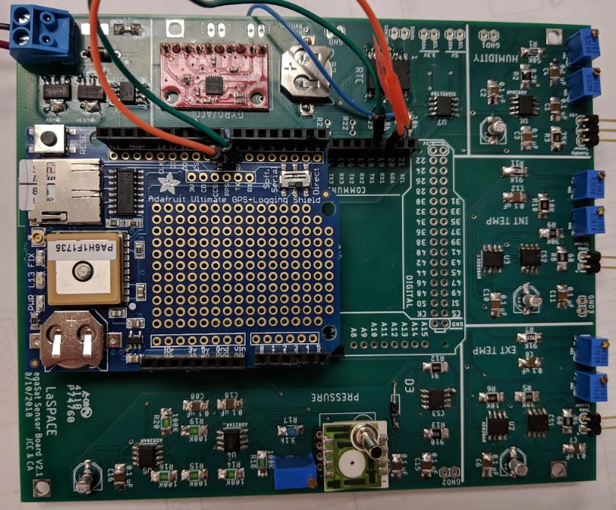
MegaSat
The MegaSat was designed as a custom shield for students to have a base payload
Contains a base set of sensors and interfaces
Figure 2: MegaSat prototype with datalogger and accelerometer breakout board

Slide 9
External Breakout Boards
External boards are different from shields because they do not stack directly on the microcontroller
They can be made to connect directly to a PCB and usually act as modules to perform specific tasks
These have to be wired correctly and may increase the complexity of your design

Slide 10
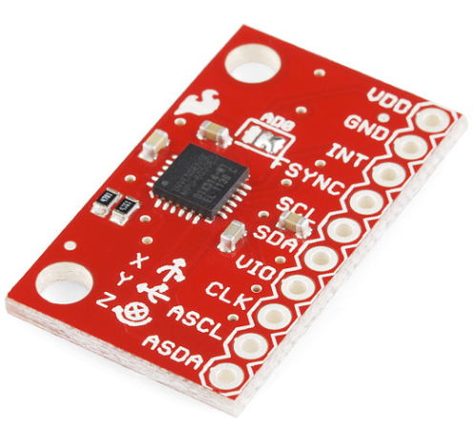
SparkFun Triple Axis Accelerometer and Gyroscope Breakout
The MegaSat uses a breakout board to further enhance your experience
The accelerometer/gyroscope microchip is very small and would be difficult for a
beginner to solder
Breakout boards come with all
components soldered in place
and are easy to incorporate
into your PCB design
Figure 3: Sparkfun accelerometer/gyroscope breakout board

Slide 11
Expansion
Several predesigned shield are available from retailers such as Adafruit, Sparkfun, and Amazon
When using multiple shield keep in mind which pins are being used by which shields
Make sure you select a shield that is compatible with your microcontroller
There are differences between the Arduino Mega and other Arduino microcontrollers, such as the UNO, so most shields are not automatically interchangeable

