Slide 1
Lecture 09.01: Data Acquisition

Slide 2
Sensors and Transducers
A transducer is a material, substance, or device that converts a signal from one form of energy into another.
A sensor is a transducer that detects or measures a physical property and records, indicates, or otherwise responds to it.
We are primarily concerned with sensors that will react to some physical property, for example pressure, and convert to an electrical signal.

Slide 3
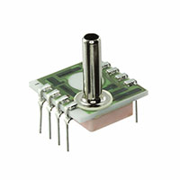
NOTE: Transducers
There are certain sensors types of sensors that commonly referred to as transducers.
Often these are associated with sensors for measuring pressure, liquid levels, and ultrasonics.
However, it should be pointed out that all sensors are transducers even if they are not explicitly called a transducer.
Ultrasound Transducer
Pressure Transducer

Slide 4
Sensor Classification
A passive sensor detects or responds to external stimuli from the environment
Ex. Bulb Thermometer
An active sensor emits a signal (light, sound, radio wave) and detects reflections or the environments reaction to the emitted signal
Ex. Radar
Passive Sensor
Active sensor

Slide 5
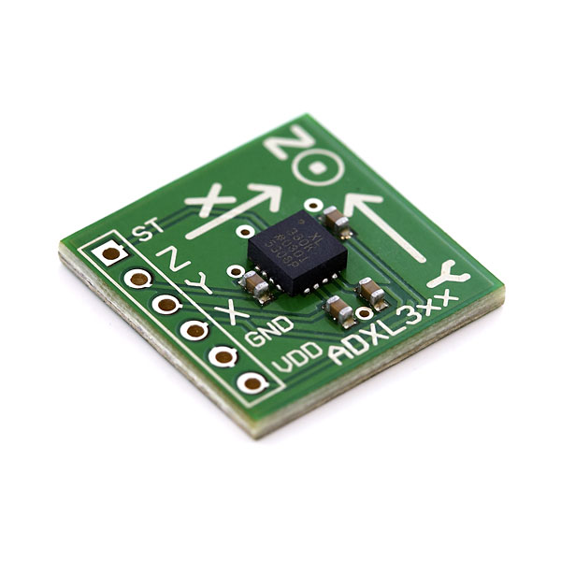
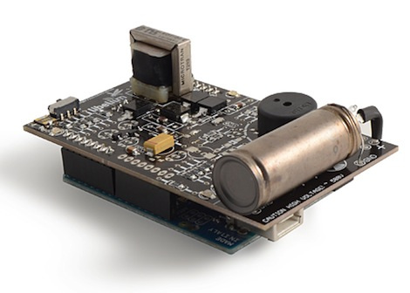
Example Sensor Inputs: Physical Variables
Temperature
Pressure
Humidity
Light Intensity
Radioactivity
Acceleration
Altitude
EMF strength
(Electromagnetic fields)
Pressure Sensor
Accelerometer
Geiger Counter

Slide 6
Electrical Signal Outputs
The output of a sensor will vary depending on the sensor in use. Could be electrical, mechanical, sound etc. Most of the sensors we will use will output electrical signals.
These signals can vary in:
Voltage (Most common final output)
Current
Variation with time
Pulse Amplitude & Width
Frequency
Signal Duration
Some sensors will include ADCs and output a digital signal that must be interpreted by another device such as a microcontroller or computer.

Slide 7
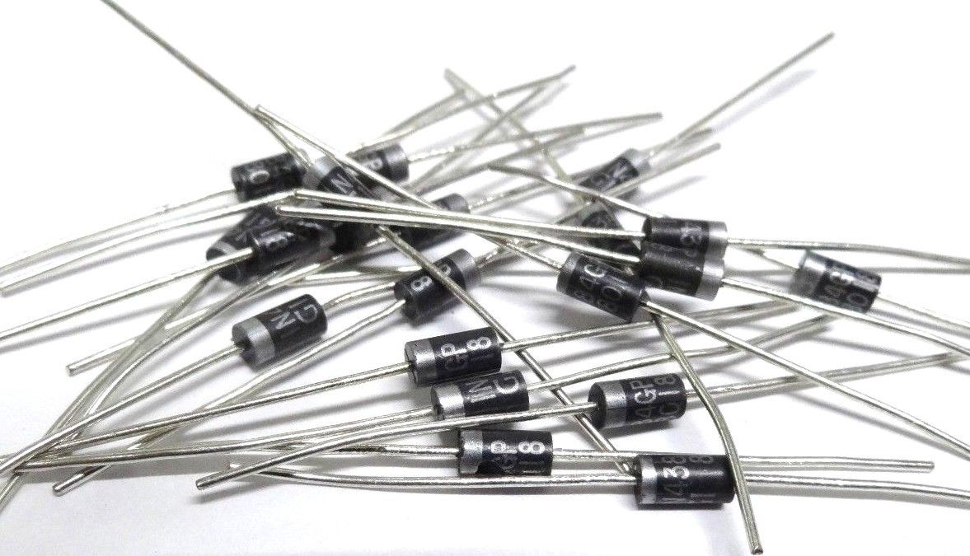
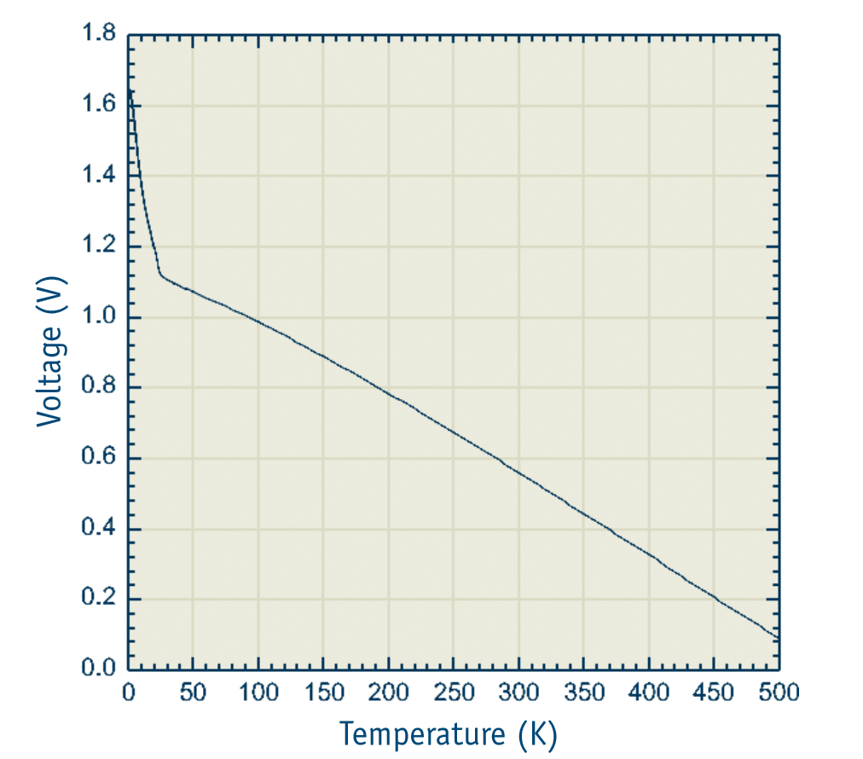
Temperature Sensors
There are a multitude of methods to measure temperature. It can be measured by thermistors (resistance varies with temperature), thermocouples (dissimilar metals create a voltage varies with temperature), or semiconductor junction devices (voltage across junction varies with temperature).
PN-junction diodes can be used to measure temperatures in the range of 20 – 500K. In this range, the forward voltage of the diode varies linearly with temperature. The forward voltage drops approximately -2.1 mV / K.
1N457 Si Diode

Slide 8
Pressure Sensors
A diaphragm bows in or out depending on the atmospheric pressure being applied to it. The diaphragm is made of conductive material. This changes the distance and conductivity between it and a metal plate beneath it. A transducer reads this change in conductance as pressure. Note, temperature compensation is essential for proper pressure readings.
The MegaSat uses a pressure transducer that gauges absolute pressure (zero reading = perfect vacuum). It also has temperature compensation built in.
1230-015A-3L Pressure Transducer

Slide 9
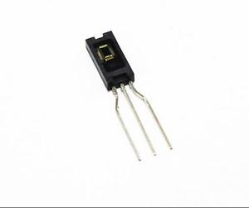
Humidity Sensors
How they work
The most common way humidity sensors work is by gauging how electricity jumps the air gap in a capacitor. All substances conduct electricity differently, and this includes dry vs humid air. The change in conductivity is interpreted as humidity.
MegaSat
The board uses a capacitive sensing element that is light sensitive so care must be taking to keep it out of the light.
HIH-4000-003 Humidity Sensor

Slide 10
Acceleration and Orientation Sensors
There are multiple ways to make an accelerometer. The MegaSat has the simplest type. A semiflexible conductive mass spans a gap between two beams like a bridge. Underneath it lies a conductive plate. If an accelerative force causes the bridge to bend, then the capacitance between it and the plate will change. Circuitry converts this change to voltage for an acceleration reading.
A gyroscope is more complicated. The physics involved includes the conservation of angular momentum and the Coriolis Effect. The gyro used by the MegaSat gets it readings from the change in capacitance caused by the Coriolis Effect.
Curious students may research “vibratory MEMS rate gyroscope” if they would like to know more.
SEN-11028 ROHS
Accelerometer-Gyro combo

Slide 11
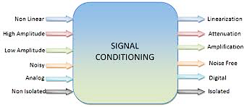
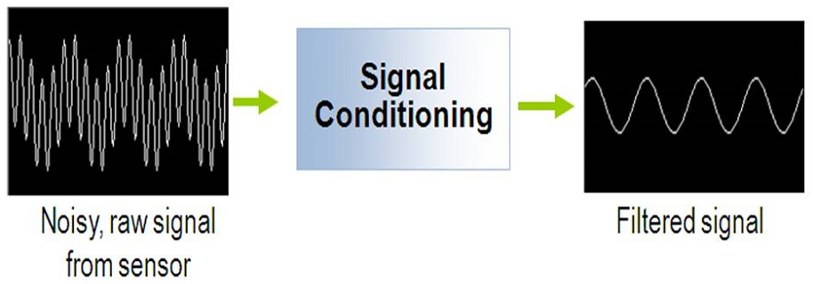
Signal Conditioning
Sensors output an electric signal, but many times the signal cannot be directly interpreted by humans or other electronics. This can be fixed with signal conditioning.

Slide 12
Span and Base
Span refers to the voltage range of possible outputs of the device.
Base refers to the lowest possible output of the device.
We want to use signal conditioning to match the span and base of our sensor to device reading it.
If they do not match than the some of information in the signal could be lost.
Example:
Temperature sensor:
450 mV to 800 mV
BASE = 450 mV, SPAN = 350 mV
Signal Conditioning Output:
0V to 3V (to match ADC)
BASE = 0V, SPAN = 3V
Notes:
11.6 mA is 7.6 mA above the base. (7.6 mA)/(16 mA) represents 47.5% of the output span.
47.5 % of the temperature span is 80.8 degrees, so the temperature is 80.8 degrees above the base temperature (-20), or 60.8

Slide 13
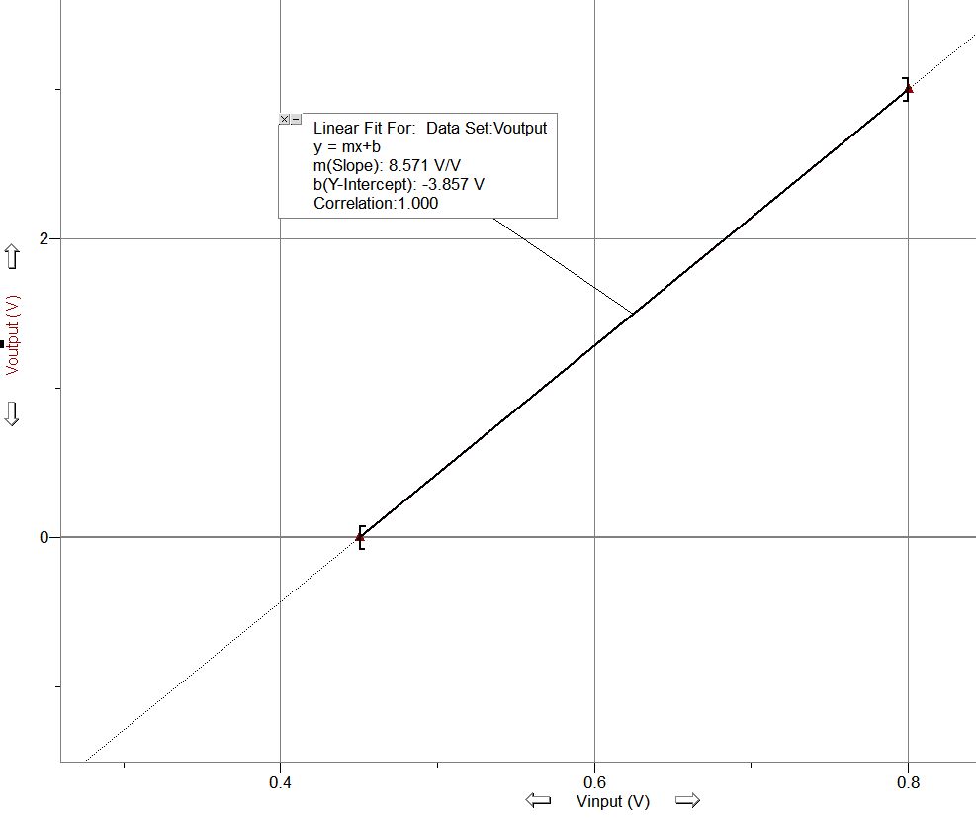
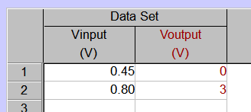
Span and Base Adjustment
The relation between the input and desired output is simply a line passing though the two points formed by minimum and maximum values.
The input values on x axis and output values on the y.
In this case the line that passes though (0.45,0) and (0.80, 3)
Notes:
11.6 mA is 7.6 mA above the base. (7.6 mA)/(16 mA) represents 47.5% of the output span.
47.5 % of the temperature span is 80.8 degrees, so the temperature is 80.8 degrees above the base temperature (-20), or 60.8

Slide 14
Transfer Function
The equation of between the input and the output of the signal condition is called the transfer function.
For a linear transfer function call the slope the gain and the intercept the offset.
Gain = 8.571
Offset = -3.857 V
How do we design and build a circuit that performs this transfer function?
Amplifying Circuits
Notes:
11.6 mA is 7.6 mA above the base. (7.6 mA)/(16 mA) represents 47.5% of the output span.
47.5 % of the temperature span is 80.8 degrees, so the temperature is 80.8 degrees above the base temperature (-20), or 60.8

Slide 15
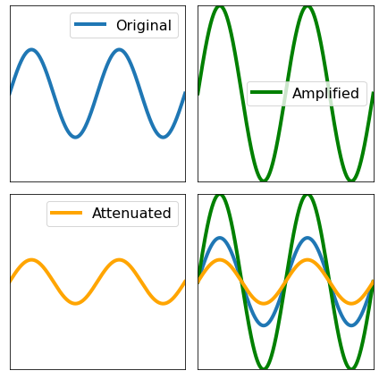
Amplification and Attenuation
When a signal is too small to be interpreted correctly, the signal can be amplified. Amplification is the process of increasing the power of an electrical signal. (Gain >1)
Sometimes, a signal is strong enough to damage equipment or other devices or exceed the desired thresholds. In such cases, it often useful to attenuate the signal. Attenuation is the process of reducing the power of an electrical sensor.(Gain<1) Attenuation can occur when a signal is sent over long distances.
Notes:
https://www.geeksforgeeks.org/data-communication-transmission-impairment/

Slide 16
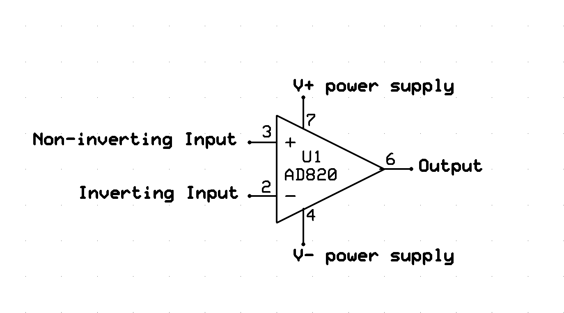
Signal Conditioning Circuit Operational Amplifier or “Op amp”
Amplifying circuits are built using an IC called an op amp.
An op amp takes 2 input signals and outputs 1.

Slide 17
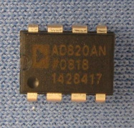
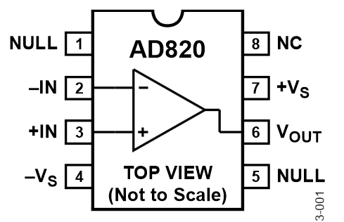
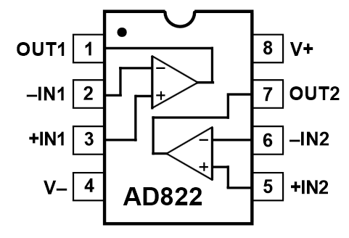
Operational Amplifier ICs
Available in Single(1x), Dual(2x), Quad(4x) Packages
May be Bipolar power supply (ex. +/-V_{s} = +/- 12V)
Single supply operation (ex. +12V, GND)
Variety of voltage and frequency ranges for different chips.

Slide 18
Op Amp Golden Rules
The output changes to do whatever is necessary to make the voltage difference between both inputs zero.
The inputs draw no current.
The output influences the input pins via the external feedback resistor. Use the Rules and Ohm’s Law to analyze or synthesize op amp circuits.
Some common simple amplifying circuits are

Slide 19
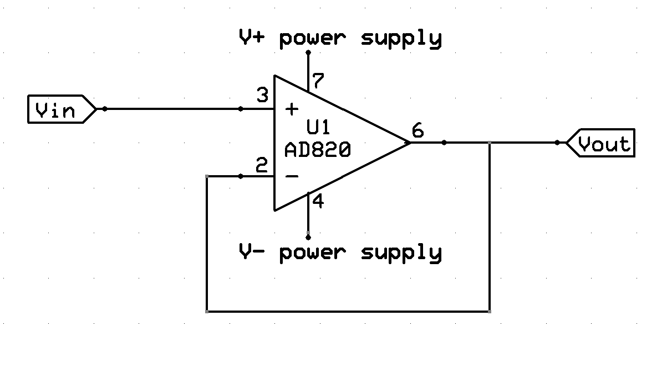
Signal Conditioning Circuit Buffer
A buffer provides voltage or current isolation between to components to prevent the signal from affecting the performance of a component.
Current on V_{out} comes from the supply, not V_{in}.
Gain of Buffer
Vin = Vout
Gain=1

Slide 20
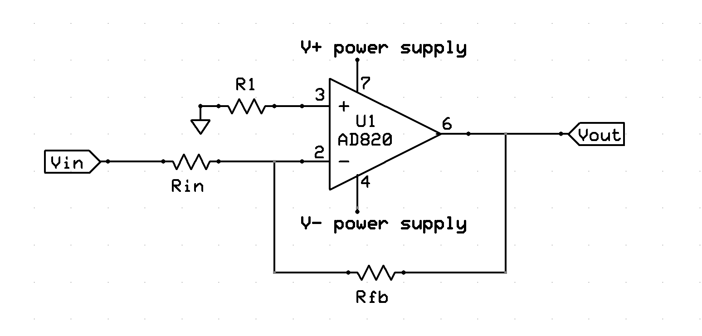
Signal Conditioning Circuit Inverting Amplifier
Inverted op amps have Vin connected to the negative terminal.
Signal is inverted (flipped).
$$G=−\frac{R_{fb}}{R_{in}}$$
Gain<0

Slide 21
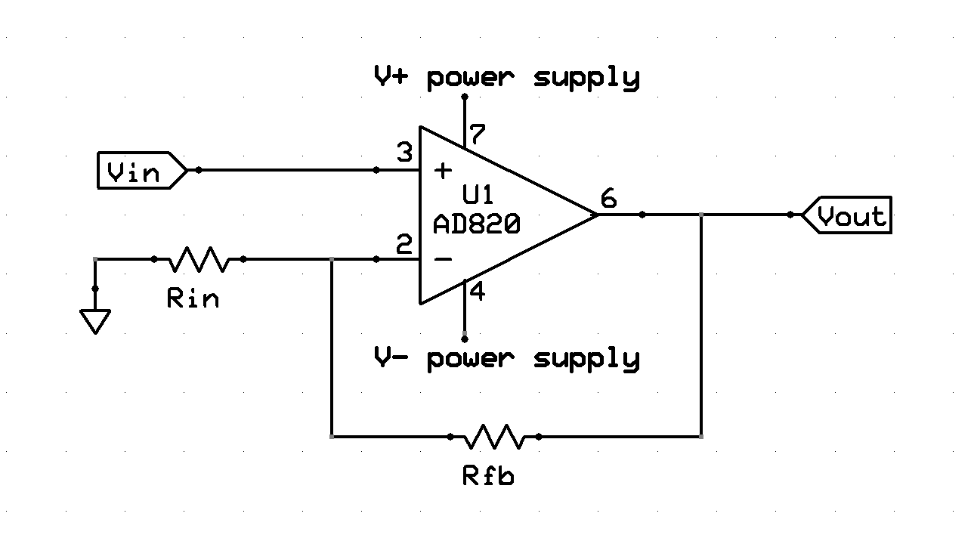
Signal Conditioning Circuit Non-Inverting Amplifier
Non-inverted op amps have Vin connected to the positive terminal. This is commonly used in electronics to isolated circuits from each other.
$$G=1+\frac{R_{fb}}{R_{in}}$$
Gain>0

Slide 22
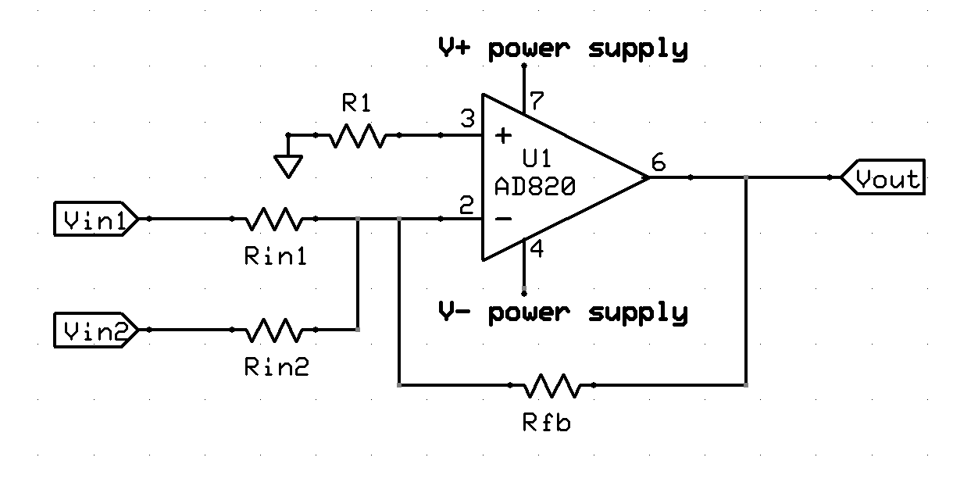
Signal Conditioning Circuit Summing Amplifier
Summing op amps have multiple inputs are connected into a single terminal. Can be inverting (shown here) or noninverting.

Slide 23
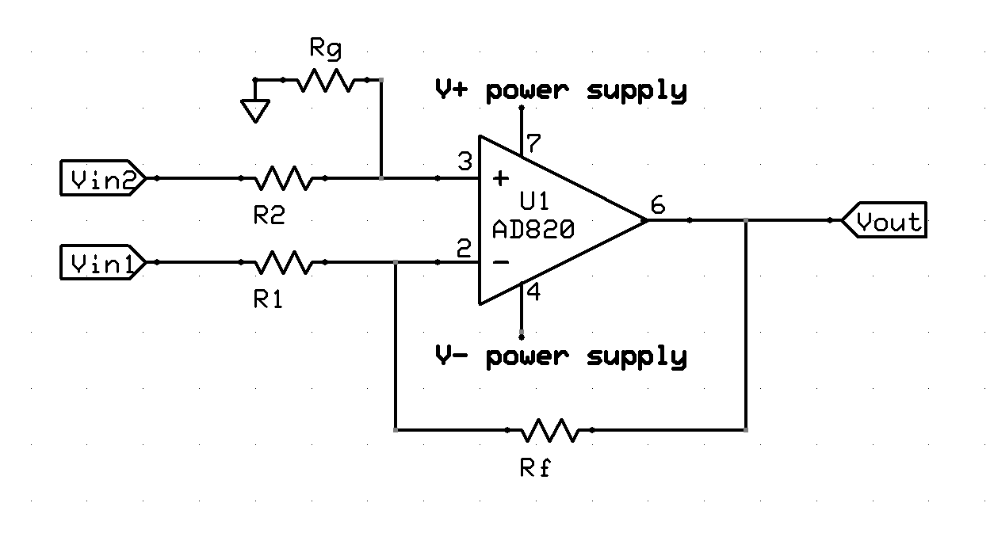
Signal Conditioning Circuit Difference Amplifier
A difference op amp has an input into both the negative and positive terminals.
It amplifies the difference between the two signals.

Slide 24
Op Amp Circuits
A common variation is to add an offset to previous examples which shifts the entire signal by a constant amount up and down.
The minimum and maximum output values are limited by source V₊ and V₋.
It is also common to have multiple stages of amplification, for example first use buffers to prevent the amplifiers from affecting the sensor signals.
Data sheets for Op Amp ICs will often include applications showing how to calculate required values

Slide 25
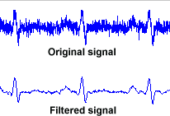
Electronic Filters
All sensors have noise in their outputs to some degree. Noise is undesired variations in electronic signals.
Electronic filters are circuits that remove unwanted noise from an applied signal and produce a cleaner signal. They may separate combined signals or restore distorted signals.
Typically remove a signal faster (low pass) or slower (high pass) than the signal you care about
In the image above, the signal has had unwanted frequencies removed.
The rapid noise has been removed.
Notes:
http://www.medteq.info/med/ECGFilters

Slide 26
Input and Output Impedance
Impedance is the resistance a circuit has to current flow when voltage is applied. Measured in Ohms. Resistance is a component of impedance. But also includes frequency dependent effects.
Input impedance is the equivalent impedance of the circuit when viewed from the input side of the circuit.
Example: The input of an oscilloscope will often be 50 Ω.
Output impedance is the equivalent impedance of a circuit when viewed from the output side of the circuit.
Example: The output of a signal generator will often be 50 Ω.
Notes:
https://www.ncbi.nlm.nih.gov/books/NBK11076/

Slide 27
Impedance Matching
An impedance mismatch is when the input impedance and output impedance of two connected electronics differ. Impedance mismatches introduce additional noise and power loss to the system through signal reflections and other phenomenon.
Impedance matching is the practice of designing the input or output impedance of a circuit to match its corresponding signal source or load. This is often done to maximize power transfer or minimize signal reflections.

Slide 28
Data Acquisition Flow
TRANSDUCER
/SENSOR
SIGNAL
CONDITIONING
DATA COLLECTION
AND STORAGE
ANALOG-TO-DIGITAL
CONVERSION
READOUT
AND/OR DISPLAY

