Slide 1
Schematics and Prototyping Lecture

Slide 2
Schematic Diagrams
Schematic diagrams represent an electronic circuit in symbolic form.
A schematic need not depict the actual physical arrangement of the components

Slide 3
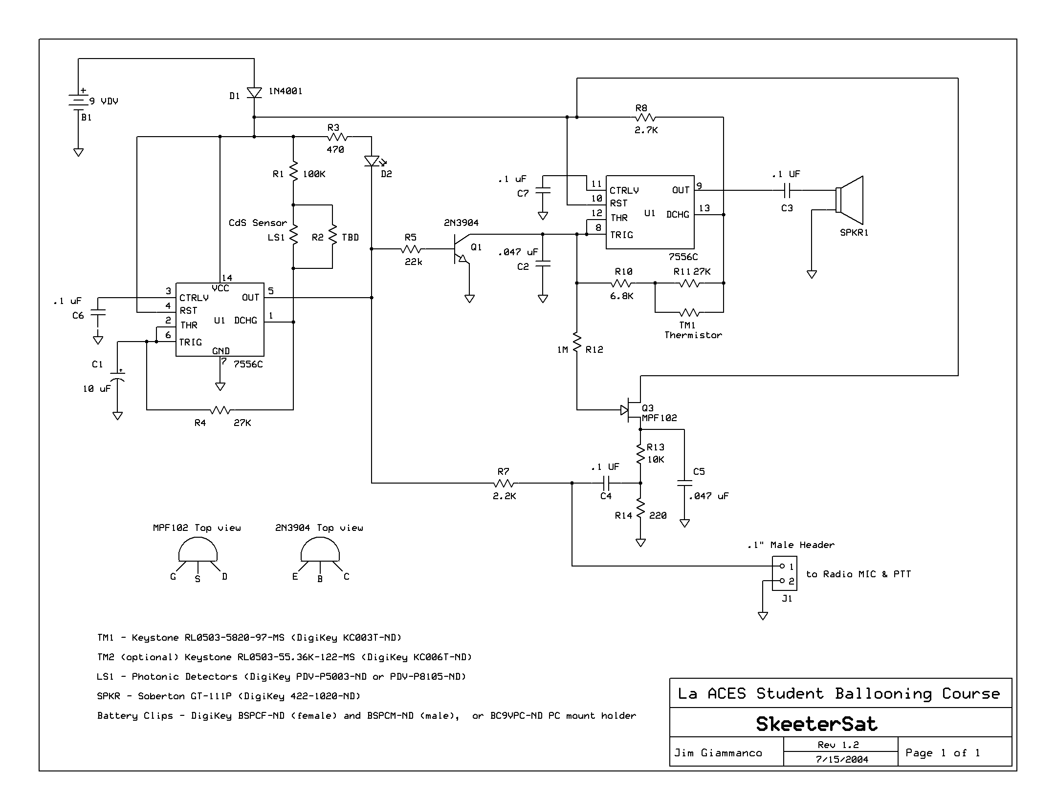
SkeeterSat Schematic

Slide 4
Schematic Symbols
Wires and wire connections
Current practice:
Either A or B is acceptable C is the preferred style
D is seldom used E is interpreted as a non-connection

Slide 5
Schematic Symbols Cont.
Power sources (V) common connections (GND)
The “+” sign may not always appear on a battery symbol. By convention, the longer horizontal line represents the positive terminal
Note that no polarity is shown for the ac source

Slide 6
Schematic Symbols Cont.
Common connections (GND)
“Earth” means an actual connection to a conductor driven into the soil.
“Chassis” means a bonded electrical connection to the metallic case of chassis of a device.

Slide 7
Schematic Symbols Cont.
Resistors (R) and Capacitors (C)

Slide 8
Schematic Symbols
Inductors (L) and Transformers (T)
simple
inductors
adjustable
adjustable
tapped
The two parallel lines indicate that the inductor is wound on a core of iron, iron powder, or ferrite material.
transformers

Slide 9
Schematic Symbols
Diodes (D)
The arrow points in the allowed direction of
conventional (positive charges) current flow.
The bar represents the cathode, marked with a band on most parts.

Slide 10
Schematic Symbols
Transistors (Q)
P-channel junction
field-effect transistor
bipolar NPN
junction transistor
bipolar PNP
junction transistor
N-channel junction
field-effect transistor
P-channel MOS
field-effect transistor
N-channel MOS
field-effect transistor

Slide 11
Schematic Symbols
Logic Gates
Most complex integrated circuits are represented on schematic diagrams as a rectangular block symbol, with pin numbers and, usually, pin functions indicated; but many logic integrated circuits have special symbols that identify their function.

Slide 12
Schematic Symbols
Switches (S) and Relays (K)
double pole single throw
DPST
single pole single throw
SPST
single pole double throw
SPDT
double pole double throw
DPDT
single pole double throw
relay
rotary switch
1 pole, 5 position

Slide 13
Drawing Schematic Diagrams
You can use one of the many schematic capture programs available on the internet for free. The SkeeterSat schematic shown earlier was prepared with ExpressPCB.
Schematic Capture Programs
ExpressPCB http://www.expresspcb.com/
Eagle http://www.cadsoftusa.com/freeware.htm
Schematic capture is a step in the design cycle where the electronic diagram of the electronic circuit is created by a designer.

Slide 14
Building a prototype
Solderless breadboards
Perfboards or Protoboards
Manhattan Construction
Dead Bug Construction
Etched Circuit Boards

Slide 15
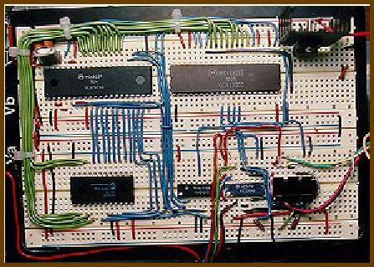
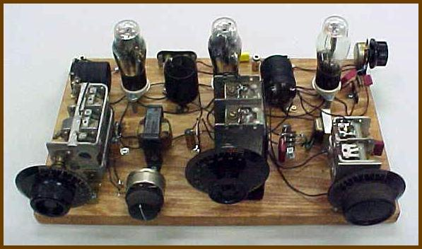
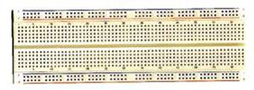
Solderless Breadboards
The term breadboard originated in the early days of radio, when many experimenters actually built circuits on the wooden boards used in the kitchen for rolling out bread dough.
Modern solderless breadboards
Best thing to come along since sliced bread!
A ham radio transmitter circa 1930
Notes:
Connections are made by plugging short pieces of solid (not stranded) hookup wire into the socket holes on the breadboard.
Solderless breadboards are not recommended for circuits operating at frequencies above couple of MHz or so

Slide 16
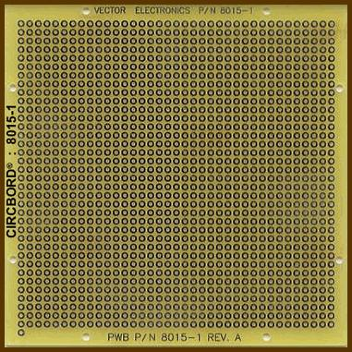
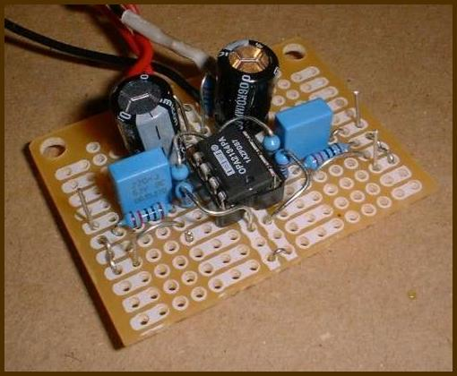
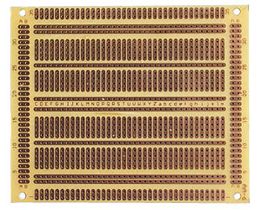
Perfbord or Protoboard
Components are soldered to the board, with connections made using a combination of short pieces of wire and the copper traces already present on some versions of these boards.

Slide 17
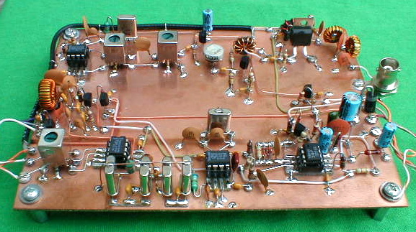
Manhattan Construction
Manhattan Style uses little “islands” of PCB material glues to a substrate s ties points for components.

Slide 18
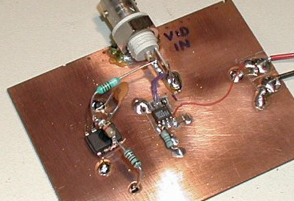
Dead Bug Construction
“Dead bug” style is a type of board design with the integrated circuits (IC’s) flipped upside-down with their pins sticking up into the air like a dead insect. While it is messy-looking, it can be used to make more compact circuits than other methods.

Slide 19
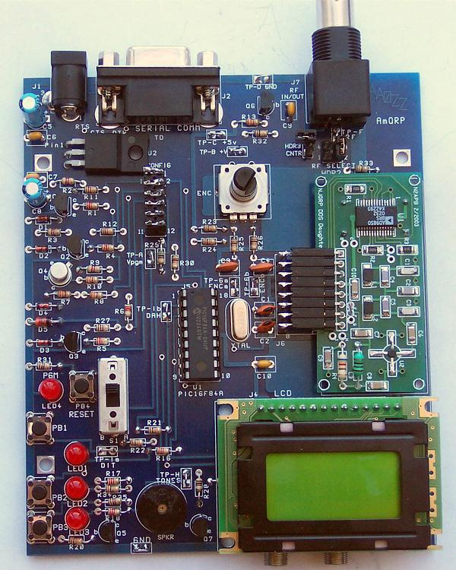
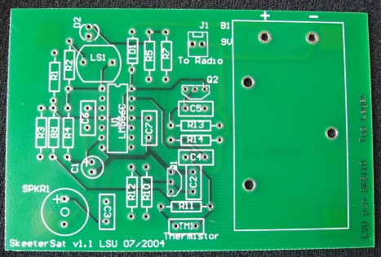
Etched Circuit Boards
While etched boards are the most reliable method of circuit construction, they can be expensive in small quantities ($300+ per board). Cost per board drops rapidly when quantities exceed 25 or so.

Slide 20
Prototyping with Surface Mounted Device (SMD) components
  Difficult to prototype SMD components without a PCB board
  Can solder wires directly to the leads
    -However, this requires a fair amount of precision and handling to accomplish. May unintentionally damage component if mishandled
    -Some devices are sensitive to electrostatic discharge (ESD) and can be destroyed by touching them.

Slide 21
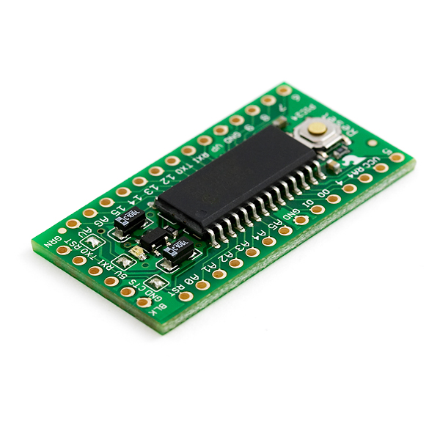
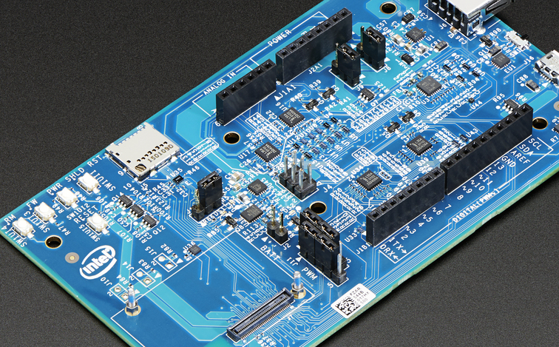
Breakout Boards
Common method for testing specific chips is to make or buy a board that draws out all the desired leads to terminals that are easier to interface with.

Slide 22
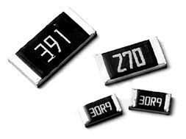
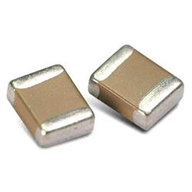
Two-terminal SMD
  Resistors and Capacitors
    Case Code usually reported in XXYY format where XX is the length and YY in the width in mm or inches
    VERY important not to mix up imperial and metric values! Ex. 0603 can be 0.6mm x 0.3 mm OR 0.06 x 0.03 in
  Other two terminal devices such as LEDs have their own package sizes and dimensions
  Dimensions are always listed on the DATASHEET

Slide 23
Multi-terminal SMD
  Wide variety of packages and footprints available
  Many manufacturers will adhere to standard package sizes common throughout the industry
      This is not true for all components
  Types of SMD footprints
      Small outline transistors (SOT), Small outline integrated circuit (SOIC), Dual Flat No-Lead (DFN), Ball Grid Array (BGA)

