Slide 1
Constructing a Standard LaACES Octagon Payload Box

Slide 2
In this Lecture
This lecture will cover the steps needed to construct a standard LaACES octagon payload box
Materials used in this lecture are:
Polystyrene foam sheet 3000 cm² (1.4 cm thick)
Straight edge/right angle tool
Sharpie
Band saw
Sandpaper
Roll of masking tape
Polyurethane glue
Clamps
Tongue depressor
Dremel tool
Straws
Roll of econokote
Heat sealing iron
4 plastic grommets

Slide 3
Cutting the Foam
The enclosure will be an octagonal cylinder 24.4 cm tall with octagon edge lengths of 7.65 cm
Start by cutting 4 squares of polystyrene foam
2 squares (15.7 cm x 15.7 cm)
2 squares (18.5 cm x 18.5 cm)
Measure out the octagon sides using right isosceles triangles in the corners (4.6 cm edges for small square, 5.4 cm for large square)
The smaller octagon should have edge lengths of 6.4 cm and 7.7 cm for the larger
Figure 1: Make 2 different sized octagons from the four squares

Slide 4
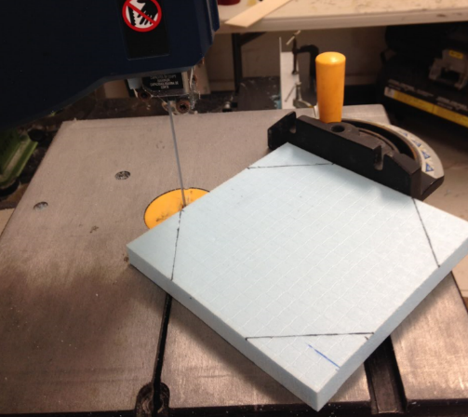
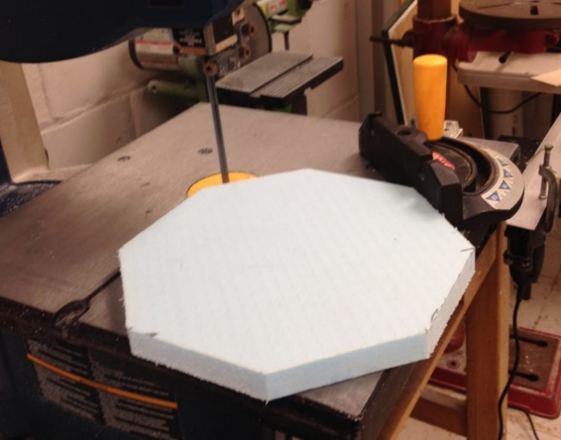
Cutting the Foam
Make the cuts for the octagon using a bandsaw or exacto knife
If using a bandsaw, you can use a guide such as the one pictured, set at 45⁰, to help make the cuts.
Figure 2: Make the cuts for the octagon with a band saw, using the guide to help

Slide 5
Making the Endcap
Apply polyurethane glue to one side of the smaller octagon
Place the smaller octagon in the center of the larger octagon
Use clamps or weights to apply pressure as the glue cures
DO NOT clamp directly onto the foam
Once the glue is cured, drill two holes on opposite corners of the top of the endcap (17cm apart) for the flight string to pass through
Figure 3: Gluing the endcap together

Slide 6
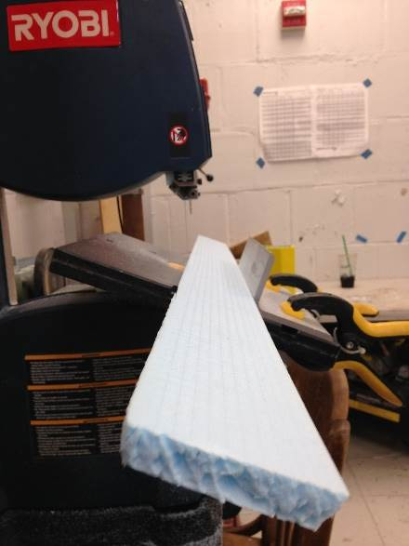
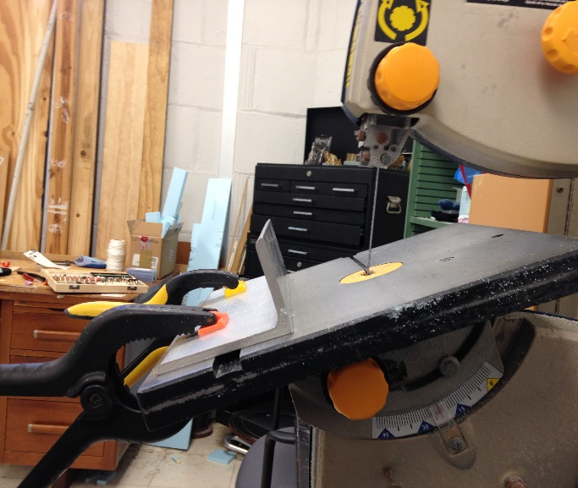
Cutting the Housing Walls
Now cut the 8 pieces that make the walls of your payload
These cuts will need to be made at a 22.5° angle on both sides
To set up for 22.5⁰ cuts, angle the bandsaw to 22.5⁰ and use clamps and metal 90’s to improve the accuracy of the cuts
The distance between where the blade goes through the platform and the bottom of the metal 90 is 7.1 cm
Make the cuts on both sides, you should have eight 23 cm long pieces
Figure 4: Bandsaw table angled at 22.5⁰ for the wall cuts

Slide 7
Cutting the Housing Walls
If a band saw is not available use the mitered corner guide to make the cuts for the wall found in the “Construction Considerations and Techniques” lecture
Use equation W = 2(R)tan(π/N) to determine the width of your cuts
R = 8.5 cm and N = 8 in this case
You will make 8 of these cuts on a XPS foam sheet
Dimensions: (23cm x 61.6cm)
This will form the walls of your payload housing

Slide 8
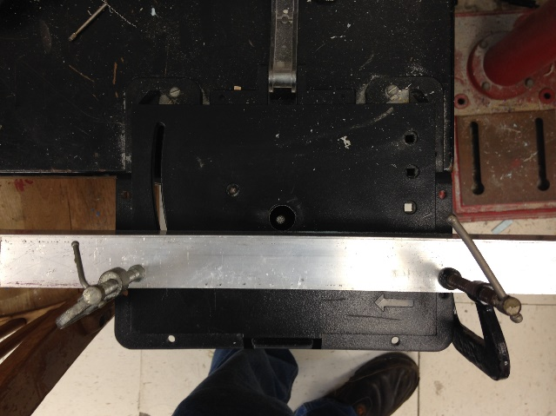
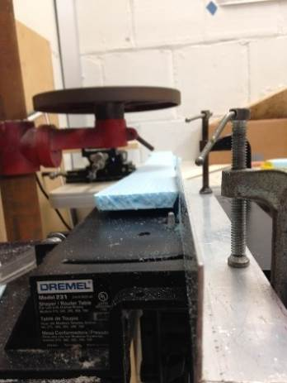
Making Mounting Grooves
You will now cut grooves on 4 of the wall pieces for straw mounting using the Dremel tool
The spacing between the metal 90 and the Dremel bit is 0.5 cm.
The diameter and height of the Dremel bit are both 0.5 cm
Make sure the longer edge of the wall piece is facing up
Figure 5: Setting up the Dremel tool and making grooves for the straws

Slide 9
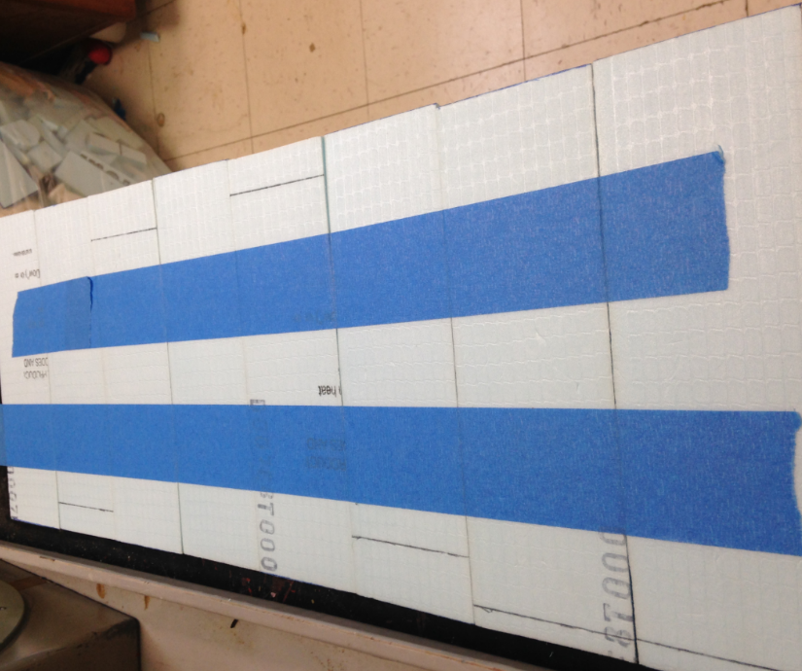
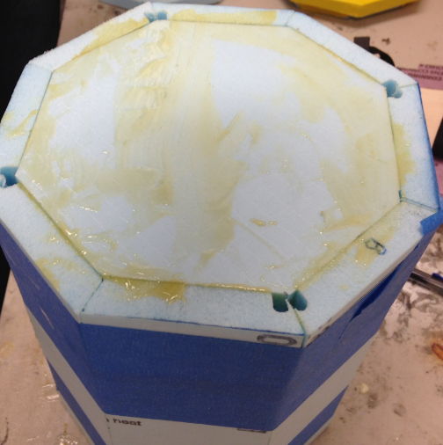
Preparing the Walls
From here, the place the pieces in a line and tape the long edges together, placing grooved edges next to each other for the 2 straw holes
Dampen one side of each side piece and place polyurethane glue on the other.
Apply glue to the edges of the small octagon you cut earlier, and glue it to the inside ring of the wall pieces at one end
Figure 6: Tape the walls together on the outside
Figure 7: Tape the walls up and allow the glue to cure

Slide 10
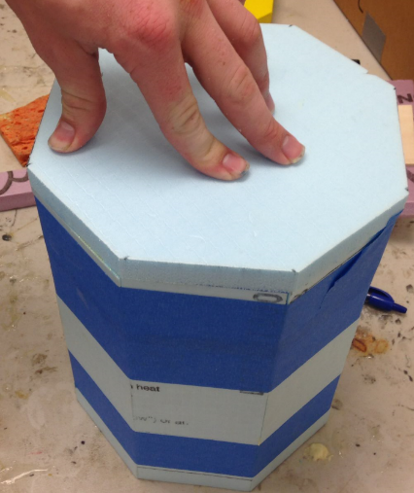
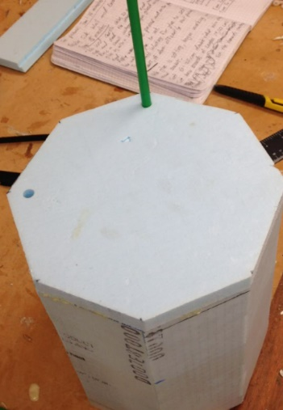
Making the Base
Once the glue on the smaller octagon has cured, apply glue to one side of your last large octagon piece
Glue the large octagon onto the closed end so that it is flush with the payload walls
Apply pressure with weights as the glue cures
Drill two holes into the base to make clean straw holes
Glue straws into the grooves you cut in the walls
Figure 8: Glue the large octagon to the end
Figure 9: Make straw holes in the base

Slide 11
Applying External Coating
Use your heat sealing iron to apply a layer of econokote to the entire outside of the payload
To prevent air bubbles it is best to start in the middle and work your way out to the edge while applying the econokote
Puncture the econokote where the straw mounting holes are and glue plastic grommets in the holes
Adding plastic grommets to the end cap and base will further secure the flight strings and keep the strings from wearing away at the foam.
Figure 9: Applying econokote to the endcap

Slide 12
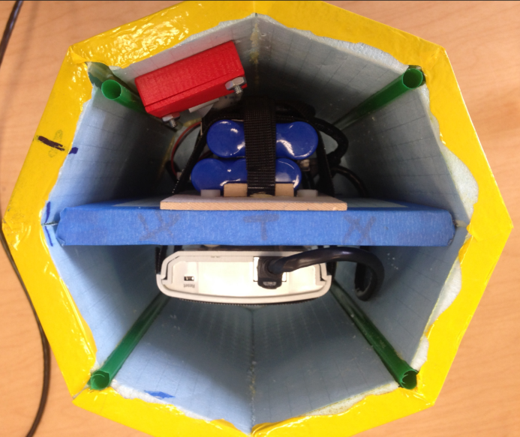
Adding Internal Features
Once the payload is finished you can add foam inserts and mounts as needed to secure you payload components inside the housing
See the “Payload Construction Considerations & Techniques” lecture for more ideas
Figure 10: An top-view of an old LaACES video payload with foam inserts and mountings

Slide 13
References

