Slide 1
Payload Construction Considerations & Techniques

Slide 2
Flight Vehicle Constraints
Federal Aviation Authority (FAA) places constraints on what can be flown on a balloon without a flight waiver
Maximum weight of ~5.4 kg (~12 lbs.)
Density less than 13.2 g / cm² (~3 oz / in² )
Weight of balloon vehicle is ~2.5 kg
Leaves about 2.5 kg for student payloads
We will fly about 5 payloads, so each payload will be constrained to ~500 grams

Slide 3
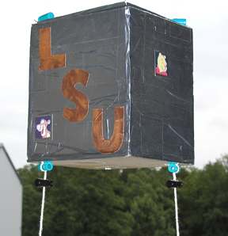
LaACES Vehicle Interface
Only a mechanical interface between payload & flight vehicle
Two flight string cords are separated by ~17 cm
Both strings must pass through payload with a break
Use a thin walled tube (straw) secured to payload structure
Payload secured vertically on flight string with spring clips

Slide 4
Construction Materials - Metal
Advantages of using metal like Aluminium
Strong and relatively light weight
Comes in many different forms & sizes
Easily machined and bolted together
Relatively inexpensive
Disadvantages of using metal
Heavy (15 cm cube with 1 mm sheet Al would weigh ~360 grams)
Excellent thermal conductor

Slide 5
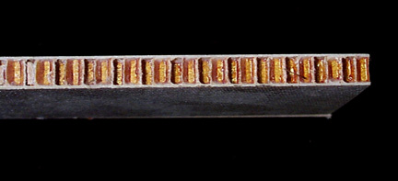
Construction Materials - Composites
Composites include materials such as G-10, Fiberglass, Carbon fiber extrusions, NOMEX honeycomb sandwich
Advantages of using composites
Extremely strong and light weight
Comes in sheets and extruded shapes
Relatively easy to cut
Excellent thermal insulator
Disadvantages of using composites
Can be very expensive
Can be difficult to form and glue

Slide 6
Polystyrene Foam
Extruded Polystyrene (XPS) is a composite material
Polystyrene resin mixed with critical additives in extruder
Continuous smooth skin formed during extrusion process gives cladding
Advantages of XPS foam
Inexpensive and readily available
Strong and rigid
Lightweight
Thermal insulator (R value of 3 with ½” thickness)
Easy to cut and glue
Disadvantages of XPS foam
Available as sheet stock only
Not as strong as other composite materials or metals

Slide 7
XPS Properties
Trade name is Foamular® and Duramate®
Foamular website site http://www.foamular.com/
Foamular thickness from ½” to 4” and sheet size from 2’ x 8’ to 4’ x 8’
Duramate thickness from ½” to 4” and sheet size of 2’ x 8’ or 4’ x 8’
Can be bought at Home Depot and Lowes as well
https://www.lowes.com/pd/Dow-Common-0-55-in-x-4-ft-x-8-ft-Actual-0-55-in-x-4-ft-x-8-ft-Residential-Sheathing-R3-Faced-Polystyrene-Foam-Board-Insulation-with-Sound-Barrier/1000168167

Slide 8
Surface Treatments
Can apply lightweight plastic shrink wrap (Econokote) to XPS foam to improve resistance to moisture
Also reduces foam degradation from UV exposure and cold
Bright orange/yellow/white color for visibility
Can use desiccant packs to reduce condensation
EMI shielding by securing Al foil to outside surface
White (Elmer’s) glue or tape appears to work fine
Electrical contact with taped down, roughened copper foil strips
Al foil surface also good for thermal properties

Slide 9
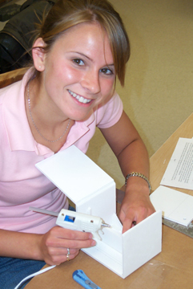
Adhesives
Polyurethane (Gorilla) glue is adhesive of choice for critical joints
High adhesion and resilience even at low temperatures (-40° F)
Moisture activated, expands while curing (~3x), moderate curing time
Epoxy is very strong but can become brittle in extreme cold
Cyanoacrylate (super glue) for quick bonding of non-porous surfaces which mate closely
3M Kapton tape (“space tape”) is strong, bonds to nearly everything but is very expensive
Low-temperature, hot-melt glue for joints
More rigid but no cold embrittlement
Glue cools slowly, so have a moment for alignment
Reaches full strength in about a minute
High-temp, hot-melt tends to melt the foam

Slide 10
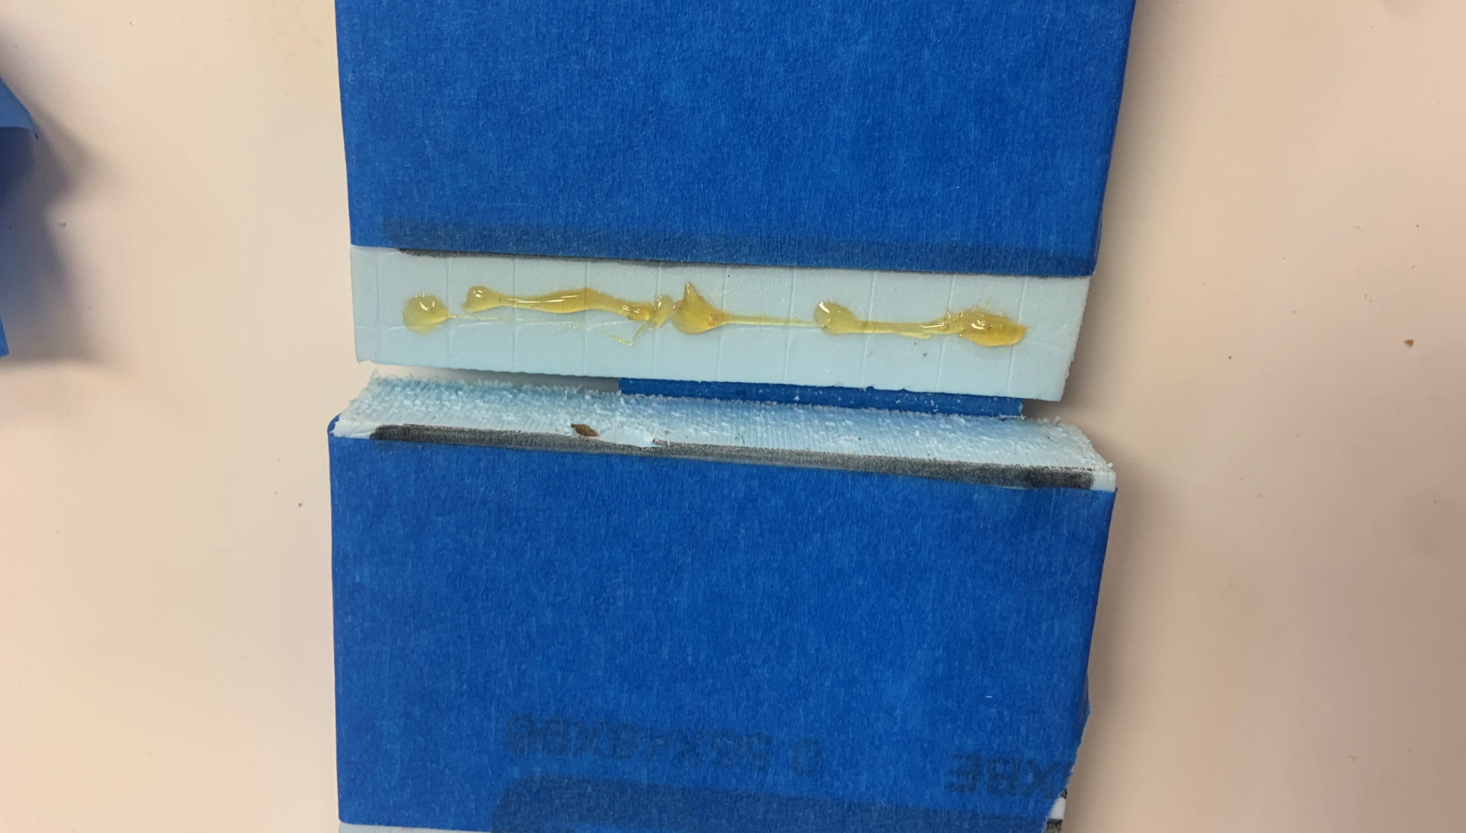
Tips for Polyurethane Glue
Best to wear gloves when working with Gorilla Glue
Lightly moisten the surface before applying the glue
As the polyurethane glue cures it will expand outside the newly created joint.
Two ways to deal with issue
Place masking tape on both edges of the joint before mating, remove tape after glue is finished curing
Wipe glue away as it cures with tongue depressor
Apply tape to both sides of the joint before gluing

Slide 11
Cutting XPS
Materials needed for construction
Modeling knife and a good supply of new, sharp blades
Machinist’s square, metal straightedge (12”, 36”), spring clamps
Cutting surface (large cardboard or hardboard) and flat work table
Keep knife blade sharp
Replace blade after 3 – 5 feet of cutting
Clearly mark where to cut using square and straightedge
Measure twice, cut once!
Cut in three passes
Hold knife blade against straightedge and cut upper surface on 1st pass
Don’t move straightedge and on 2nd pass cut through foam
On 3rd pass cut through bottom surface of the XPS foam

Slide 12
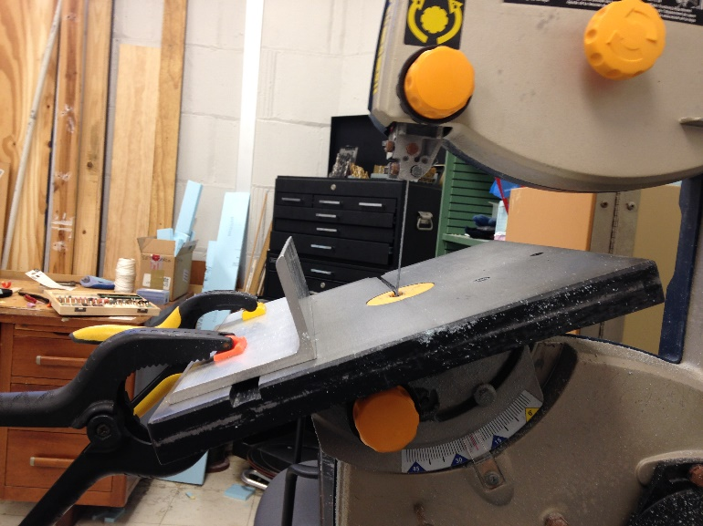
Cutting XPS (optional)
If available it is best to cut XPS with a bandsaw or table saw
DO NOT wear any loose clothing while operating the band saw
DO NOT put your hands in line with the blade path at any times
DO NOT lean into the band saw while making cuts
ALWAYS wear eye protection while operating the band saw
Use a band saw guide to help make cuts along marks
For angled cuts you can adjust the angle of the saw’s table
A bandsaw with table angled down

Slide 13
Gluing XPS foam
When gluing edges or walls together it is necessary to apply pressure as the glue cures
This pressure can be applied with weights, clamps, or tape.
Do not clamp directly on to the foam

Slide 14
Making Bends
Mark center and diameter of hole on both sides of XPS foam
Use a straight pin pushed perpendicular to the foam to transfer the hole center
Use knife to cut groove into foam
For a mitered bend cut a groove of width W through the top clad and the foam to depth D
Put polyurethane glue in groove and bend
For a bend of angle Θ the groove width is W = 2(D)tan(Θ/2)
EX: 90° angle & D = 0.5” ➔ W = 2(0.5)tan(90/2) = 1”

Slide 15
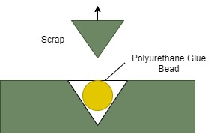
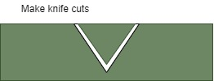
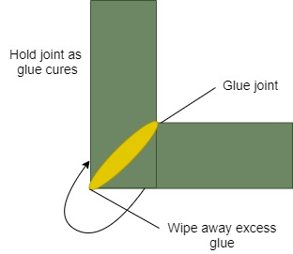
Steps for Mitered Corner
Step 1
Step 2
Step 3

Slide 16
Other Construction Tips
Can also make curved shapes using same groove and folding technique
For an N-sided polygon to fit over a circle of radius R the width of each side is W = 2(R)tan(π/N) computed in radians
Ex: for a hexagon to snugly fit over a circle of radius 5”
W = 2(5)tan(π/6) = 5.773” (~ 5” 25/32”)
Minimize number of glue joints and reinforce when needed
Heavy components (e.g. batteries) should be distributed near floor of box and supports reinforced
Might use a double walled box to further protect components from temperature/moisture
Access to interior is usually best through top where stress is less

Slide 17
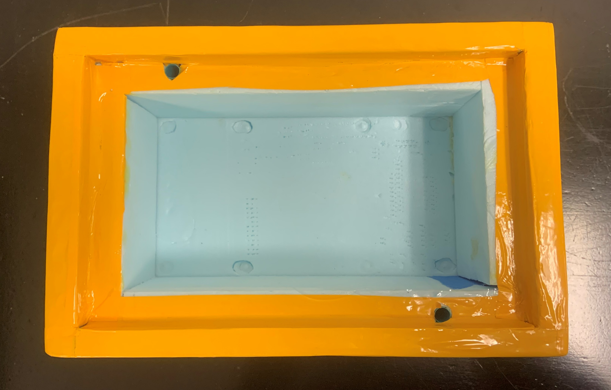
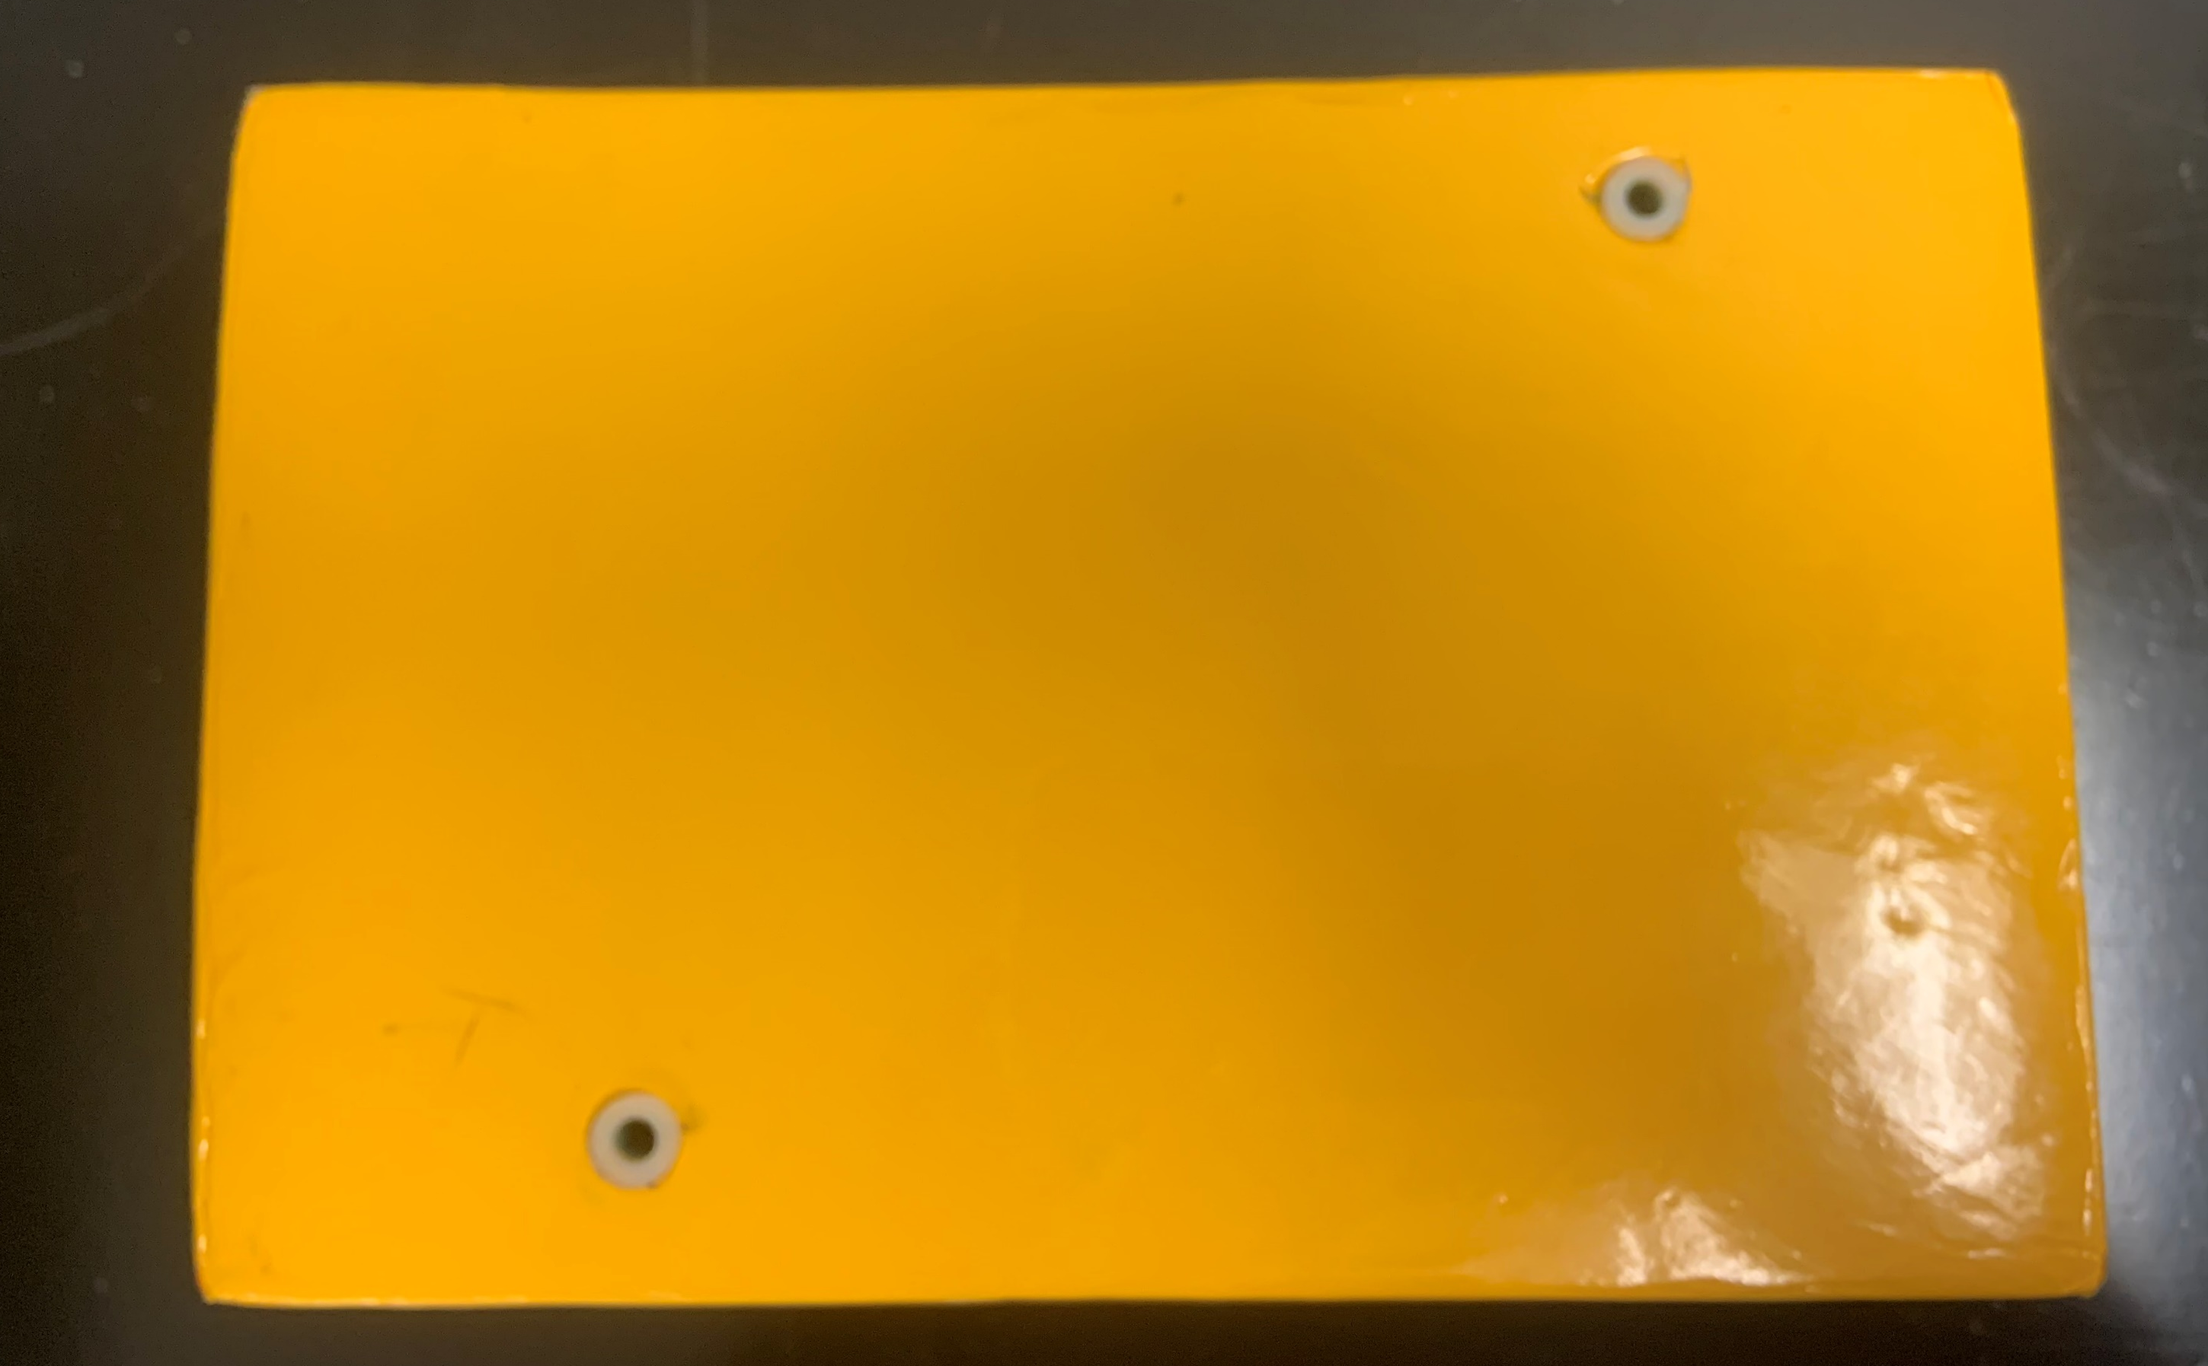
Adding Flight String Holes
To interface with the flight string you will need to make two holes 17 cm. apart that extend vertically through the payload.
This is best done with a drill or drill press and a 0.25” bit
Glue straws in holes for reinforcement
Glue plastic grommets into the holes to further secure the flight strings and keep the strings from wearing away at the foam.
Holes with straws added for reinforcement
Grommets added to the outside of holes

Slide 18
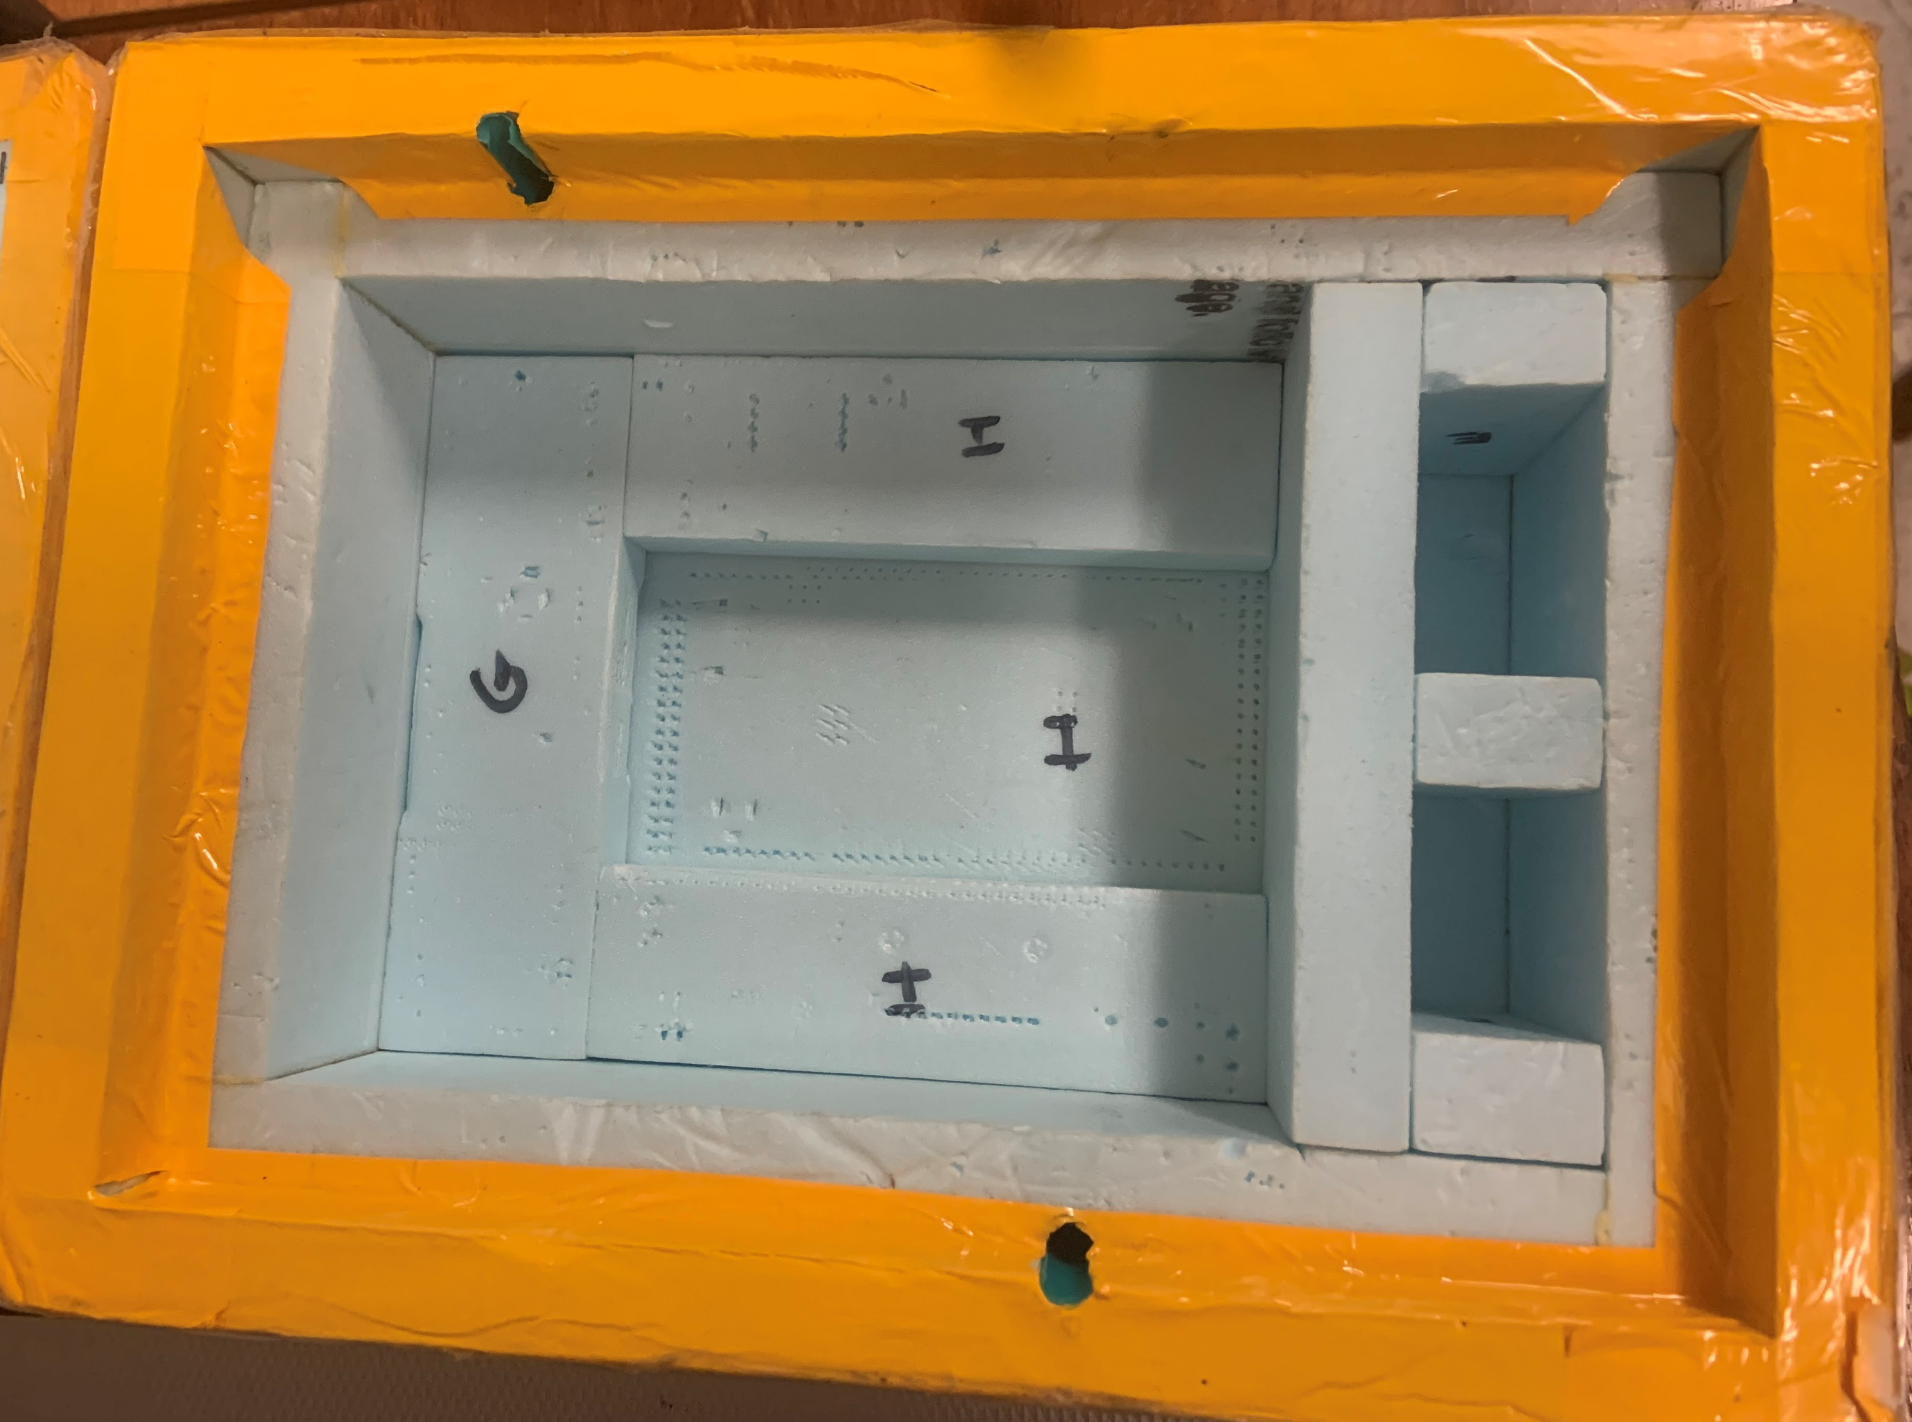
Interior Attachments
T-nuts or ordinary nuts taped or glued to the foamboard can be used for machine screw mounting
Extra foam inserts inside the payload can help secure components
Connectors / electrical feedthroughs / switches need to be hot-glued to snug-fitting holes in the wall
Flight vehicle string interface tubes should penetrate box top and bottom and be securely glued to joint corners
A standard MegaSat box with foam inserts

Slide 19
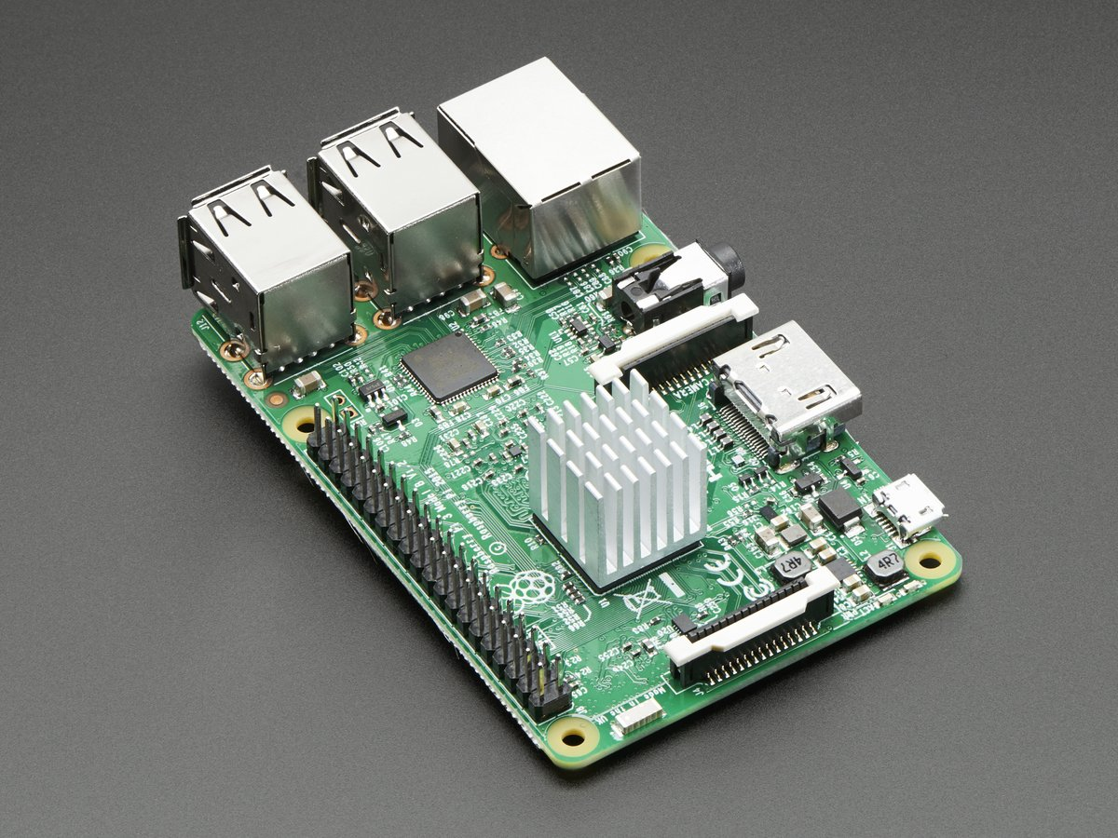
Payload Best Practices
Some sensors will need to be placed outside the payload
Make sure holes for cabling are made and are of proper size before applying Econokote
It is usually good to tape external sensors down to prevent interference with the flight string
Make incisions into foam inserts/walls to prevent stress on internal cables
Consider the thermal properties of your box and electronics
Heaters or heat sinks may be required
Hot glue potentiometers, SD cards, etc. to prevent movement during flight
Heat sink on Raspberry Pi microcontroller

Slide 20
References
http://www.foamular.com/ - Website of XPS products board products

