Slide 1
Mechanical Design Guidelines

Slide 2
Mechanical Design Topics
How to produce mechanical drawings
What mechanical interfaces do you need to specify
How do material choices affect your payload
What are the steps for producing a sound mechanical design
What should your testing procedure be
Handy, pocket size reference book is “Pocket Ref” by Thomas J. Glover available at ACE Hardware stores.

Slide 3
Reasons for Producing Drawings
Aide to configuration planning
Help determine what components are needed
Determine how components will go together
Check that dimensions & locations are consistent
Specify what is to be built
Proper drawings are needed by shop personnel
Communicate with management & reviewers
Document what has been built
Track changes in the configuration
Provide record of experiment configuration

Slide 4
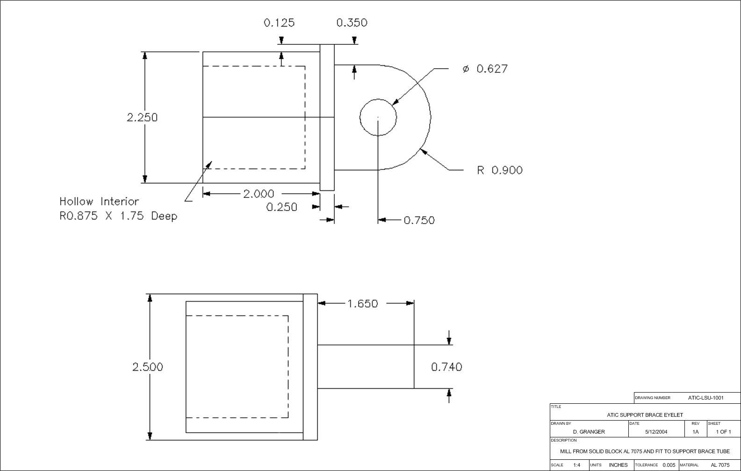
Sample Drawing

Slide 5
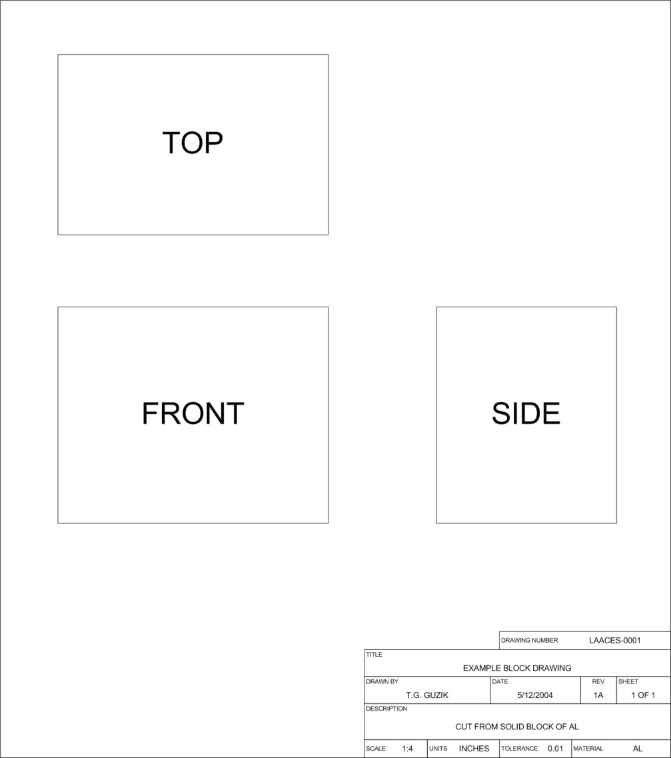
Basic Views in a Drawing
Most drawings provide Top, Front and Side views
What the component would look like if viewed from that direction
Views arranged usually as if object were unfolded
Sometimes an isometric (3D) view is provided

Slide 6
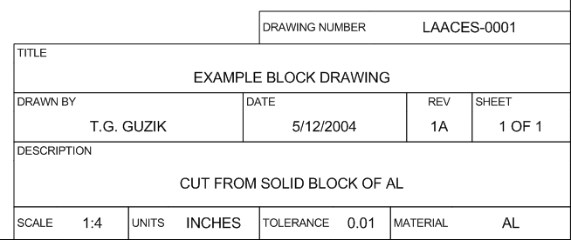
Drawing Label
The label provides all of the information necessary to interpret the drawing and track revisions
Included in the label should be a drawing number, title, author, date, revision number, sheet number, scale, units, tolerance, material and a description of any other relevant information

Slide 7
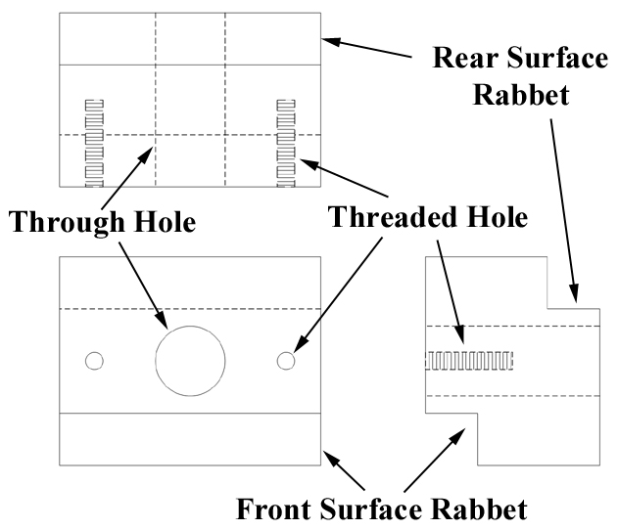
Representing Hidden Surfaces
Surfaces that can be seen in a particular view are indicated by a solid line
Surfaces that are “hidden” are indicated by a dashed line
Through holes are solid circles face on and dashed for side view
Threaded holes have perpendicular or diagonal dashing to indicate screw threads

Slide 8
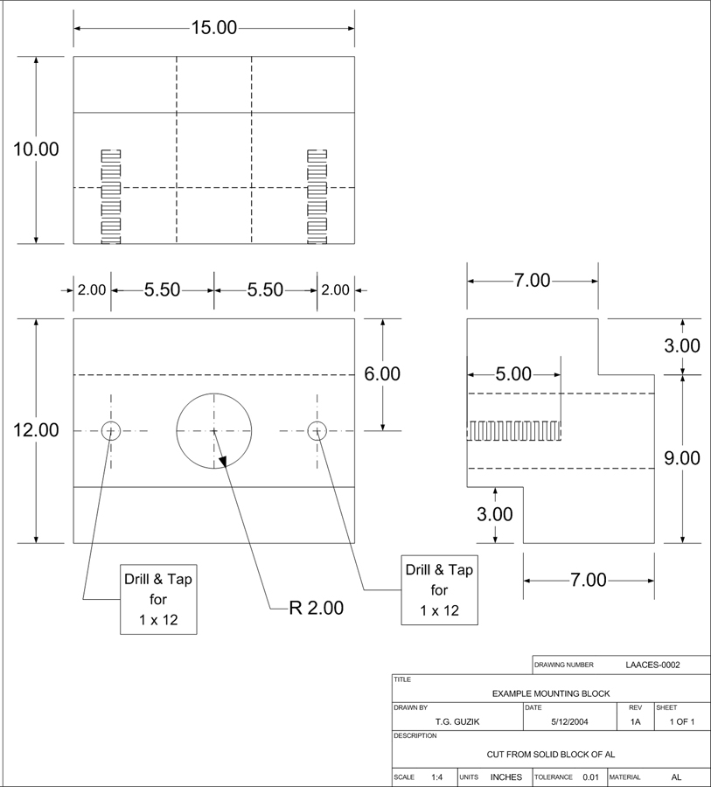
Putting Dimensions on the Drawing
All surfaces, holes & cuts should be dimensioned to specify location, width, length & depth
Consistent with units and tolerance specified in label
Reference to common surface or point
Holes are specified with a radius for clearance
Threaded holes are specified with a screw size & depth
Callout boxes provide addition information

Slide 9
Mechanical Interfaces
There are multiple interfaces that you will need to identify, specify and control
Component to component interfaces
Where and how does each part of your experiment contact another part?
Electrical connectors, motors, actuators, hinges
Component to payload structure interfaces
Where and how do you secure your experiment components within the payload box?
Payload to balloon vehicle interface
Interface already specified in LaACES balloon vehicle lecture
How will you implement this interface?
Your documentation should list all your interfaces and specify how they will be implemented and controlled

Slide 10
Material Considerations
When you choose materials for your payload you need to consider how they will affect your payload
How will a material affect your sensors?
Iron / steel will distort the readings of a magnetic sensor
Will your observation port window transmit the desired frequencies?
Will the material outgas and affect the sensor readings?
How will a material be affected by the environment?
The intense cold can embrittle many plastics and glues
Non-rigid, closed cell foam will expand dramatically in vacuum
How much does a material weigh? Is there a lighter material that will do the same job?
When in doubt obtain a material sample and test it.

Slide 11
Weight Budget
Early on in your project establish a weight budget
List of ALL payload parts, their weight, a weight uncertainty, the weight total and the uncertainty in this total
Weights can be estimated, calculated or measured
Largest uncertainty for estimated, smallest uncertainty for measured
Initially keep a contingency of ~20% to cover missing items and weight uncertainty
The more complete (number of items, measurements instead of estimates) your weight budget is, the lower the contingency needed
As your design matures your weight budget should include more details, more measured components, lower uncertainty and lower contingency

Slide 12
Payload Design Questions 1
Component Layout:
How many components does your experiment have?
Where do these components need to be located?
Are there issues where components need to be kept separate?
Component Access:
What components need to be frequently accessed (e.g. on/off switch)?
What components need to be infrequently accessed (e.g. configuration DIP switches)?
If a component needs to be replaced how will this be done?
Component Mounting:
Are there any critical alignment issues with sensors?
How will components be secured to not come loose during flight?

Slide 13
Payload Design Questions 2
Payload Integration:
In what order are components assembled to produce the completed payload?
Thermal Control:
What payload surface treatments are necessary to control thermal properties?
How much insulation of what type located where is necessary to protect critical components?
Do you need active thermal controls (e.g. heaters)?
Strength:
How will you determine that your structure is strong enough to survive the balloon flight without falling apart?

Slide 14
Develop a Testing Plan
Many design issues can be quantified by testing under controlled conditions
Such a Test Plan needs to address the following issues:
What components or systems need to be tested?
What test data needs to be collected?
What tests need to be performed?
What is the test procedure?
How will the data be recorded, analyzed and documented?
Need to assure payload will survive the flight environment
Thermal testing for the extremes of hot and cold
Vacuum testing for the low pressure at high altitude
Shock testing for when balloon bursts and payload lands

Slide 15
Major Tests
Develop prototypes or mock-ups
Test component layout and mounting
Develop specifications for mechanical interfaces
Thermal Vac chamber testing and shock testing for strength
Thermal testing using dry ice
Tropopause temperature get down to ~-60º C and dry ice surface temperature is –78.5º C
Test glues and other materials for embrittlement
Test thermal insulation properties
A small vacuum bell jar can simulate the pressure environment
Material outgassing, expansion, high voltage corona / arcing, etc.
Major shock is on landing
Nominal decent rate is 20 fps, so drop test article about 10 feet

Slide 16
References
“Pocket Ref” by Thomas J. Glover, 3rd Edition, 2003, Sequoia Publishing, Inc. P.O. Box 620820, Dept. 101, Littleton, CO 80162-0820, http://www.sequoiapublishing.com/ , also available in ACE hardware stores

