Slide 1
Defining the Project Tasks, Cost and Schedule
Project Management Unit #3

Slide 2
Cost & Schedule Estimates
The principal measures of a project are cost, time (schedule) and performance
For a given project one or more of these measures may be constrained
For LA ACES your launch opportunity has a fixed date and you must have a payload ready by this date
Initial estimates on cost and schedule are essential to determine if your plan is realistic
May need to plan for (or implement) trade-offs according to established priorities
Cost and schedule needs to be monitored throughout the project life-cycle

Slide 3
Steps to defining the project tasks
Determine the primary characteristics of the project
Establish the project scope
Establish the project priorities
Determine how best to organize the project tasks
Organization by deliverable
Organization by process
Combination of two
Create the Work Breakdown Structure (WBS)
Establish highest level, most general tasks
Establish “tree structure” of lower level tasks
Lowest level used to identify “work packages

Slide 4
Determining the project scope
Defining the project scope is a necessary precursor to developing an effective project plan.
Determining the scope includes addressing the following questions:
What are the major objectives for the project?
What are the major deliverables or outputs over the life of the project and when are they due?
What are the significant events or milestones that will happen during the project?
What technical requirements must be satisfied?
What are the project constraints or limits that must be taken into account?
This effort goes hand-in-hand with development of the system requirements.

Slide 5
Determining the project priorities
The primary measures of a project are in terms of cost, schedule and performance
Usually very difficult (impossible ?) to enhance or optimize all three of these measures at the same time
Establishing the priorities at project start provides guidance for trade-offs
Better
Faster
Cheaper
Pick two
(ancient engineering wisdom)
Required to stay fixed or constrained? (e.g. fixed budget or schedule)
Allowed or desired to be enhanced? (e.g. better or cheaper)
Acceptable to exceed? (e.g. increased cost, schedule slip, downsized)
All three priority types should be used when ranking the primary measures of cost, time and performance
Priorities can change, so these need to be reviewed at times

Slide 6
Organizing the project tasks
Are tasks focused on producing a tangible result?
Project and tasks are structured by concrete products or deliverables (e.g. building a hydroelectric dam)
Task definitions breakdown into subdeliverables, further sub-deliverables and work packages
Can be run in a highly parallel fashion
Are tasks focused on processes or phases?
Project evolves over time where results from one phase affect tasks in subsequent phases
Tasks and “deliverables” defined as outputs needed to move to next phase
Many aerospace projects are actually a combination of these two structures
Phases allow new innovations to be defined and developed
Tangible results (e.g. spacecraft) occur during the project

Slide 7
The Work Breakdown Structure
NASA definition of the WBS
A family tree subdivision of effort to achieve an end objective
Developed by starting with the end objective required and successively subdividing it into manageable components in terms of size and complexity
Product or task oriented and should include all the effort necessary to achieve the end objective
MIL-HDBK-881 definition of the WBS
Product-oriented family tree composed of hardware, software, services, data, and facilities. A WBS displays and defines the product, or products, to be developed and/or produced.
Relates the elements of work to be accomplished to each other and to the end product
Expressed down to any level of interest. However the top three levels are as far as any program or contract need go unless the items identified are high cost or high risk.

Slide 8
Why use a WBS?
Identifies the tasks, subtasks and units of work necessary to complete the project
Identifies the relationships between tasks
Increases the probability that every requirement will be accounted
Organize areas of responsibility and authority
Used to estimate project cost and schedule
Can be used to track the costs of each element
Can be used to monitor progress by completion of tasks

Slide 9
WBS Structure
The WBS has a hierarchical structure
Most general units at the highest level
Most specific units at the lowest level
Use a “tree structure” to provide task details
1.0 Major Task A
1.1 Sub Task A
1.2 Sub Task B
1.2.1 Sub Unit A
1.2.2 Sub Unit B
2.0 Major Task B
3.0 Major Task C
Split each top level general unit into subunits (level 2)
Split each subunit into further subunits (level 3)
For most projects it is unlikely to need to split subunits to below level 4
Each unit should have an identifier code representing the hierarchical, tree structure (e.g. see figure)

Slide 10
WBS Subunits
Each WBS subunit is a deliverable of some kind
Entities necessary for exiting the current phase such as system requirements, ICD documents, test results, etc.
Concrete products such as power system, realtime clock software module, sensor readout system, etc.
Lowest WBS level is defined by Work Packages
The contents of a Work Package includes:
Description of the work to be done including a time schedule
The resources needed and the cost of the work
The person responsible for assuring the work is completed
Multiple work packages may be needed for each low level WBS unit
A sum or “roll up” of the Work Packages yields a cost and time estimate for the unit

Slide 11
Example WBS (Incomplete)
1.0 Power System
1.1 Power Source
1.2 FCU Supply
1.3 DAU HD Supply
1.4 DAU Supply
1.5 CubeSat Supply
1.5.1 Interface to power source
1.5.2 FCU Control Interface
1.5.2.1 Establish control requirements
1.5.2.2 Design control interface
1.5.2.3 Prototype & test design
1.5.2.4 Complete design
1.5.2.5 Implement & test design
1.5.3 DC/DC Converters
1.5.4 FCU Monitoring Interface
1.6 Integrate & test power system
2.0 Flight Control Unit
3.0 Data Archive Unit
4.0 Data Archive Disk
5.0 Auxiliary Transmitter
6.0 Mechanical Structure
7.0 Thermal Control
8.0 System Integration & Testing
9.0 Management
Example takes one subunit down to level 4
Many times level 3 is sufficient and level 4 defines the work package
Each major unit has a similar level 2 list of subunits
Each level 2 subunit has a similar level 3 list of subunits

Slide 12
Steps to developing the estimates
Develop the general project definition and set of tasks
Perform a rough cost and time estimate
Develop the detailed project definition, tasks and WBS
Estimate the cost and time for each individual, lowest level element of the WBS
Roll-up (add) the cost and time for each low level WBS elements to obtain the estimates for higher level elements
Establish the project schedules
Reconcile differences between the macro and micro estimates

Slide 13
Factors affecting the estimate
Task Definition: The completeness of your project definition will determine if all tasks have been taken into account.
People Productivity: People do not focus on a task with 100% efficiency. The difference between “calendar time” and effort must be considered.
Project Structure: A dedicated project team will be able to focus its effort on completing the project effectively.
Padding: People may increase estimates to take into account unknown risks and this may force an unnecessary trade-off.
Culture: What is deemed acceptable behavior by the organization (e.g. padding vs. accuracy) will affect estimates.
Downtime: Equipment repairs, holidays, vacations, exam schedules can all affect the time estimate.

Slide 14
Estimating Techniques
Scaling: Given a cost for a previous project then an estimate for a new project can be scaled from the known cost. E.g NASA, at times, uses spacecraft weight to estimate total cost.
Ratio: Costs for subunits of the new project would be proportional to similar subunits in a previous project. For example, if it takes 1 day to build & test a particular sensor unit, then an instrument with 10 sensors would take 2 technicians, 5 days to complete.
Learning Curve: If the same task is repeated a number of times there will be a cost / time savings relative to the first time the task is done.
WBS Roll-up: Times and costs associated with the lowest level WBS work packages are estimated and then these are added or rolled-up to yield the costs for higher level units.

Slide 15
Guidelines for Estimates
Estimates should be done by the person most familiar with the task
If possible obtain estimates from several people and use the variance for risk assessment
Multiple estimates should be done independently to avoid “GroupThink”
Base the estimates upon normal conditions.
Use consistent units when estimating task time.
Work package estimates should not include contingencies
Use a separate risk assessment for estimating the affect of abnormal conditions and contingencies.

Slide 16
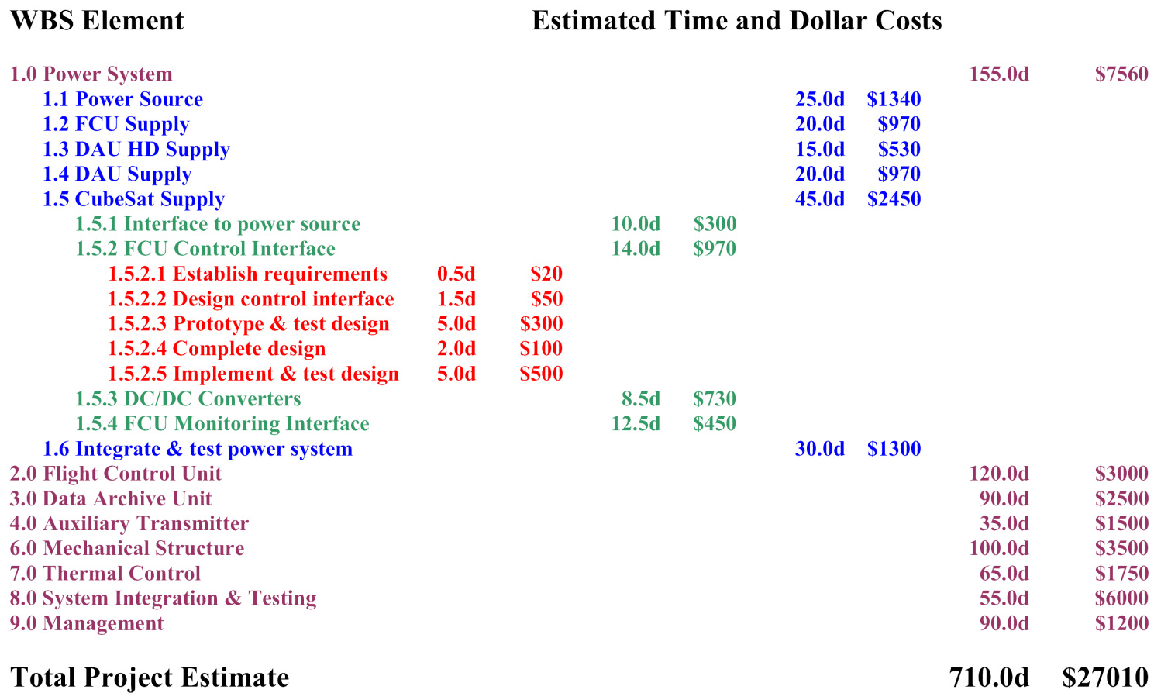
Example WBS Cost Roll-up

