Slide 1
The Ultimate GPS Logger Shield – GPS
LaACES Student Ballooning Course

Slide 2
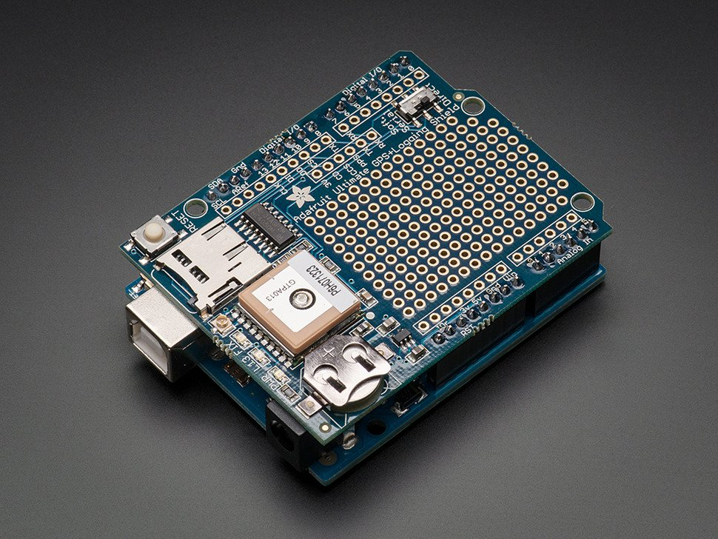
Introduction
Now that you’ve learned about the Global Positioning System, it’s time to learn about the GPS receiver you’ll be using - the Adafruit Ultimate GPS Logger Shield
Figure 1: Shown is the Adafruit Ultimate GPS Logger Shield. It is stacked on an Arduino Uno

Slide 3
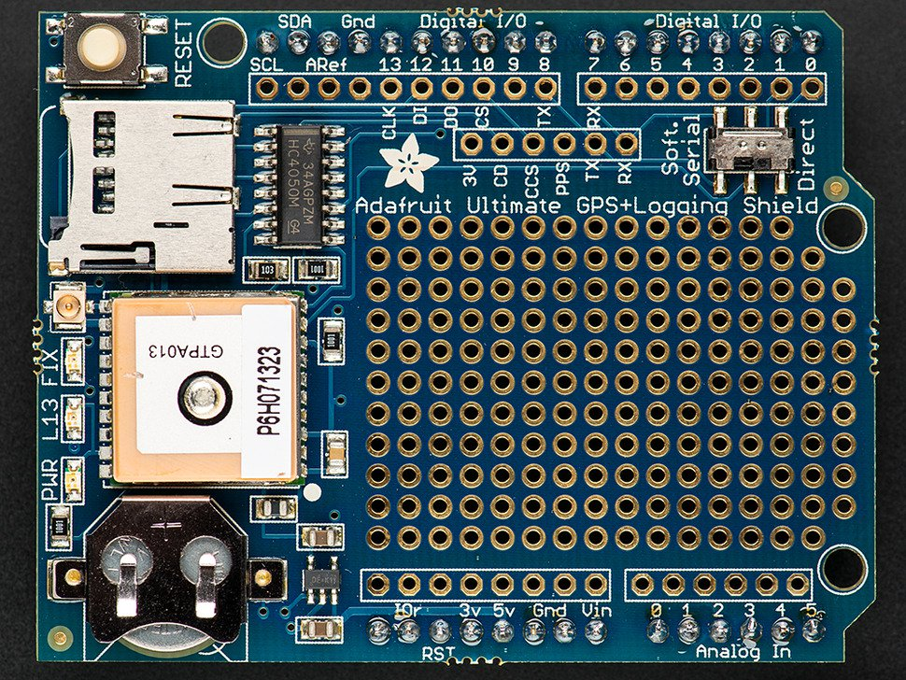
Adafruit Ultimate GPS Logger Shield Overview
This is the Arduino Ultimate GPS Logger Shield. It comes with
microSD socket
Internal antenna and connector for external antenna
GPS unit
RTC and coin cell holder
Prototyping Area
Figure 2: Shown is the Adafruit Ultimate GPS Logger Shield. From top to bottom, the red arrows show the microSD socket, the external antenna connector, the GPS unit, and the coin cell battery holder. The yellow dashed square designates the prototyping area

Slide 4
Antennas
The GPS shield has a built-in patch antenna. For the MegaSat, this antenna will suffice
Payload shielding or sensitivity requirements may require an external antenna. See Figure 3 for where this would be attached
Most GPS antennas will have an SMA connector, so a SMA to uFL connector will be required
The GPS shield detects external antennas and uses them automatically
NMEA sentences provide antenna status (internal, external, or that a problem exists)
Figure 3: The red arrow is pointing to the Adafruit Ultimate GPS Logger Shield’s external antenna connector. It is located between the microSD socket and the FIX LED. To connect an antenna, a uFL to SMA connector will be required

Slide 5
Real Time Clock (RTC)
A Real Time Clock (RTC) is a computer clock that keeps the current time
When the GPS has a fix, the RTC sets itself to the current UTC time
If the GPS loses power, this ensures the GPS will keep the correct time
The GPS has a built-in RTC, but not a built-in battery. A coin cell battery needs to be inserted. See Figure 4
A new battery can run the RTC for 7+ years
Figure 4: Shown is the Adafruit Ultimate GPS Logger Shield’s coin cell battery holder. When inserting a coin cell battery, ensure the positive side is facing up, away from the Shield

Slide 6
LEDs on GPS Shield
There are 3 different LEDs on the GPS shield, see Figure 5
Green (PWR)
Power LED. If it’s not on, the shield doesn’t have power
Yellow (L13, SD card access)
Solid when Arduino is bootloading
Flickers when SD card is being accessed
Red (FIX)
Blinking every second, GPS does not have a fix
Blinking once every 15 seconds, GPS has a fix
Figure 5: Shown are the three LEDs on the Adafruit Ultimate GPS Logger Shield. They are located next to the external antenna connector. From left to right, there is the power LED (lit when the Shield has power), the L13 LED (lit when the Arduino is bootloading and flickers when the SD card used), and the FIX LED (blinks at different frequencies corresponding to the GPS fix quality)

Slide 7
Prototyping and Breakout Areas
There is a prototyping area on the GPS shield, see Figure 6
Next to the Prototyping area are six breakouts
3V: Outputs 3 volts
CD: Card-detect output from the microSD socket. It is shorted to ground if there is not a card inserted
CCS: Card chip select line. It is connected to digital 10 by default
PPS: This is a pulse per second output when the GPS has a fix
TX: GPS transmit line
RX: GPS receive line
Figure 6: Shown is the prototyping and breakout areas on the Adafruit Ultimate GPS Logger Shield. The red dashed box is surrounding the prototyping area. The yellow dashed box surrounds the breakout area. The RX and TX breakout pins are used for Software Serial communication

Slide 8
Communication: Two Methods
Two ways to communicate with the GPS shield: Direct Connect and Software Serial
Direct Connect connects the Shield to the Arduino’s Serial 0 channel. This is the channel used for uploading sketches
The Arduino is removed from communication. Commands sent directly to the Shield using the Serial Monitor
Software Serial uses jumpers to utilize a different Serial channel so sketches can be uploaded to the Arduino

Slide 9
Communication: Direct Connect
Direct Connect connects the GPS serial TTL UART directly to the Arduino’s USB-serial converter chip
To enable Direct Connect:
Start with the switch on Soft Serial to upload a blank sketch
Then flip the switch down (Figure 7)
NMEA sentences will start showing up on the Serial Monitor
While using Direct Connect, you cannot upload sketches to the Arduino! The programming UART is being used by the GPS shield
Figure 7: Shown is the communication switch on the Adafruit Ultimate GPS Logger Shield. In this position, the Shield is communicating via Direct Connect. This method has the Shield using the main Arduino UART to communicate with the computer. Because of this, sketches cannot be uploaded while using Direct Connect

Slide 10
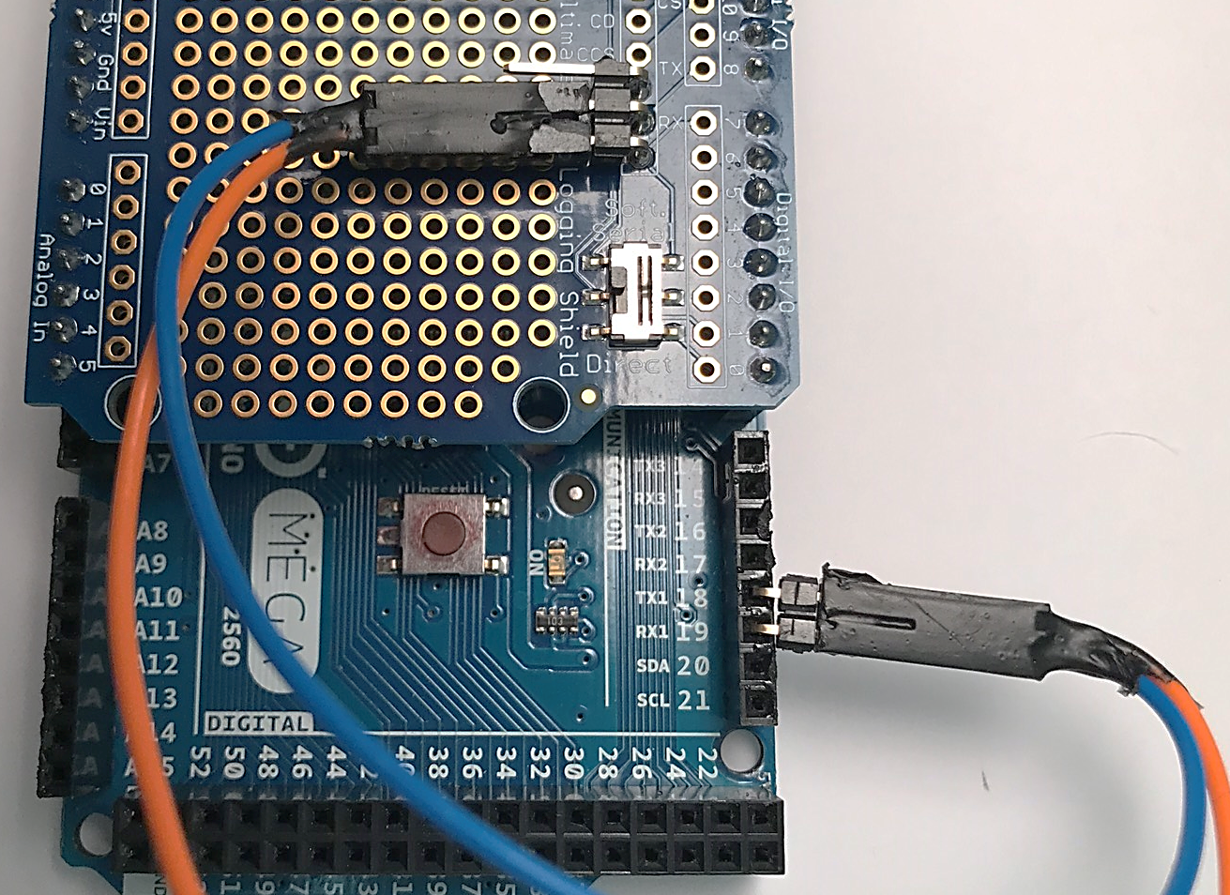
Communication: Software Serial
Software Serial allows sketches to be uploaded using the Arduino’s main UART because a different UART is used for GPS communication
The Shield switch should be on Soft Serial. Jumpers will be used to connect GPS TX and RX pins to two Arduino UART pins. See Figure 8
To communicate with the GPS shield, upload sketches to the Arduino. Adafruit has a GPS library to help receive and parse the GPS data stream
Figure 8: Shown is the communication switch on the Adafruit Ultimate GPS Logger Shield and jumpers connecting the RX and TX breakout pins to Arduino pins 18 and 19, respectively. When the switch is in this position, the Shield is communicating via Software Serial. This method allows sketches to be uploaded to the Arduino

Slide 11
Software Serial: Interrupt
GPS send data to a Serial buffer. This buffer needs to be read manually. There are two ways – polling and interrupts. Interrupts are the proper way.
Polling
Arduino checks to see if anything is in the serial buffer on a regular interval. Must stop what it is doing to check.
Constantly checking the front door to see if the Amazon package is delivered yet
Interrupt
When a specific signal is received, the Arduino goes and reads the serial buffer. Otherwise, it keeps on doing other things.
Cleaning the house, doing laundry, etc. until the doorbell rings, then the front door is checked for the Amazon package.

Slide 12
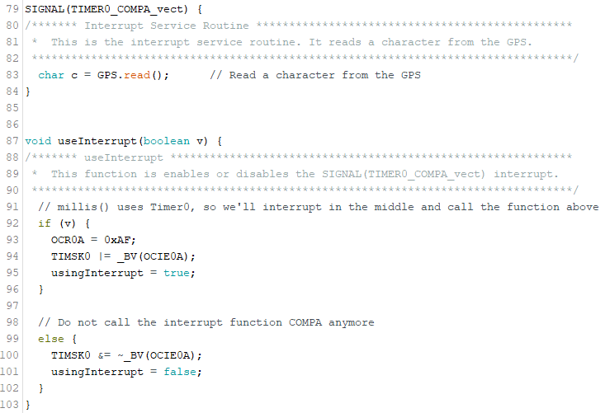
Interrupt Example
Figure 9 is the code used to interrupt and read the GPS serial buffer
Timer0 is an internal timer used for millis(). Interrupt between the millis() pulses to read a character from the serial buffer every millisecond.
Figure 9: The top function simply reads a character from the GPS serial buffer. The second function uses Timer0 (an internal timer on the Mega), which is used to increment the millis() call. This function says to interrupt between the millis() increments (so as not to interfere with it). This will result in the Mega reading a character from the GPS serial buffer once a millisecond.

Slide 13
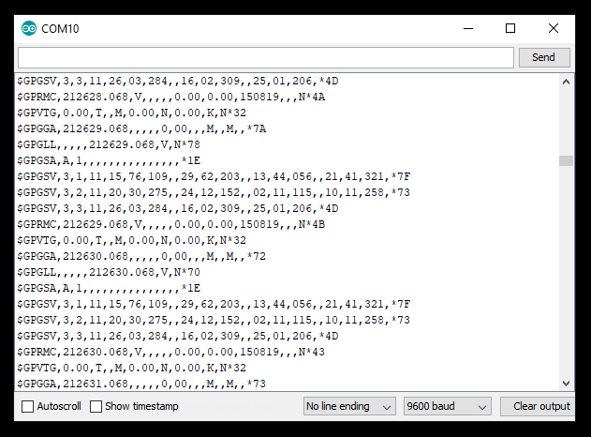
Data Streams
Data received from the GPS shield will be NMEA sentences.
Figure 10 shows what raw GPS data will look like in the Serial Monitor
$GPRMC,212628.068,V,,,,,0.00,0.00,150819,,,N*4A
This is an example of a NMEA sentence pulled from Figure 10
From this data stream, we can see it was taken on August 15, 2019 at 21:26:28 UTC. A fix was not achieved.
Figure 10: Shown is an example of the raw output of the Adafruit Ultimate GPS Logger Shield on the serial monitor when the Shield is switched to Direct Connect. The GPS did not have a fix, so most data fields are blank

Slide 14
Parsing
When using Software Serial, the NMEA data can be parsed using the Adafruit GPS library. This allows information (such as time, date, latitude, speed, etc.) to be easily available
Adafruit_GPS.h file in library lists all possible information obtained from parsing
$GPRMC,212628.068,V,,,,,0.00,0.00,150819,,,N*4A
GPS Command | Result
GPS.day | 15
GPS.month | 8
GPS.hour | 21
GPS.second | 28

Slide 15
Information and Image References
Information
https://learn.adafruit.com/adafruit-ultimate-gps-logger-shield/overview
Images
GPS shield – slides 2 and 3: https://www.adafruit.com/product/1272?gclid=Cj0KCQjwhdTqBRDNARIsABsOl9_UNhRtd2VDGjp-aaau_JLLP2AxSAH72n2Fm4Md7Ipr6MLFVqatdUYaAlb1EALw_wcB

