Slide 1
Data Acquisition

Slide 2
Sensors and Transducers
A sensor is a device that detects or measures a physical property and records, indicates, or otherwise responds to it.
A transducer is a material, substance, or device that converts the reaction from the active sensor into electrical signals
Often the sensor and transducer are integrated into a single unit – for example, a thermistor’s resistance changes with temperature; it converts temperature into resistance.

Slide 3
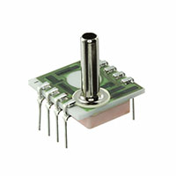
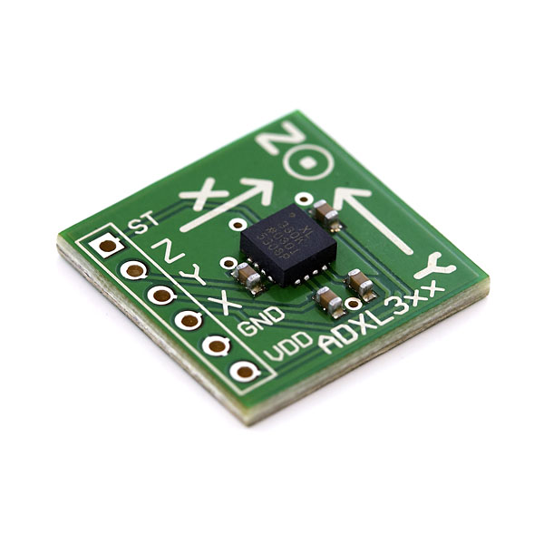
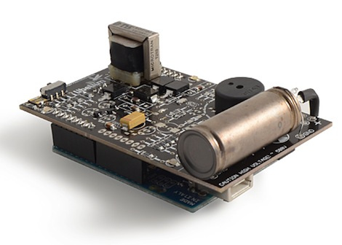
Sensor Inputs: Physical Variables
Temperature
Pressure
Humidity
Light Intensity
Radioactivity
Acceleration
Altitude
EMF strength
(Electromagnetic fields)
Pressure Sensor
Accelerometer
Geiger Counter

Slide 4
Sensor Classification
A passive sensor detects or responds to external stimuli from the environment
An active sensor emits a signal (light, sound, radio wave) and detects reflections or the environments reaction to the emitted signal
Passive Sensor
Active sensor

Slide 5
Electrical Signal Outputs
The output of a sensor will vary depending on the sensor in use. Most sensors will output electrical signals.
These signals can vary in:
Voltage
Current
Pulse Amplitude & Width
Frequency
Signal Duration
Some sensors will output a digital signal that must be interpreted by another device such as a microcontroller or computer.
Ultrasound Transducer
Pressure Transducer

Slide 6
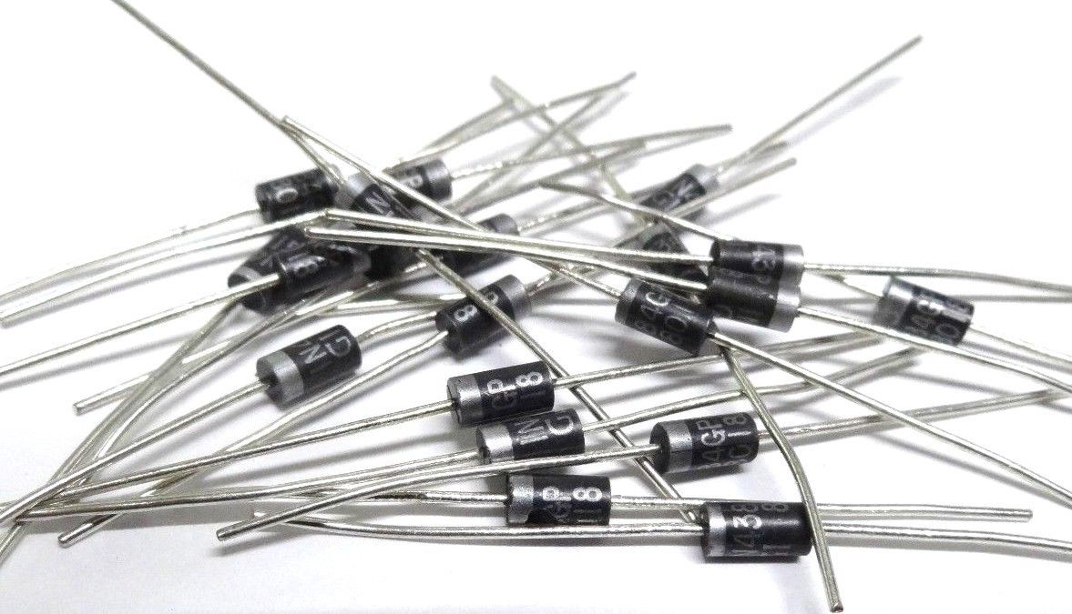
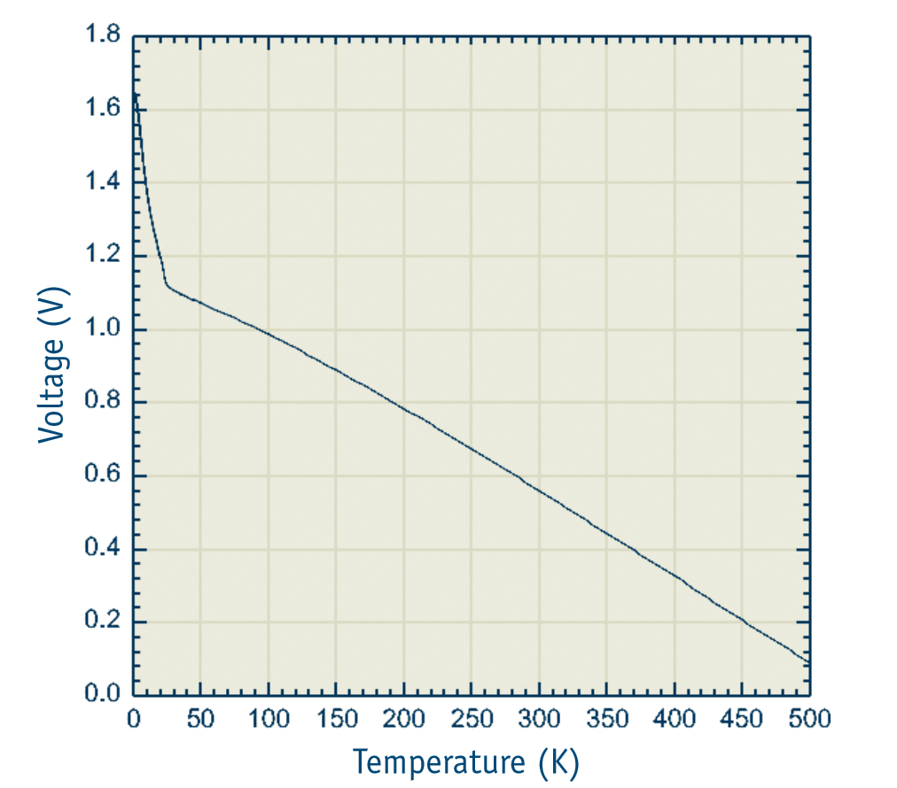
Temperature Sensors
There are a multitude of methods to measure temperature. It can be measured by thermistors (resistance varies with temperature), thermocouples (voltage varies with temperature), or semiconductor junction devices (current varies with temperature).
PN-junction diodes can be used to measure temperatures in the range of 20 – 500K. In this range, the forward voltage of the diode varies linearly with temperature. The forward voltage drops approximately -2.1 mV / K.
1N457 Si Diode

Slide 7
Pressure Sensors
A conductive material called the diaphragm bows in or out depending on the atmospheric pressure being applied to it. This changes the distance and conductivity between it and a metal plate beneath it. A transducer reads this change in conductance as pressure. Note, temperature compensation is essential for proper pressure readings.
The MegaSat uses a pressure transducer that gauges absolute pressure (zero reading = perfect vacuum). It also has temperature compensation built in.
1230-015A-3L Pressure Transducer

Slide 8
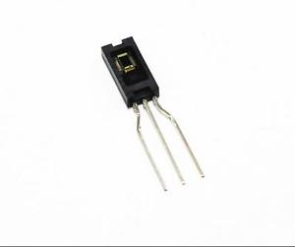
Humidity Sensors
How they work
The most common way humidity sensors work is by gauging how electricity jumps the air gap in a capacitor. All substances conduct electricity differently, and this includes dry vs humid air. The change in conductivity is interpreted as humidity.
MegaSat
The board uses a capacitive sensing element that is light sensitive so care must be taking to keep it out of the light.
HIH-4000-003 Humidity Sensor

Slide 9
Acceleration and Orientation Sensors
There are multiple ways to make an accelerometer. The MegaSat has the simplest type. A semiflexible conductive mass spans a gap between two beams like a bridge. Underneath it lies a conductive plate. If an accelerative force causes the bridge to bend, then the capacitance between it and the plate will change. Circuitry converts this change to voltage for an acceleration reading.
A gyroscope is more complicated. The physics involved includes the conservation of angular momentum and the Coriolis Effect. The gyro used by the MegaSat gets it readings from the change in capacitance caused by the Coriolis Effect.
Curious students may research “vibratory MEMS rate gyroscope” if they would like to know more.
SEN-11028 ROHS
Accelerometer-Gyro combo

Slide 10
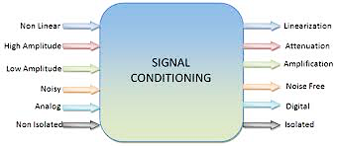
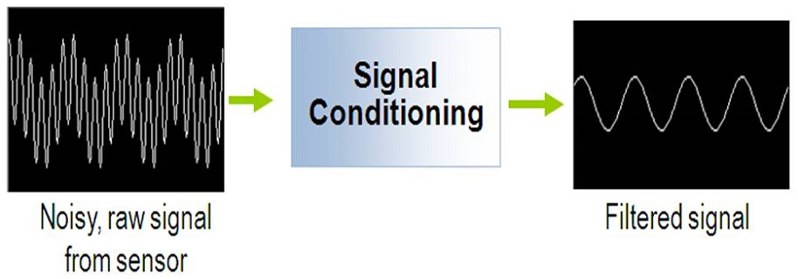
Signal Conditioning
Sensors output an electric signal, but many times the signal cannot be directly interpreted by humans or other electronics. This can be fixed with signal conditioning.

Slide 11
Amplification and Attenuation
When a signal is too weak to be interpreted correctly, the signal can be amplified. Amplification is the process of increasing the power of an electrical signal.
Sometimes, a signal is strong enough to damage equipment or other devices or exceed the desired thresholds. In such cases, it often useful to attenuate the signal. Attenuation is the process of reducing the power of an electrical sensor. Attenuation occurs naturally over long distances.
Notes:
https://www.geeksforgeeks.org/data-communication-transmission-impairment/

Slide 12
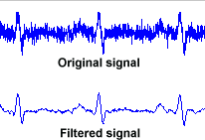
Electronic Filters
All sensors have noise in their outputs to some degree. Noise is undesired variations in electronic signals.
Electronic filters are circuits that remove unwanted noise from an applied signal and produce a cleaner signal. They may separate combined signals or restore distorted signals
In the image above, the signal has had unwanted frequencies removed.
Notes:
http://www.medteq.info/med/ECGFilters

Slide 13
Input and Output Impedance
Impedance is the resistance a circuit has to current flow when voltage is applied. Resistance is a component of impedance. The impendence of various components in a circuit will vary. Often, it is most useful to measure the input and output impendence of a circuit.
Input impedance is the equivalent impedance of the circuit when viewed from the input of the circuit. Similarly, output impedance is the equivalent impedance of a circuit when viewed from the output of the circuit.
Input and output impedance can be measured or calculated.
Notes:
https://www.ncbi.nlm.nih.gov/books/NBK11076/

Slide 14
Impedance Matching
An impedance mismatch is when the input impedance and output impedance of two connected electronics differ. Impedance mismatches introduce additional noise and power loss to the system through signal reflections and other phenomenon.
Impedance matching is the practice of designing the input or output impedance of a circuit to match its corresponding signal source or load. This is often done to maximize power transfer or minimize signal reflections.

Slide 15
Level Shifting
Many digital electronics communicate on different logic voltages. For example, the Arduino Mega digital pins communicates with +5V, while the Raspberry Pi communicates with +3.3V. It is possible for a Raspberry Pi to communicate with a Mega through level shifting.
Level Shifting is the conversion of logic signals from one voltage level to another. It converts the “HIGH” voltage level of the input to a different voltage. In the example above, a level shifter would change the 3.3V logic to 5V logic or vice versa.

Slide 16
Span and Base Adjustment
Example:
Temperature sensor:
450 mV to 800 mV
BASE = 450 mV, SPAN = 350 mV
Signal Conditioning Output:
0V to 3V (to match ADC)
BASE = 0V, SPAN = 3V
Span refers to the voltage span of the device. Base refers to the lowest voltage of the device.
If the span of two components do not match than the signal could be lost.
Notes:
11.6 mA is 7.6 mA above the base. (7.6 mA)/(16 mA) represents 47.5% of the output span.
47.5 % of the temperature span is 80.8 degrees, so the temperature is 80.8 degrees above the base temperature (-20), or 60.8

Slide 17
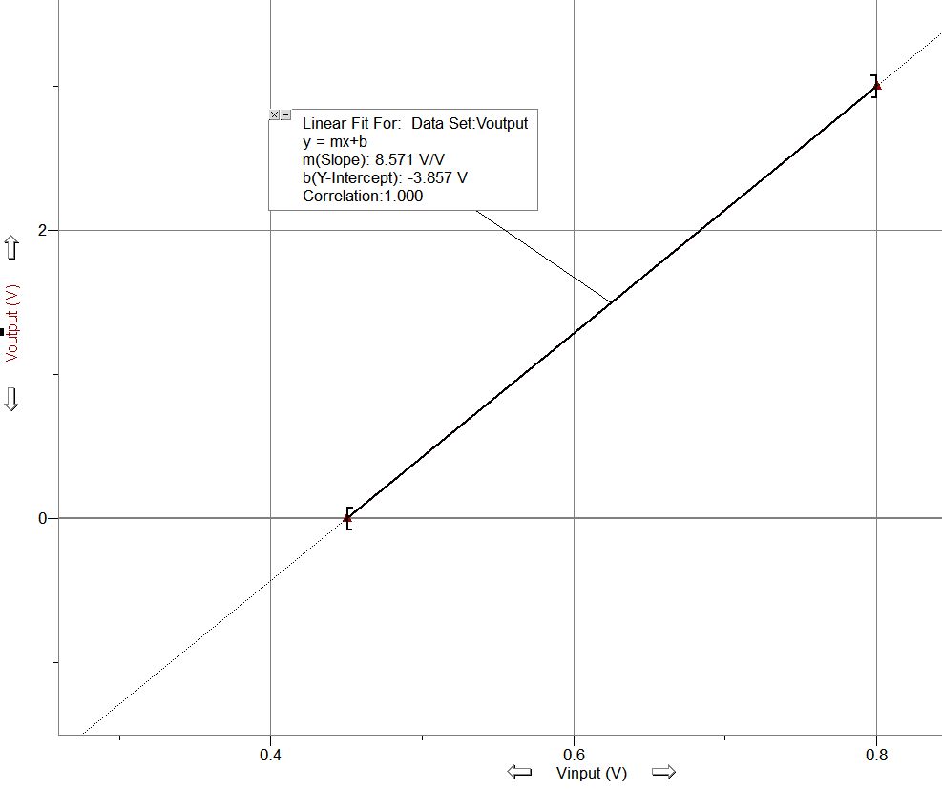
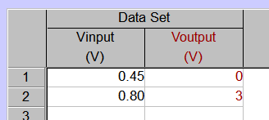
Span and Base
Gain = 8.571
Offset = -3.857
Design and Build a circuit that performs this transfer function.
What do we need?
Notes:
11.6 mA is 7.6 mA above the base. (7.6 mA)/(16 mA) represents 47.5% of the output span.
47.5 % of the temperature span is 80.8 degrees, so the temperature is 80.8 degrees above the base temperature (-20), or 60.8

Slide 18
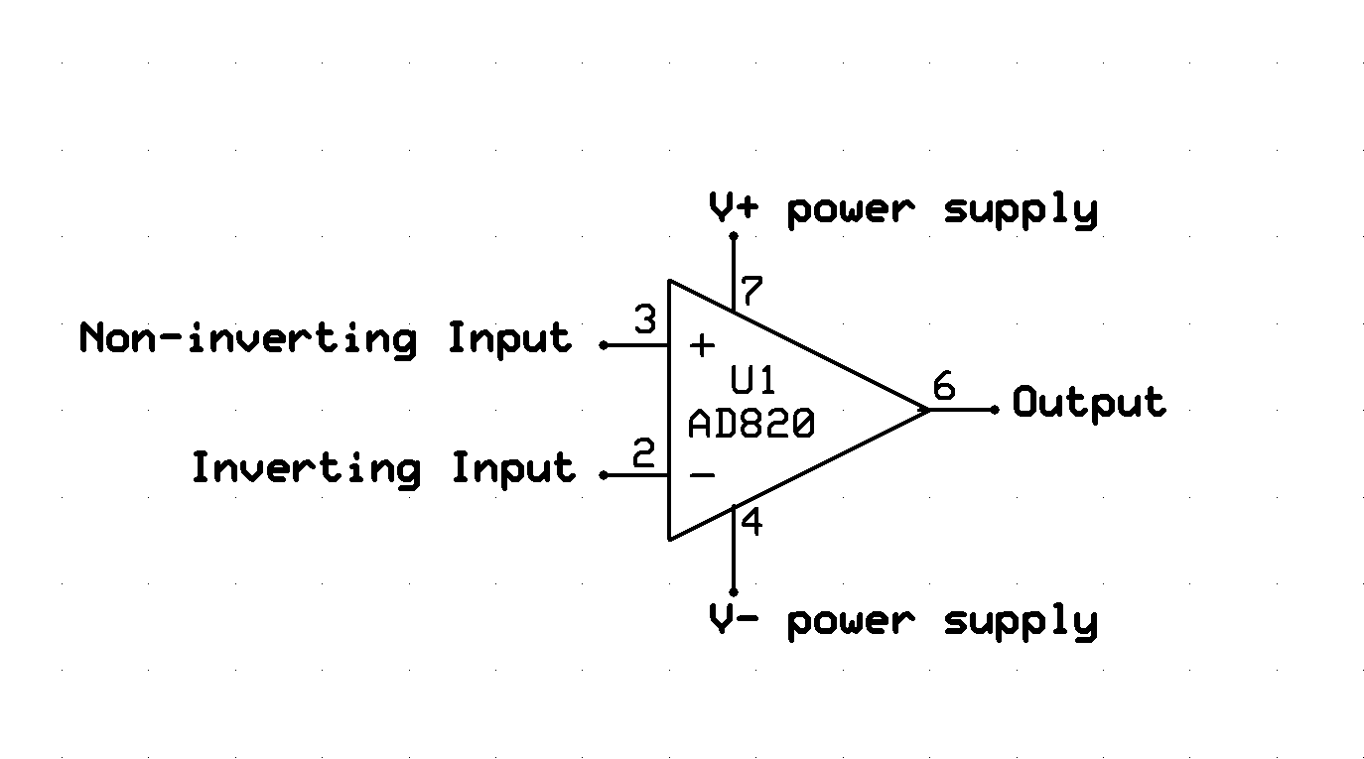
Signal Conditioning Circuit Operational Amplifier or “Op amp”
An op amp takes 2 input signals and outputs 1
Ideal Op amp Parameters:
▪Input Z = ∞ ▪Out Z = 0
▪Gain = ∞ ▪BW = ∞ ▪Vos = 0

Slide 19
Op Amp Golden Rules
The output attempts to do whatever is necessary to make the voltage difference between both inputs zero.
The inputs draw no current.
The output influences the input pins via the external feedback network. Use the Rules and Ohm’s Law to analyze or synthesize opamp circuits.

Slide 20
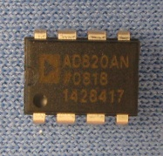
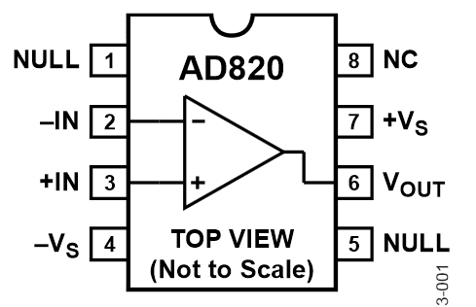
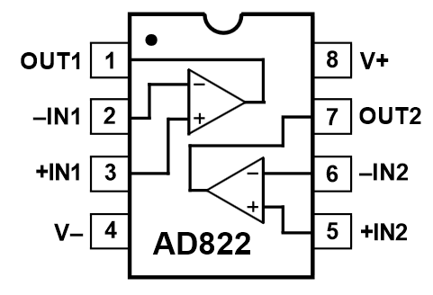
Operational Amplifier
Available in Single, Dual and Quad Packages
Bipolar power supply (typ. +/- 12V)
Single supply operation (typ. +12V, GND)
V- < Vout < V+

Slide 21
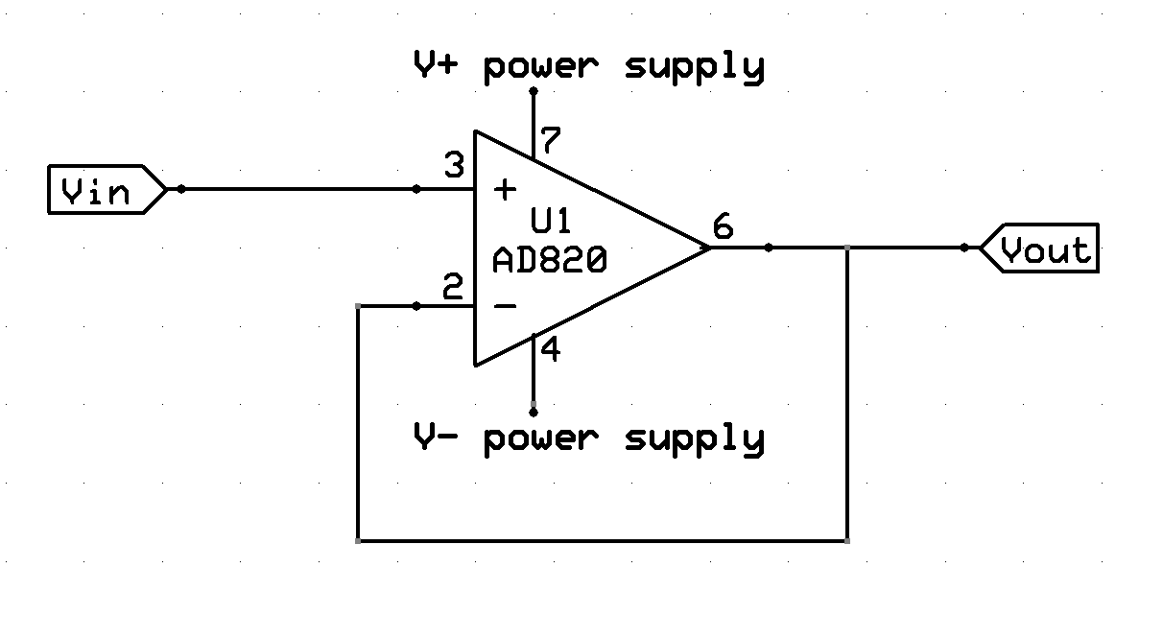
Signal Conditioning Circuit Buffer
A buffer provides voltage or current impedance between to components to prevent the signal from affecting the performance of a component.
Gain Buffer
Vin = Vout

Slide 22
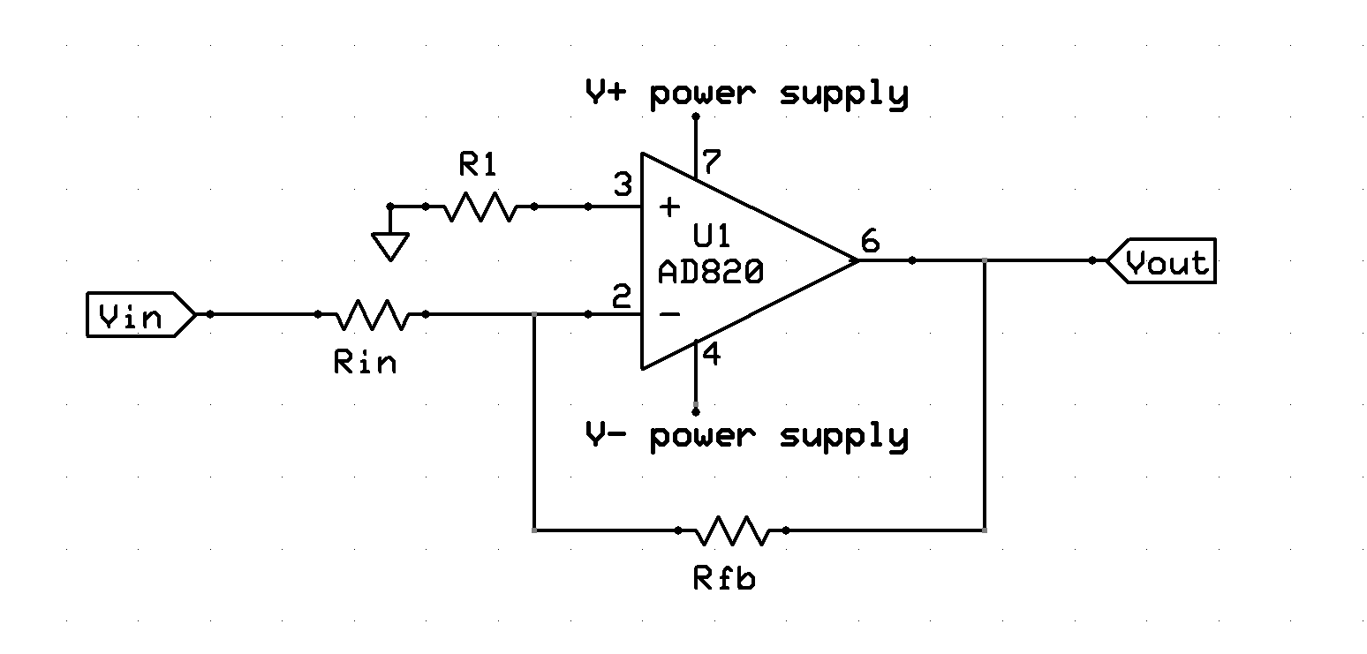
Signal Conditioning Circuit Inverting Amplifier
Inverted op amps have Vin connected to the negative terminal. This is useful for converting a smaller sensor signal into a much larger voltage.

Slide 23
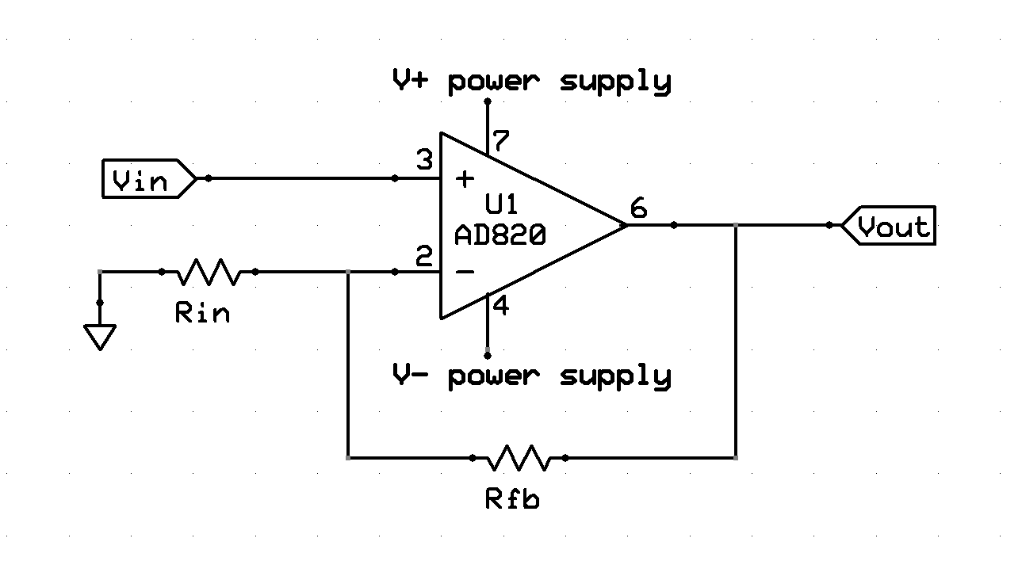
Signal Conditioning Circuit Non-Inverting Amplifier
Non-inverted op amps have Vin connected to the positive terminal. This is commonly used in electronics to isolated circuits from each other.

Slide 24
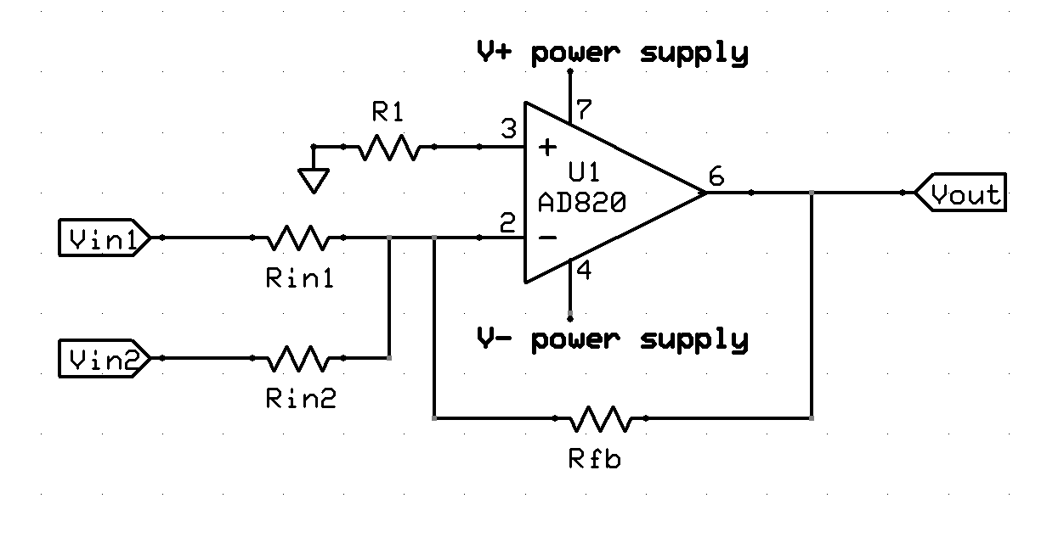
Signal Conditioning Circuit Summing Amplifier
Summing op amps have multiple inputs are connected into the negative terminal

Slide 25
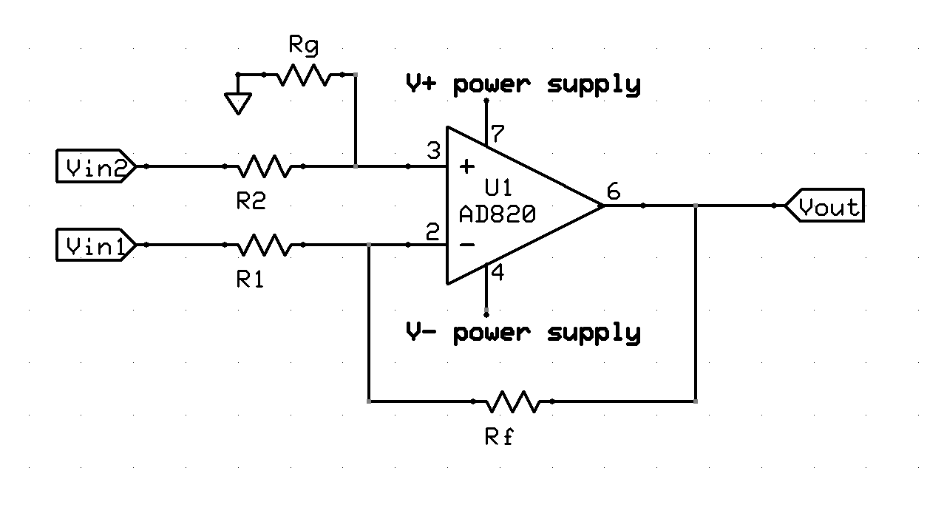
Signal Conditioning Circuit Difference Amplifier
A difference op amp has an input into both the negative and positive terminals.

Slide 26
Data Acquisition Flow
SENSOR
TRANSDUCER
SIGNAL
CONDITIONING
DATA COLLECTION
AND STORAGE
ANALOG-TO-DIGITAL
CONVERSION
READOUT
AND/OR DISPLAY

