Slide 1
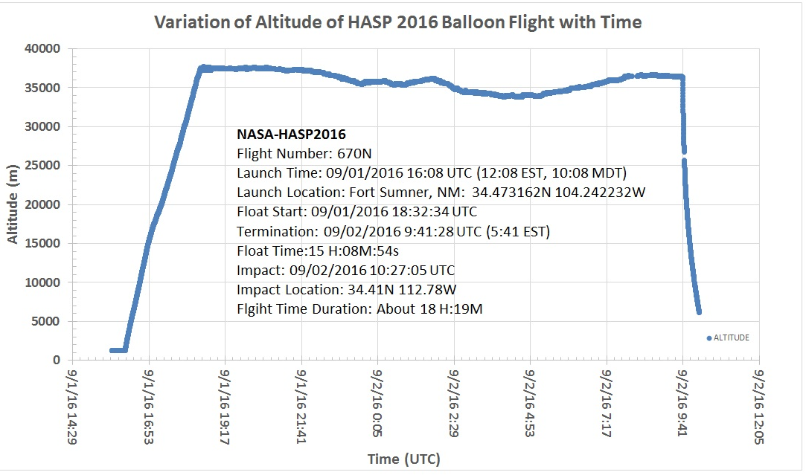
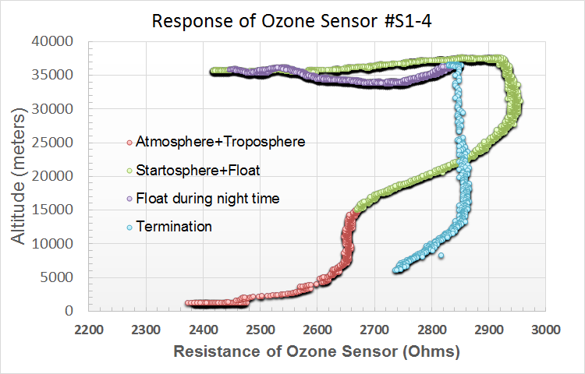
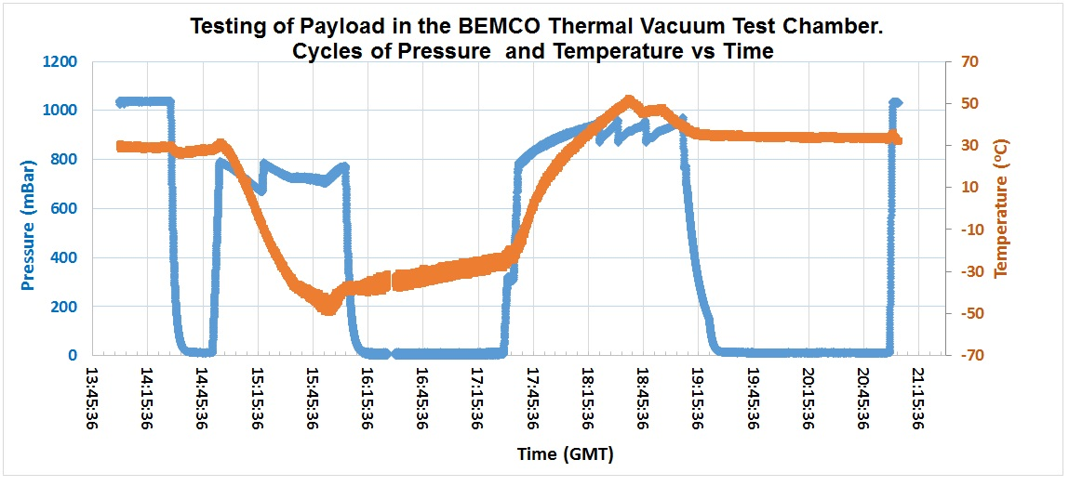
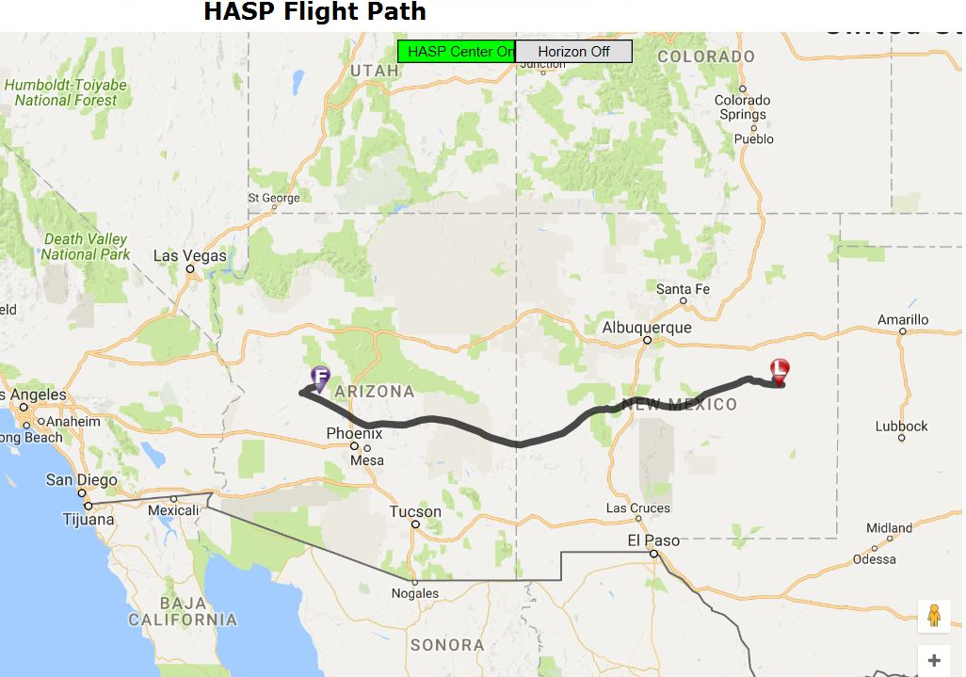
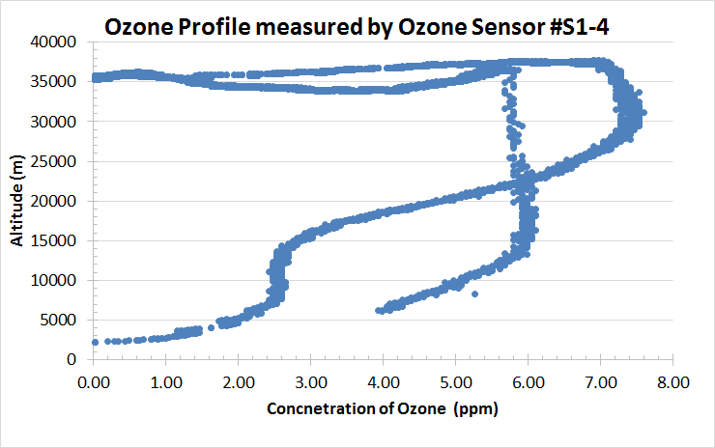
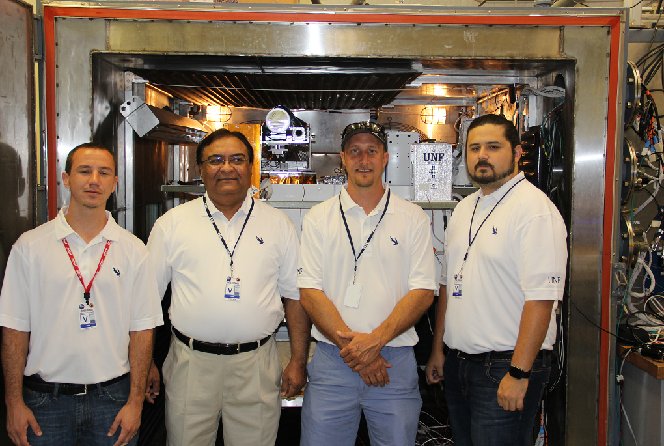
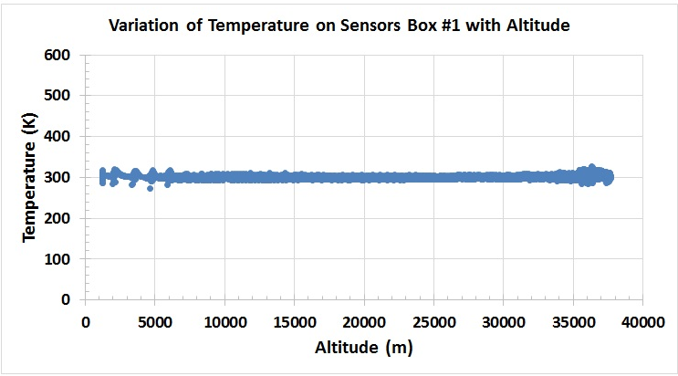
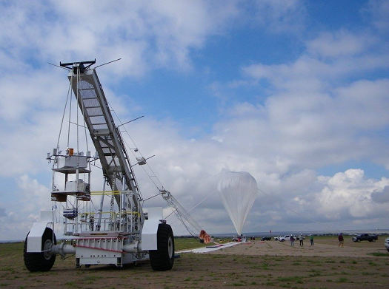
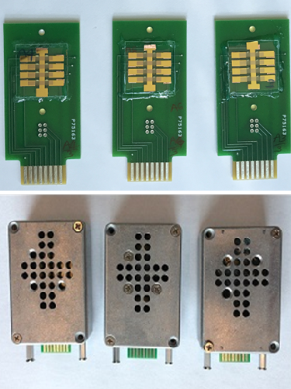
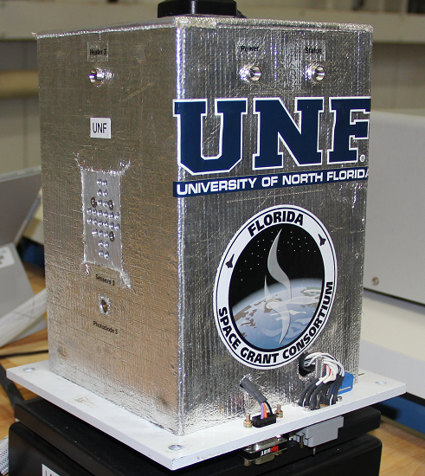
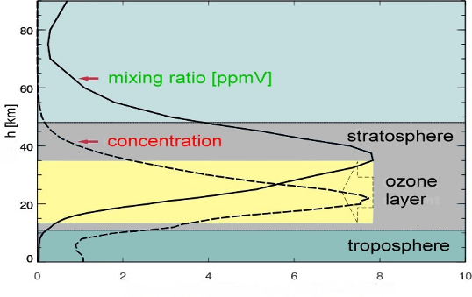
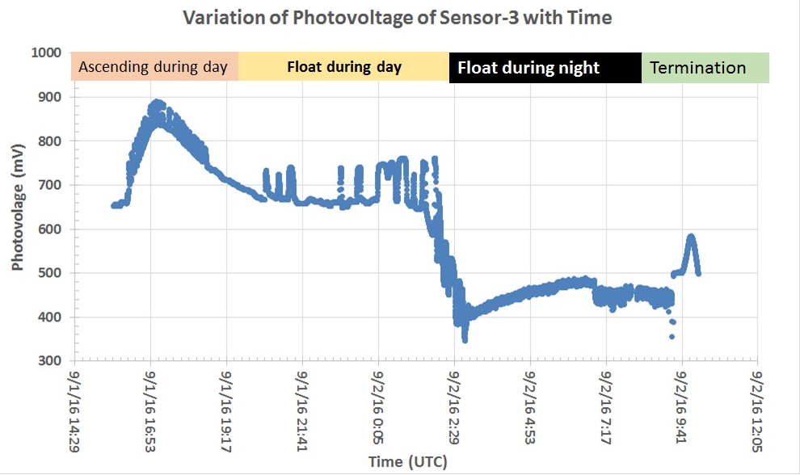
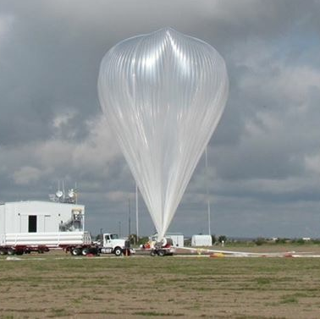
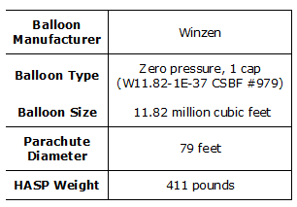
Ozone Sensors Payload and its Applications on
NASA high altitude balloon 2016 flight
F
Jesse Lard, Christopher Farkas*, Kenneth Emanuel * and Nirmal Patel
Department of Physics, *Dept. of Engineering, University of North Florida, Jacksonville, FL
Abstract / Background
The University of North Florida (UNF) team successfully developed the ozone sensors payload and launched into the stratosphere by the NASA high altitude balloon flight. The ozone sensors payload was designed and fabricated by the UNF student team. The payload consisted of three different types of nanocrystalline thin film gas sensor arrays. Each sensor array has eight thin film gas sensors, one pressure sensors, three temperature sensors, one GPS and microcontroller circuit board. The size of payload for NASA-HASP2016 flight was 6 inches x 6 inches x 9 inches and weight of about 2.7 kg. The payload met the specified design criteria of NASA and was successfully integrated for communications and successfully cleared thermal vacuum testing at the NASA-Columbia Scientific Balloon Facility (CSBF) in Palestine, TX during the first week of August 2016, certifying it for the balloon flight. The payload was launched into the stratosphere at an altitude of 120,000 feet from the NASA-Columbia Scientific Balloon Facility, Fort Sumner, NM on September 1 2016 at 12:08 EST. The flight was terminated and impacted on September 2, 2016 at 05:41 EST. The total flight duration was about 18 hours and 19 minutes. The sensors payload measured ozone gas during the flight and sent the 15 KB data file every 15 minutes. Several operating commends were successfully uplinked from the ground computer to the payload on the balloon during the flight for testing of operational parameters. The data analysis confirmed that all sensors were worked successfully and measured the ozone gas profile in the stratosphere. After termination of balloon flight, the payload was recovered in the good condition.
Results and discussion
The UNF payload was tested in the thermal vacuum chamber. Temperature was cycled from -50ºC to 55ºC and pressure from 3 mbar to 1.5 atm at the NASA-CSBF, Palestine, TX from July 31 to August 5, 2016. The payload performed well throughout testing and was certified for the NASA 2016 balloon flight.
Fig. 6 shows the NASA-HASP 2016 flight profile.
Fig.10 Response of ozone sensor #S1-4 during entire flight. Response shows a peak in the stratosphere.
Fig. 2 Variation of pressure and temperature with time during thermal vacuum test of the UNF payload
.
Fig.11 Ozone profile measured by sensor #S1-4. The concentration of ozone was maximum in the stratosphere during daytime flight.
Experimental
Nanocrystalline Thin Film Ozone Sensor
The electrical resistance of ITO increases in the presence of oxidizing gases such as ozone. Upon adsorption of the charge accepting molecules at the vacancy sites, for oxidizing gases such as ozone, electrons are effectively depleted from the conduction band, leading to an increase in the electrical resistance of n-type ITO.
Fig. 7 shows the HASP2016 balloon flight path on the Google map
Fig. 3(a) shows the picture of UNF payload for HASP2016 flight with the team.
Fig.11 shows the measured ozone profile by ozone sensor in the sensor box#1. The data shows that the ozone concentration reached a maximum of about 7.8 ppm, while in the stratosphere. All the sensors measured similar ozone profiles. The measured profile is comparable to the theoretical profile of ozone in the stratosphere, as shown in Fig. 12.
Fig.8 Thermal stability of ozone sensor during the flight was maintained constant about 305±8 K.
Fig.12 shows the theoretical ozone profile in stratosphere (http://www.atmosphere.mpg.de/enid/1yy.html)
(ppmv = parts per million by volume = volume mixing ratio)
Fig. 1 shows PCB for Ozone sensors array, sensors boxes and payload.
Conclusions
Specifications of Payload:
Payload dimension: 9 x 6 x inch
Total mass of payload with mounting plate: 2.730 kg
Current draw at 3.3 V about 40 mA and 340 mA when all heaters on
Serial downlink rate 350 bps
Serial data downlink: packetized
Three types of gas sensors arrays and each has 8 gas sensors
3 photo sensors, 3 mini Kapton heaters and temperature sensors
1 GPS and 1 pressure sensor
Fig. 4 Preparation of balloon launch at Fort Sumner, NM
The UNF students team successfully fabricated and launched ozone sensors payload in the stratosphere during 2016. The payloads successfully measured ozone profile in the stratosphere on NASA balloon flight. The measured ozone profiles by the payloads were nearly matched with the theoretical profile of ozone in the stratosphere.
Fig.9 Variation of photo voltage with time. Photo voltage is larger during daytime than that of night time. Ozone concentration was increased in the presence of more UV light.
Acknowledgements
Authors are very grateful to the Florida Space Grant Consortium for the support.
Fig. 5 High altitude balloon
Notes:
Template ID: h103_4x6

