Slide 1



NASA Space Grant College and Fellowship Program
National Council of Space Grant Directors
Communications Working Group
Promising Programs & Practices (P³)
A monthly info session for, and by, the National Space Grant Community
June 2024 Session Featuring:
Todd Ensign
Program Manager, NASA IV&V Education Resource Center
Faculty, Fairmont State University, WVSG Affiliate
NASA Robotics Alliance Grant
to Expand the Aerial Drone Competition
Hosted by the Space Grant Communications Working Group
Co-Chairs: Colleen H. Fava colleenf@lsu.edu & Michelle Coe macoe@arizona.edu
June 10, 2024

Slide 2
P³: Intent and Format
Intent
Allow community members a dedicated space and time to share promising programs and practices with the greater space grant community.
Archive of past presentations:
https://laspace.lsu.edu/promising-programs-practices-p3/
Format
2nd Monday each month at 3 pm Eastern (60-90 min)
  Zoom Meeting
  3:00 pm: Ice breaker/Announcements
  3:10 pm: Featured Presentation with Q&A (recorded)
  4:00 pm: General Discussion
National Council of Space Grant Directors
Communications Working Group

Slide 3
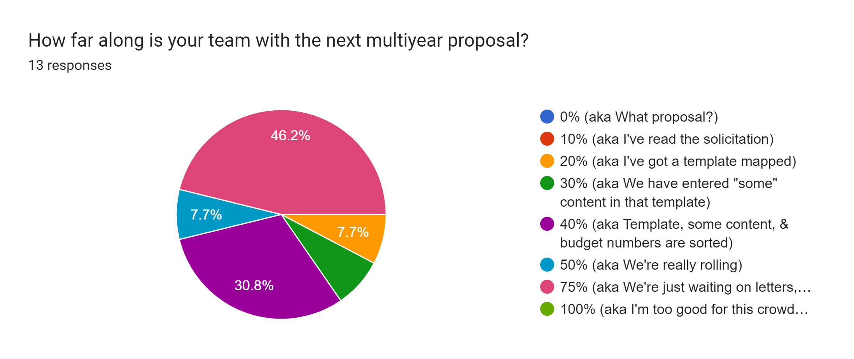
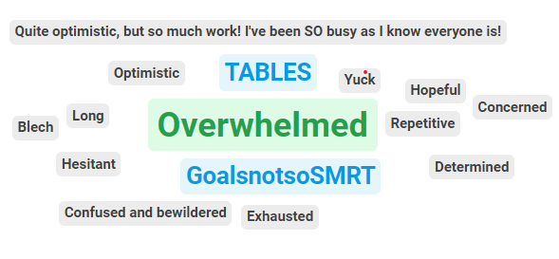
P³: June 2024 Ice Breaker
Proposal Progress Survey: How far are you with your proposal?
Word Cloud Generator: How are you feeling about the new multiyear proposal?
National Council of Space Grant Directors
Communications Working Group

Slide 4
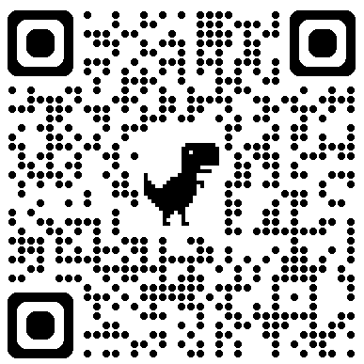
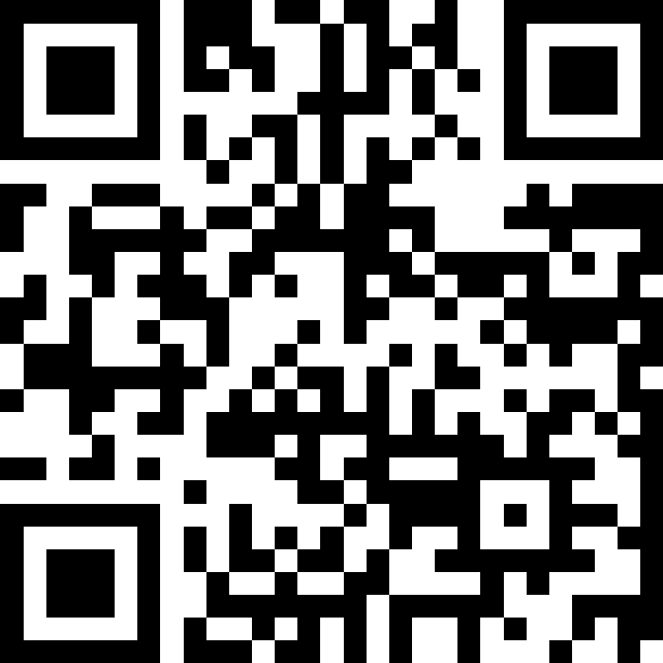
P³: June 2024 Ice Breaker
Proposal Progress Survey:
How far are you with your proposal?
https://forms.gle/Ch5v4xHBuBhsKDtV7
Word Cloud Generator:
How are you feeling about the new multiyear proposal?
https://app.sli.do/event/bNysPdN2GLTmwZWhzksCVz
National Council of Space Grant Directors
Communications Working Group

Slide 5
P³: 2023 in Review
Date | Presenter | Presentation Title
January 23, 2023 | Shirley Campbell, NSGF; Chris Flynn, MTSGC; Susie Johnson, IDSGC | Best Practices & Lessons Learned on All Things Finance
February 13, 2023 | Meredith Hecker, (MTSGC); Sarah Krichels Goan; Marie Steckleberg | Space Grant Logic Models
March 2023 | No session / NASA OSTEM Comms Team | Communications Workshop at National Meeting in DC
April 10, 2023 | Angie Verissimo, Indiana; Mary Lara, Arizona | Successfully Engaging with Underrepresented Communities
May 8, 2023 | Ellen Brennan & Chip Cole, Vermont; Dawn Whitaker, Indiana | Developing a Space Grant Operations Manual
June 12, 2023 | Shawna McBride, Wyoming, Chair of the National Space Grant Foundation Board | How to Participate in the next Microsoft Gives Campaign
July 10, 2023 | BREAK
August 14, 2023 | Planning Meeting | Planning Meeting
September 11, 2023 | National Meeting | Hawaii Space Grant National Meeting
October 16, 2023 | Planning Meeting | Planning Meeting
November 13, 2023 | BREAK
December 11, 2023 | Melanie Page and Lynn Michaluk, WVSGC | Cohort Model for External Evaluation
National Council of Space Grant Directors
Communications Working Group

Slide 6
P³: 2024 in Progress
Date | Presenter | Presentation Title
January 22, 2024 | Jobi Cook (NC SGC), Michaela Lucas (NE SGC), Celena Miller (TX SGC) | Professional Development Opportunities for Educators
February 12, 2024 | Chris Carter, (VASGC); Keanno Fausto, Jonelle Sayama, Danielle Hagen (Guam Drone Corps) | Implementing Drone Programs at Your SGC
March 11, 2024 | Community Read of the new Multiyear Solicitation | Community Read of the new Multiyear Solicitation
April 2024 | No session | No session
May 2024 | No session | No session
June 10, 2024 | Todd Ensign, Program Manager, NASA IV&V Education Resource Center; Faculty, Fairmont State University (WVSG Affiliate) | NASA Robotics Alliance Grant to Expand the Aerial Drone Competition
July 15, 2024 | Kathryn Williamson, Evaluator for Alabama | In development: Evaluation Logistics: student survey responses, streamlined reporting, hidden labor, staffing capacity, meaningful SMART goals, etc.
August 12, 2024
September 9, 2024
October 21, 2024
November 18, 2024
December 11, 2024
National Council of Space Grant Directors
Communications Working Group

Slide 7
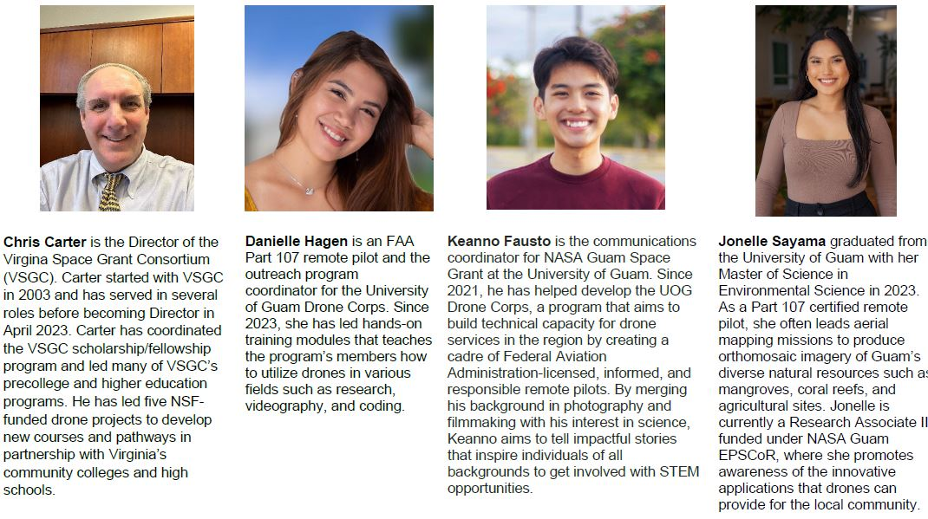
P³: February Session Recap
Summary of Participation: 27 Unique Attendees, 20 Jurisdictions, 95 min total meeting time, 75 min average time on per attendee
National Council of Space Grant Directors
Communications Working Group

Slide 8



P³: March Session Recap
Summary of Participation: 59 Unique Attendees, 34 Jurisdictions, 210 min total meeting time, 114 min average time on per attendee
National Council of Space Grant Directors
Communications Working Group

Slide 9
P³: 2024 Looking Ahead
Ideas from Fall 2023 National Meeting in HI
Cost-Share: Getting it from affiliates, holding them accountable, documenting it at your university
NASA Center Interns: Support Beyond Funding (housing)
Virtual and/or Hybrid Symposiums & Poster Sessions
We wanted to know more about…
Embedded Teacher Program in Wisconsin
Plant the Moon Challenge
Chris Koehler’s Coursera, Pathway to Space Program
National Council of Space Grant Directors
Communications Working Group

Slide 10
P³: June Session
NASA Robotics Alliance Grant
to Expand the Aerial Drone Competition
Presented by Todd Ensign, Program Manager, NASA IV&V Education Resource Center
Faculty, Fairmont State University, West Virginia Space Grant Consortium Affiliates
National Council of Space Grant Directors
Communications Working Group

